Slide 1
PaaS for the new Cloud Era
QCon San Francisco - 2014
Asanka Abeysinghe
Vice President, Solutions Architecture - WSO2,Inc

Slide 2

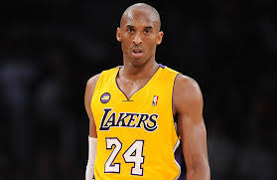
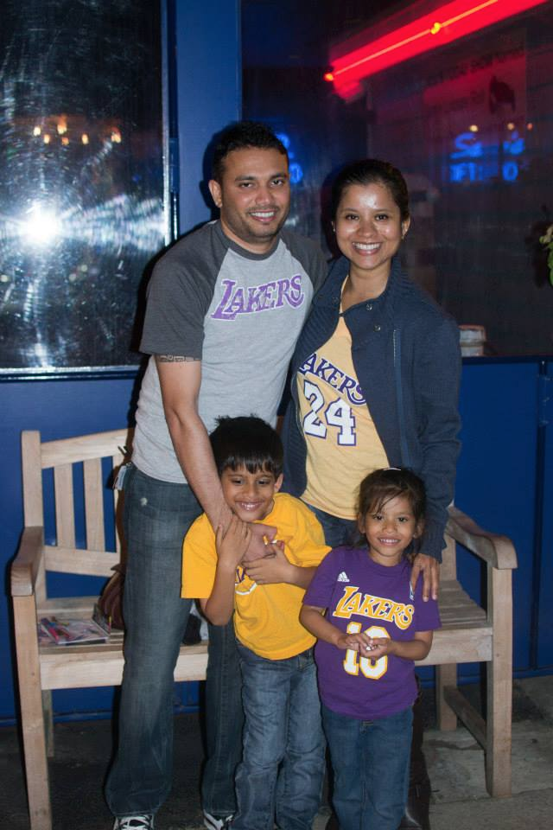
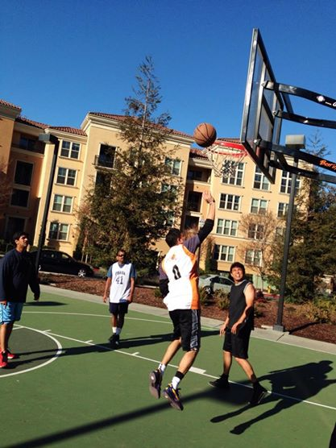
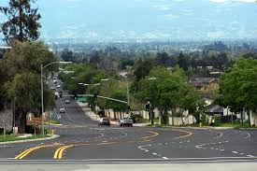



Committer
Architect & Technology Evangelist

Slide 3
Agile
Application development is

Slide 4
{ API } Driven
Application development is

Slide 5
Preprocessor driven
Application development is

Slide 6
Polyglot
Application development is

Slide 7
Quick Releases
Application development requires

Slide 8
Consumerized
Applications are

Slide 9
Unpredictable Load
Applications should handle

Slide 10

Relationship with IT
3 days to create a database
2 days to create a user
devops policies
½ day to reset a password
1 week to provision a VM
runtime policies
Picture Credit : http://web.zizinya.com/blog/

Slide 11
~80% of time to setup the environment
Developers spend

Slide 12
Solution to facilitate
Quick release cycles
Enterprise ready
Ability to migrate shadow IT apps
Agile, iterative process
Governed/Secured
Accept the creative experimen-tation
Empower the dev groups

Slide 13
Solution provides
Heterogynous runtimes
Self service
Polyglot programming model
Automated / Template driven
API driven
Workflow driven

Slide 14
Cloud
as an enabler

Slide 15
PaaS
as the core implementation

Slide 16
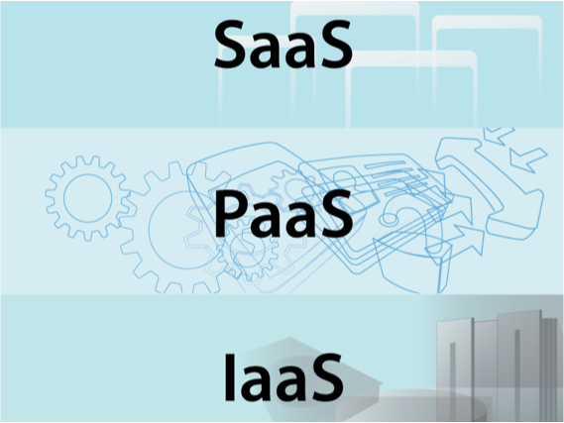
Platform as a Service

Slide 17
Roadmap
Access to (your) cloud
  Private cloud (privately/publicly hosted)
  Public cloud
Link ALM and dev tools with the cloud
Expose the services as APIs, list APIs to subscribe
Create your project templates
Develop and publish apps
Track the usage
( Iterate last two steps )

Slide 18
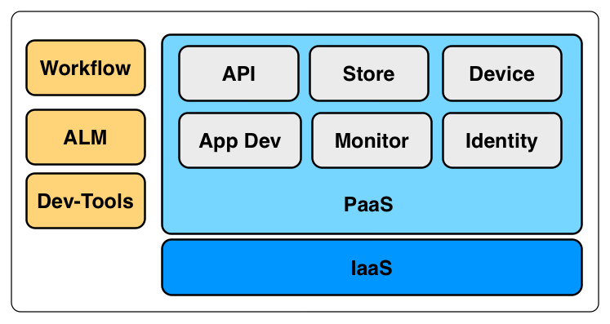
Reference Architecture

Slide 19
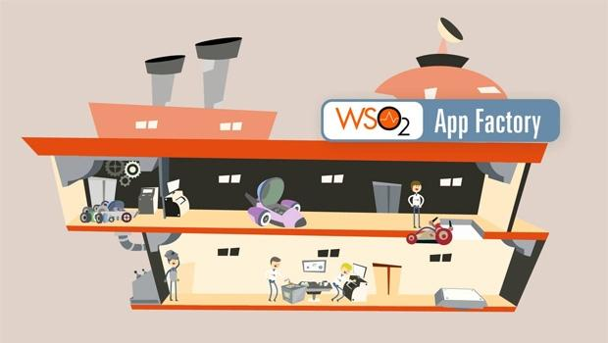
Reference Implementation
A platform that supports applications from cradle to grave.

Slide 20
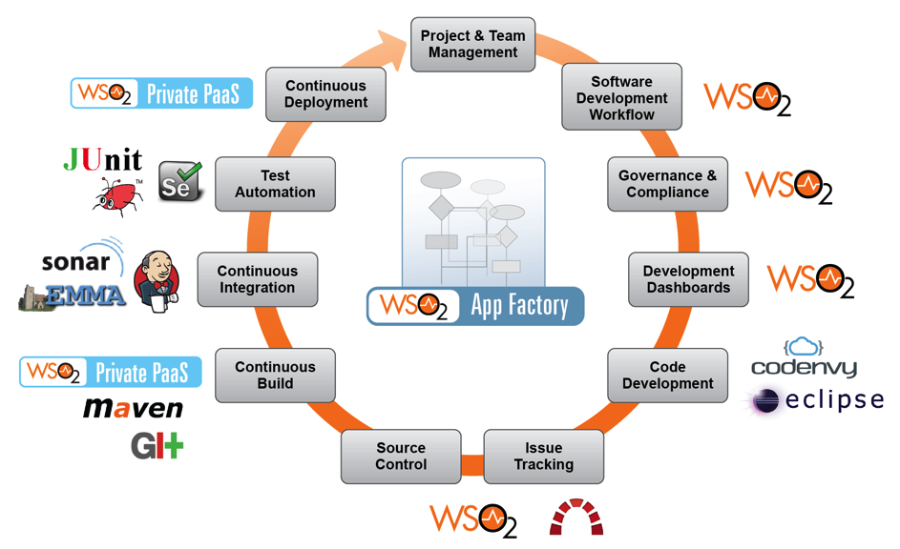
Implementation, integrated

Slide 21
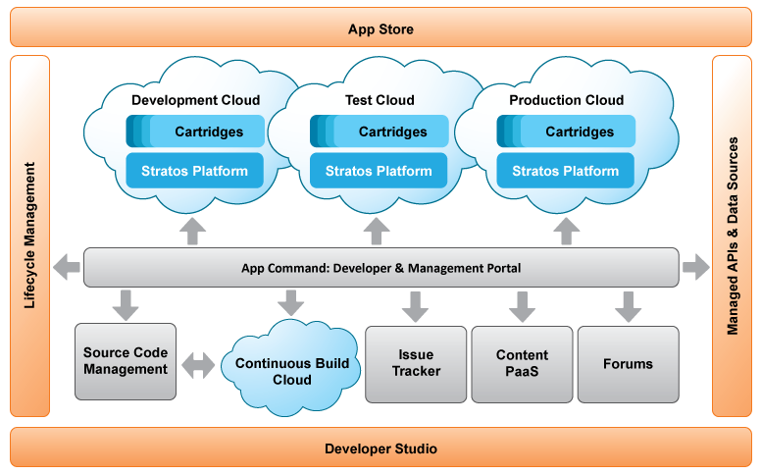
Implementation, runtime view

Slide 22
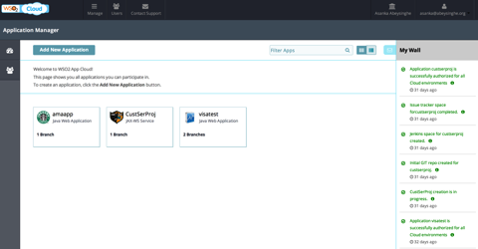
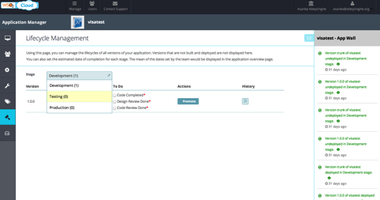
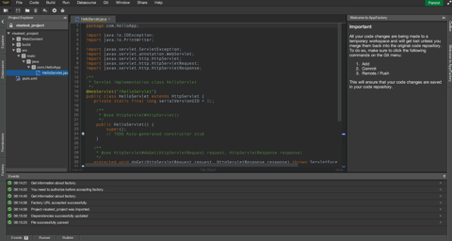
Self service, template driven

Slide 23
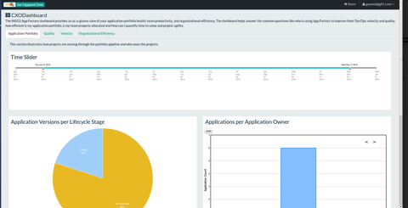
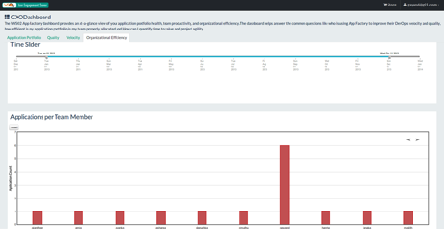
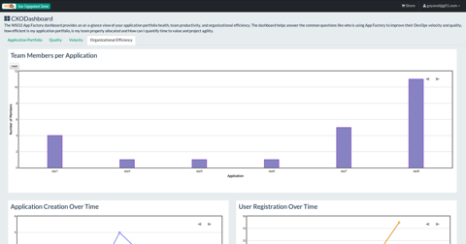
Dashboards, monitor, measure

Slide 24
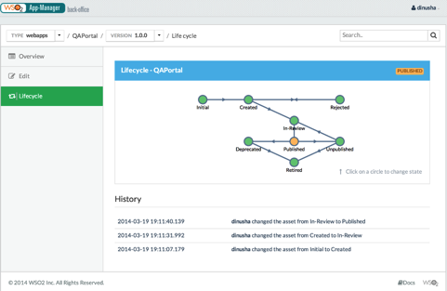
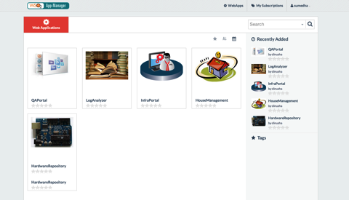
Lifecycle, manage, control, advertise

Slide 25
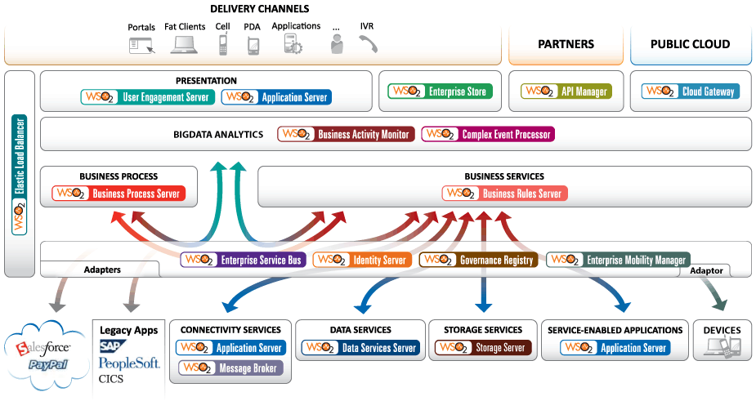
Runtime, enterprise middleware

Slide 26
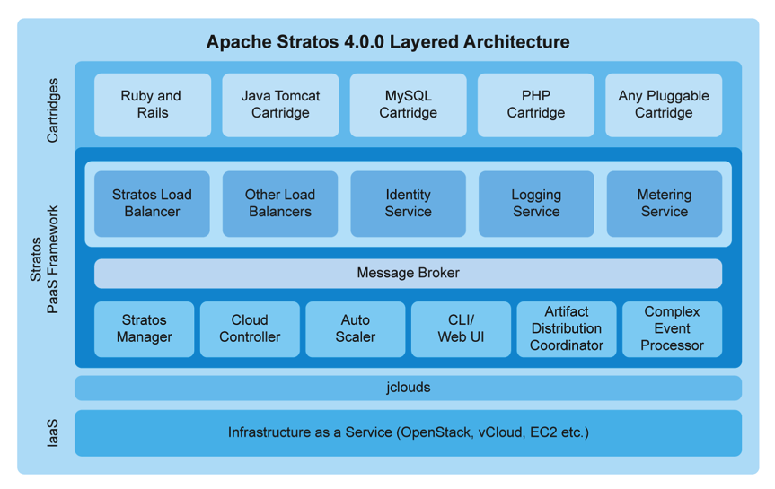
Runtime, cloud enabled, polyglot

Slide 27
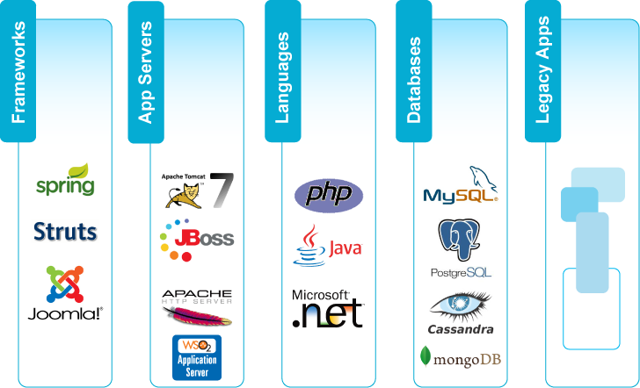
Runtime, cloud enabled, polyglot

Slide 28
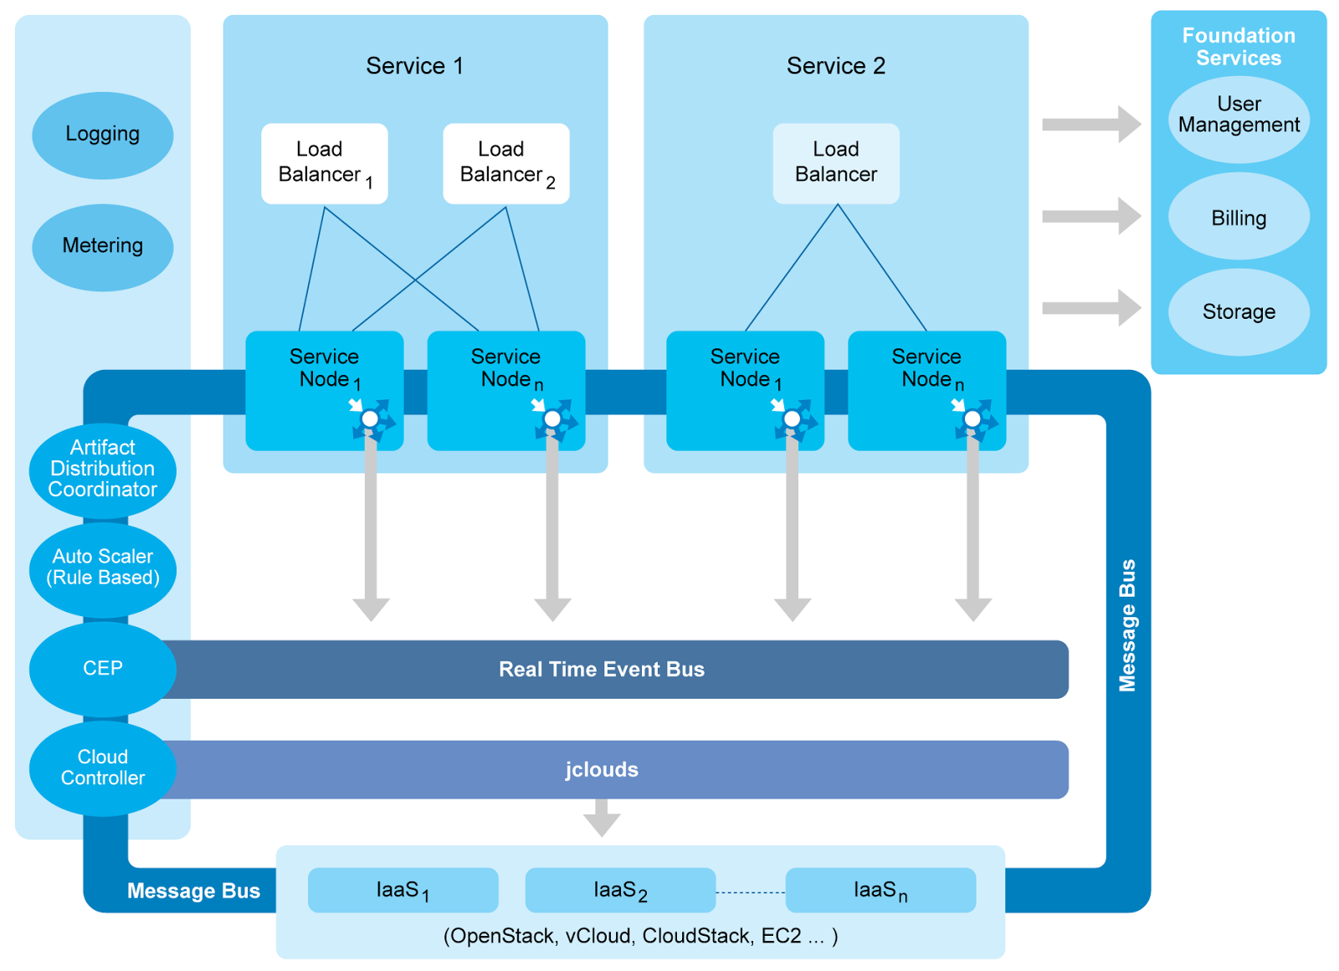
Scalable, elastic, multi-tenanted

Slide 29
Deploying at Scale
Lakmal Warusawithana,
Director-Cloud Architecture, WSO2 / VP- Apache Stratos
Wed, 5th Nov 11:50 AM

Slide 30
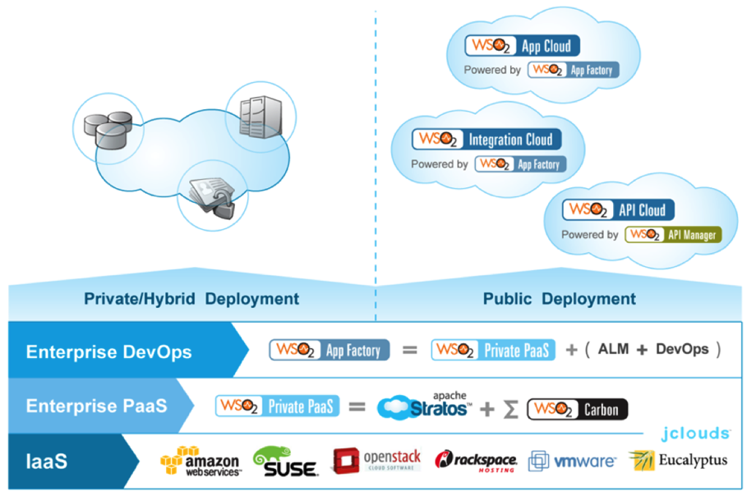
WSO2 Cloud Platform

Slide 31
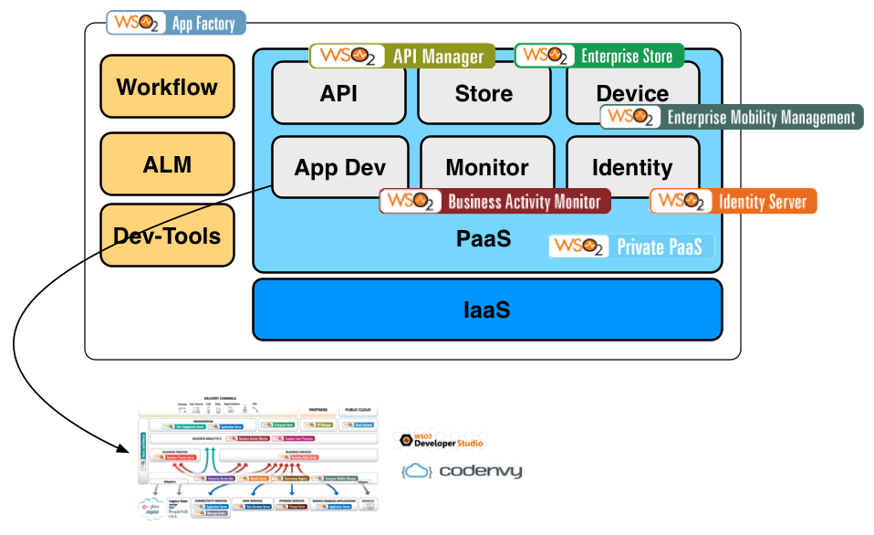
Reference architecture, cont.

Slide 32
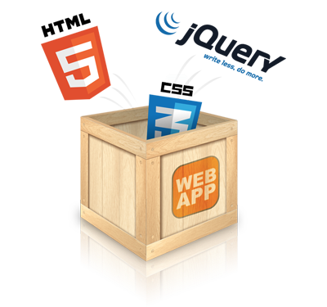

Demo
Application development and lifecycle

Slide 33
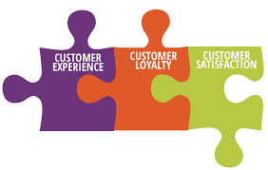
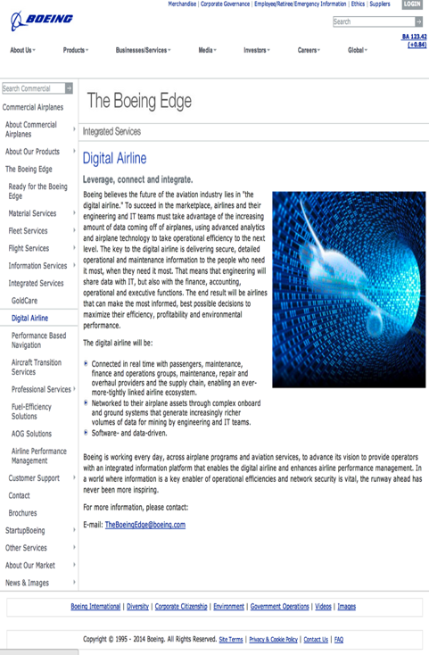
Story : DevOps PaaS in airline

Slide 34
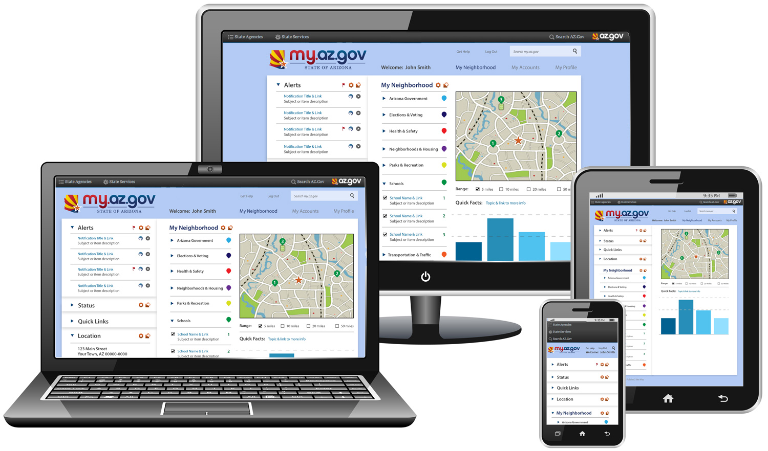
Story : DevOps PaaS in state gov.

Slide 35

b : http://asanka.abeysinghe.org
t : @asankama
e : asankaa AT wso2.com
w : http://wso2.com

