Slide 1
Async JavaScript at Netflix
Jafar Husain
@jhusain

Slide 2
Who is Jafar?
Cross-Team Technical Lead for Netflix UIs
Architect of Netflix UI Data Platform
Member of JavaScript standards committee (TC39)
16 years in the industry, formerly worked at Microsoft and GE
Notes:
Cross-Team Technical Lead for Netflix UI’s
12 years in the industry, formerly worked at Microsoft and GE
4 years of experience building systems with Functional Reactive Programming

Slide 3
This is the story of how Netflix solved
BIG async problems
by thinking differently about
Events.

Slide 4
1
3
2
201
4

Slide 5
Async Programming was very
HARD

Slide 6
The Netflix App was plagued by
Race Conditions
Memory Leaks
Complex State Machines
Uncaught Async Errors

Slide 7
Playing a Movie Asynchronously
function play(movieId, cancelButton, callback) {
var movieTicket,
playError,
tryFinish = function() {
if (playError) {
callback(null, playError);
}
else if (movieTicket && player.initialized) {
callback(null, ticket);
}
};
cancelButton.addEventListener(“click”, function() { playError = “cancelled”; }
if (!player.initialized) {
player.init(function(error) {
playError = error;
tryFinish();
}
}
authorizeMovie(function(error, ticket) {
playError = error;
movieTicket = ticket;
tryFinish();
});
});
function play(movieId, cancelButton, callback) {
var movieTicket,
playError,
tryFinish = function() {
if (playError) {
callback(null, playError);
}
else if (movieTicket && player.initialized) {
callback(null, ticket);
}
};
cancelButton.addEventListener(“click”, function() { playError = “cancelled”; }
if (!player.initialized) {
player.init(function(error) {
playError = error;
tryFinish();
});
}
authorizeMovie(function(error, ticket) {
playError = error;
movieTicket = ticket;
tryFinish();
});
});
function play(movieId, cancelButton, callback) {
var movieTicket,
playError,
tryFinish = function() {
if (playError) {
callback(null, playError);
}
else if (movieTicket && player.initialized) {
callback(null, ticket);
}
};
cancelButton.addEventListener(“click”, function() { playError = “cancelled”; }
if (!player.initialized) {
player.init(function(error) {
playError = error;
tryFinish();
});
}
authorizeMovie(function(error, ticket) {
playError = error;
movieTicket = ticket;
tryFinish();
});
});
function play(movieId, cancelButton, callback) {
var movieTicket,
playError,
tryFinish = function() {
if (playError) {
callback(null, playError);
}
else if (movieTicket && player.initialized) {
callback(null, ticket);
}
};
cancelButton.addEventListener(“click”, function() { playError = “cancelled”; }
if (!player.initialized) {
player.init(function(error) {
playError = error;
tryFinish();
}
}
authorizeMovie(function(error, ticket) {
playError = error;
movieTicket = ticket;
tryFinish();
});
});

Slide 8
Today
the majority of Netflix’s async code is written with just a few flexible functions.

Slide 9
But first a brief
JavaScript 6 tutorial…

Slide 10
Functions
function(x, y) { return x + y; }
function(x) { return x + 1; }
x
=>
x + 1
(x, y)
=>
x + y
JS
5
6

Slide 11
Fin.

Slide 12
ForEach
> [1, 2, 3].forEach(x => console.log(x))
> 1
> 2
> 3
>

Slide 13
Map

Slide 14
Map
> [1, 2, 3].map(x => x + 1)
> [2, 3, 4]
>

Slide 15
Filter

Slide 16
Filter
> [1, 2, 3].filter(x => x > 1)
> [2, 3]
>

Slide 17
concatAll

Slide 18
concatAll
> [ [1], [2, 3], [], [4] ].concatAll()
> [1, 2, 3, 4]
>

Slide 19
Map/Filter/ConcatAll
> [1, 2, 3].map(x => x + 1)
> [2, 3, 4]
> [1, 2, 3].filter(x => x > 1)
> [2, 3]
> [ [1], [2, 3], [], [4] ].concatAll()
> [1, 2, 3, 4]
>

Slide 20
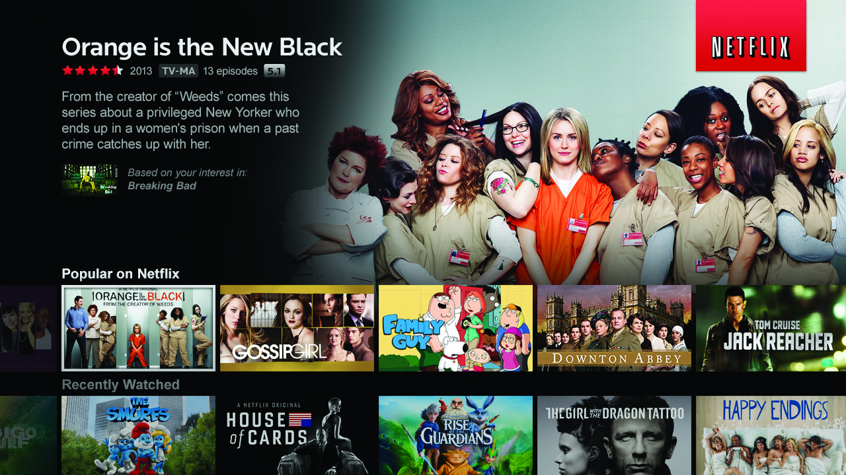

Slide 21
Let’s use map, filter, and concatAll to get a list of your favorite Netflix titles.

Slide 22
Top-rated Movies Collection
var getTopRatedFilms = user =>
user.videoLists.
map(videoList =>
videoList.videos.
filter(video => video.rating === 5.0)).
concatAll();
getTopRatedFilms(user).
forEach(film => console.log(film));

Slide 23
What if I told you…
…that you could create a drag event…
…with nearly the same code?

Slide 24
Top-rated Movies Collection
var getTopRatedFilms = user =>
user.videoLists.
map(videoList =>
videoList.videos.
filter(video => video.rating === 5.0)).
concatAll();
getTopRatedFilms(user).
forEach(film => console.log(film));

Slide 25
Mouse Drags Collection
var getElementDrags = elmt =>
elmt.mouseDowns.
map(mouseDown =>
document.mouseMoves.
filter takeUntil(document.mouseUps)).
concatAll();
getElementDrags(image).
forEach(pos => image.position = pos);

Slide 26
“What’s the difference between an Array…
[{x: 23, y: 44}, {x:27, y:55}, {x:27, y:55}]

Slide 27
… and an Event?
{x: 23, y: 44}...{x:27, y:55}.... {x:27, y:55}......

Slide 28
Events and Arrays are both collections.

Slide 29
So why don’t we program
them the same way?

Slide 31
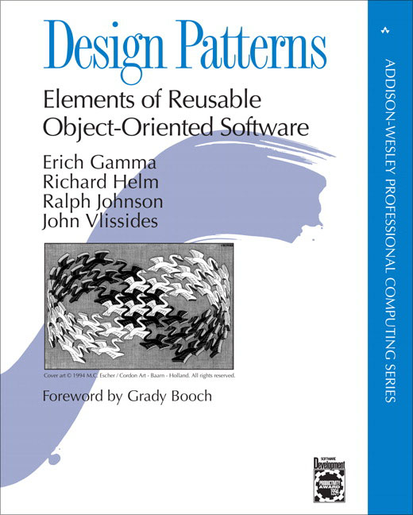

Slide 32
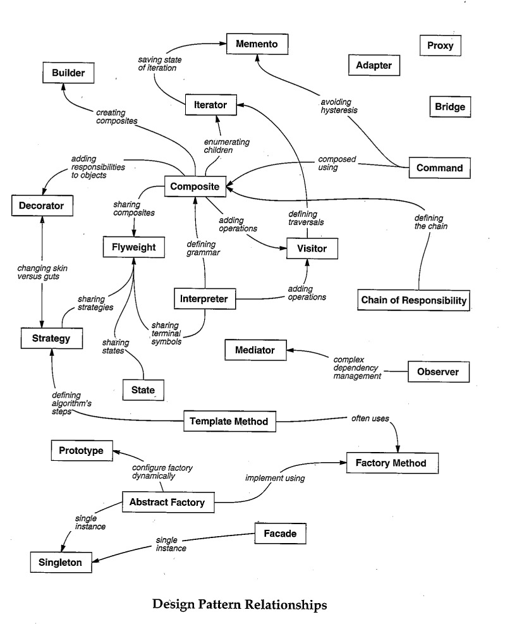
Iterator
?
Observer

Slide 33
Iterator
> var iterator = [1,2,3].iterator();
> console.log(iterator.next());
> { value: 1, done: false }
>
> console.log(iterator.next());
> { value: 2, done: false }
>
> console.log(iterator.next());
> { value: 3, done: false }
>
> console.log(iterator.next());
> { done: true }
>

Slide 34
Map, Filter, and ConcatAll can be implemented using an Iterator.

Slide 35
Observer Pattern
> document.addEventListener(
“mousemove”,
function next(e) {
console.log(e);
});
> { clientX: 425, clientY: 543 }
> { clientX: 450, clientY: 558 }
> { clientX: 455, clientY: 562 }
> { clientX: 460, clientY: 743 }
> { clientX: 476, clientY: 760 }
> { clientX: 476, clientY: 760 }
> { clientX: 476, clientY: 760 }
> { clientX: 476, clientY: 760 }

Slide 36
Iterator
progressively send information to consumer
Observer

Slide 37
The Iterator and Observer Pattern are Symmetrical.

Slide 38
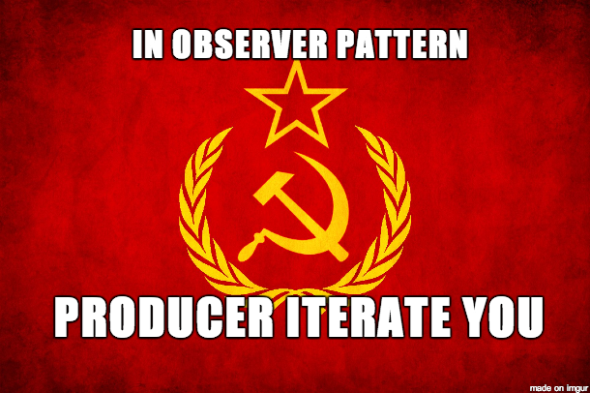

Slide 39
The authors of “Design Patterns” missed this symmetry.

Slide 40
As a result, they gave
Iterator and Observer
different semantics.

Slide 41
So Many Push APIs
DOM Events
Websockets
Server-sent Events
Node Streams
Service Workers
jQuery Events
XMLHttpRequest
setInterval

Slide 42
Introducing Observable
Observable === Collection + Time

Slide 43
Observables can model…
Events
Animations
Async Server Requests

Slide 44
Reactive Extensions
Events as Streams
Open Source (Apache2)
Ported to many languages
C
.NET
JavaScript
Java (Netflix)
Objective-C

Slide 45
http://reactivex.io

Slide 46
Events to Observables
var mouseMoves =
Observable.
fromEvent(element, “mousemove”);

Slide 47
Adapt Push APIs to Observable
DOM Events
Websockets
Server-sent Events
Node Streams
Observable
Service Workers
jQuery Events
XMLHttpRequest
setInterval

Slide 48
Event Subscription
// “subscribe”
var handler = (e) => console.log(e);
document.addEventListener(“mousemoves”, handler);
// “unsubscribe”
document.removeEventListener(“mousemoves”, handler);

Slide 49
Observable.forEach
// “subscribe”
var subscription =
mouseMoves.forEach(console.log);
// “unsubscribe”
subscription.dispose();

Slide 50
Expanded Observable.forEach
// “subscribe”
var subscription =
mouseMoves.forEach(
// next data
event => console.log(event),
// error
error => console.error(error),
// completed
() => console.log(“done”));
// “unsubscribe”
subscription.dispose();
optional

Slide 51
Expanded Observable.forEach
// “subscribe”
var subscription =
mouseMoves.forEach({
onNext: event => console.log(event),
// error
onError: error => console.error(error),
// completed
onCompleted: () => console.log(“done”)
});
// “unsubscribe”
subscription.dispose();
Observer

Slide 52
Converting Events to Observables
Observable.fromEvent = function(dom, eventName) {
// returning Observable object
return {
forEach: function(observer) {
var handler = (e) => observer.onNext(e);
dom.addEventListener(eventName, handler);
// returning Subscription object
return {
dispose: function() {
dom.removeEventListener(eventName, handler);
}
};
}
};
}

Slide 53
Observable Literal
{1……2…………3}
time
JS6

Slide 54
ForEach
> {1……2…………3}.forEach(console.log)
> {1……2…………3}
time
> 2
>
> 3
>
> 1
>

Slide 55
Map
> {1……2…………3}.map(x => x + 1)
time
> 3
>
> 4
>
> 2
>

Slide 56
Filter
> {1……2…………3}.filter(x => x + 1)
time
> 2
> 3
>
> 2
>
>

Slide 57
concatAll
[
[1]
[2, 3],
[],
[4]
].concatAll()
[1, 2, 3, 4]

Slide 58
concatAll
{
…{1}
………{2………………3},
……………{}
………………{4}
}.concatAll()
{…1…2………………3…4}
time

Slide 59
TakeUntil
{…1…2…………3}.takeUntil(
{……………4})
{…1…2…}
Source collection
time
Stop collection

Slide 60
Mouse Drags Collection
var getElementDrags = elmt =>
elmt.mouseDowns.
map(mouseDown =>
document.mouseMoves.
takeUntil(document.mouseUps)).
concatAll();
getElementDrags(image).
forEach(pos => image.position = pos);

Slide 61
mergeAll
{
…{1}
………{2………………3},
……………{}
………………{4}
}.mergeAll()
{…1…2……4………3}
time

Slide 62
switchLatest
{
…{1}
………{2………………3},
……………{}
………………{4}
}.switchLatest()
{…1…2……4}
time
subscription.dispose()

Slide 63
Don’t unsubscribe from Events.
Complete them when another event fires.

Slide 64
Mouse Drags Collection
var getElementDrags = elmt =>
elmt.mouseDowns.
map(mouseDown =>
document.mouseMoves.
takeUntil(document.mouseUps)).
concatAll();
getElementDrags(image).
forEach(pos => image.position = pos);

Slide 65
Netflix Search

Slide 66
Netflix Search
var searchResultSets =
keyPresses.
throttle(250).
map(key =>
getJSON(“/searchResults?q=” + input.value).
retry(3).
takeUntil(keyPresses)).
concatAll();
searchResultSets.forEach(
resultSet => updateSearchResults(resultSet),
error => showMessage(“the server appears to be down.”));

Slide 67
Netflix Search
var searchResultSets =
keyPresses.
throttle(250).
map(key =>
getJSON(“/searchResults?q=” + input.value).
retry(3).
takeUntil(keyPresses)).
concatAll switchLatest();
searchResultSets.forEach(
resultSet => updateSearchResults(resultSet),
error => showMessage(“the server appears to be down.”));

Slide 68
Netflix Search
var searchResultSets =
keyPresses.
throttle(250).
map(key =>
getJSON(“/searchResults?q=” + input.value).
retry(3)).
switchLatest();
searchResultSets.forEach(
resultSet => updateSearchResults(resultSet),
error => showMessage(“the server appears to be down.”));

Slide 69
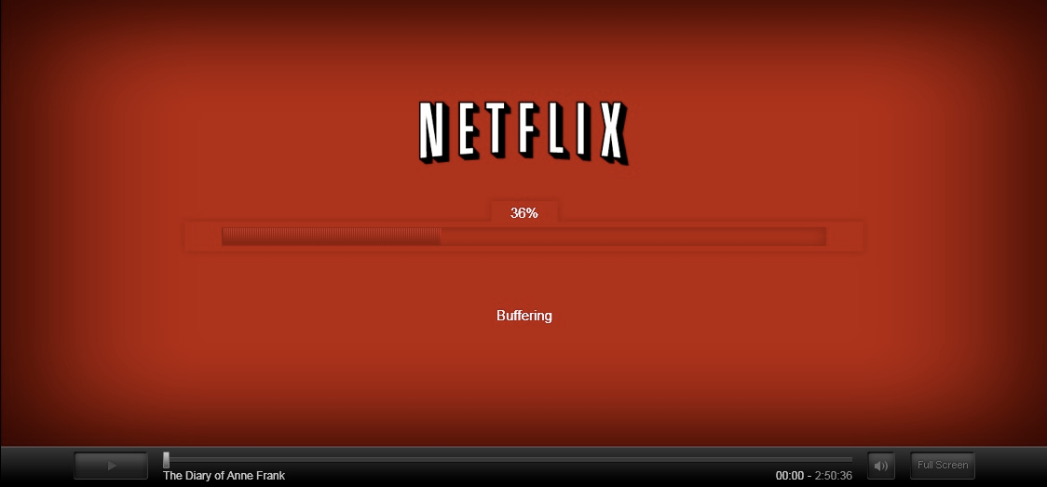
Netflix Player

Slide 70
Player Callback Hell
function play(movieId, cancelButton, callback) {
var movieTicket,
playError,
tryFinish = function() {
if (playError) {
callback(null, playError);
}
else if (movieTicket && player.initialized) {
callback(null, ticket);
}
};
cancelButton.addEventListener(“click”, function() { playError = “cancel”; });
if (!player.initialized) {
player.init(function(error) {
playError = error;
tryFinish();
}
}
authorizeMovie(movieId, function(error, ticket) {
playError = error;
movieTicket = ticket;
tryFinish();
});
});

Slide 71
Player with Observable
var authorizations =
player.
init().
map(() =>
playAttempts.
map(movieId =>
player.authorize(movieId).
catch(e => Observable.empty).
takeUntil(cancels)).
concatAll())).
concatAll();
authorizations.forEach(
license => player.play(license),
error => showDialog(“Sorry, can’t play right now.”));

Slide 72
Netflix: Observable Everywhere
App Startup
Player
Data Access
Animations
View/Model binding

Slide 73
Interactive Learning Exercises
http://jhusain.github.io/learnrx/

Slide 74
Observable in JavaScript 7?
async function* getStocks() {
let reader = new AsyncFileReader(“stocks.txt”);
try {
while(!reader.eof) {
let line = await reader.readLine();
await yield JSON.parse(line);
}
}
finally {
reader.close();
}
}
async function writeStockInfos() {
let writer = new AsyncFileWriter(“stocksAndPrices.txt”);
try {
for(let name on getStocks()) {
let price = await getStockPrice(name);
await writer.writeLine(JSON.stringify({name, price}));
}
}
finally {
writer.close();
}
}

Slide 75
Resources
reactivetrader.azurewebsites.net
https://github.com/Reactive-Extensions/RxJS
RxJava
http://jhusain.github.io/learnrx/
@jhusain

Slide 76
Questions

