Slide 1
Design Patterns for
Large Scale Data Movement
Hans Jespersen
VP Systems Engineering
hans.jespersen@solacesystems.com

Slide 2
Data Movement Patterns
The right solution depends on
the problem you’re solving
  Real-time or intermittent?
  Any weird networks?
  Acceptable latency?
  Humans or machines?
  Update rates?
  Fan-in or fan-out?
  Payload size?
  Guarantee required?
http://www.dreamstime.com/stock-images-wispy-blue-spirals-pattern-image1983204

Slide 3

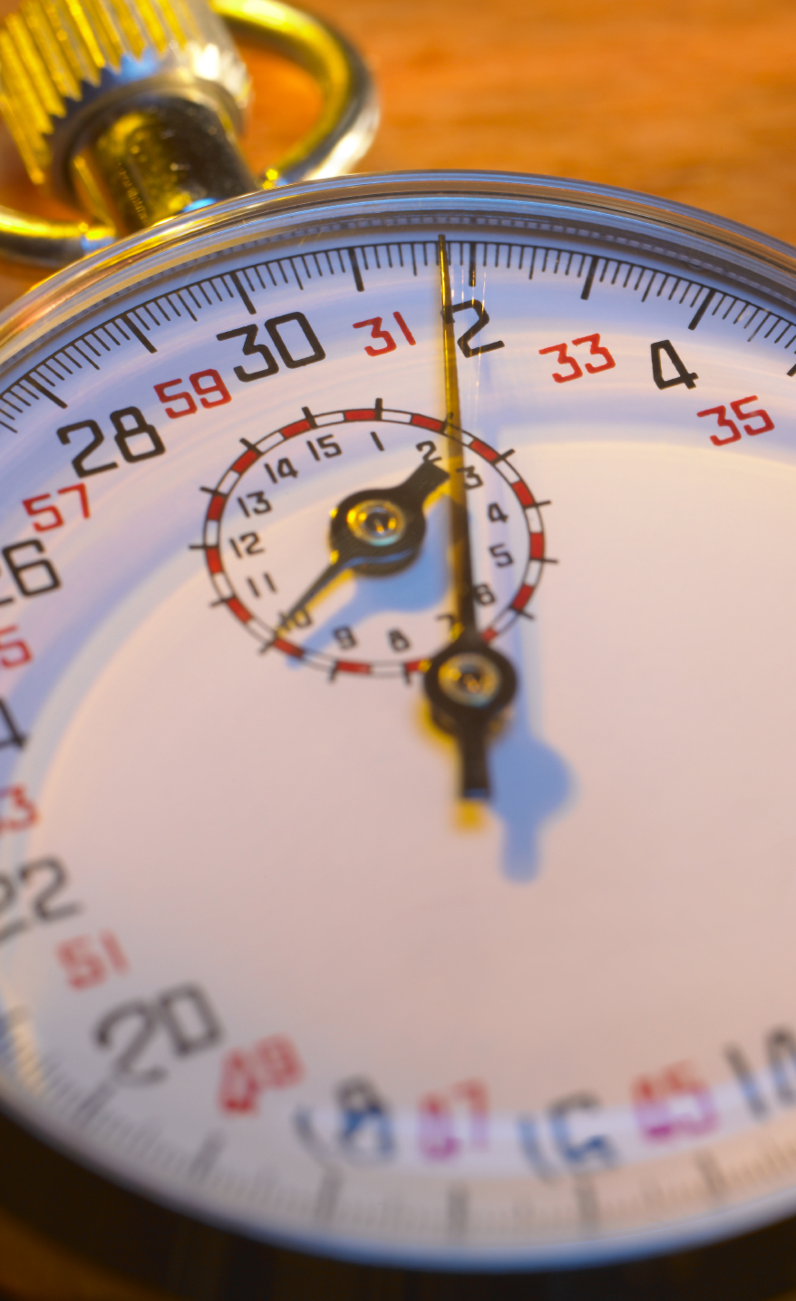
Latency Required
Some not sensitive at all
  Batch updates
Seconds often good enough
  Database sync
  User interfaces
Others measure in
milli- or micro-seconds
  Algo trading
  Industrial controls
Required
Latency
Low as
Possible
Not
Critical

Slide 4

Network Distance
Co-location for max speed
  Minimize speed of light
LAN for many apps
  10GigE networks
Long distance WAN
  Expensive, limited pipes
  Creates mismatches with other networks
Network Distance
Global
WAN
Co-location

Slide 5
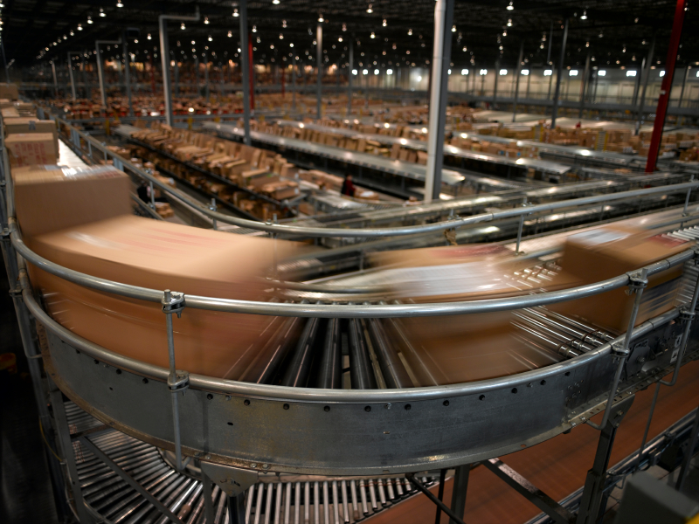
Number of Messages
Few
  Batch updates
  Simple applications
Moderate
  Risk management
  Order routing
Insane
  Market data
  Click stream analysis
Number of
Messages
OMG
Whatever

Slide 6

Degree of Distribution
Point-to-point
Fan-out (many subs)
Fan-in (many pubs)
Mesh
  Synching data between
  many endpoints
1:1
Millions of Endpoints
Degree
of Distribution

Slide 7

Message Size
Small
  Status updates, activity logging events
Medium
  Orders, product BOMs
Large
  Batch updates, media files,
  product catalogs
Very different stresses on system based on message size and frequency.
Small
Huge
Size of Messages

Slide 8
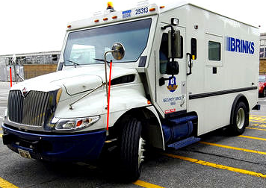
Importance of Delivery Guarantee
“Best effort” fine for
some scenarios
Others require “once
and only once”
Sequence matters for some
Some demand failsafe
even in DR scenarios
Not
Very
Delivery
Guarantee
Importance

Slide 9

Other Considerations
Message
  Format
  Protocol
  Structured/Unstructured
Network
  Availability
  RTT
  Bandwidth cost
Robustness
  Archival
  Caching
  Acceptable MTBF
  HA switchover times
  DR requirements

Slide 10

Combination of Factors Yields Design Patterns
Some attributes tend to correlate
  # of messages and
  degree of distribution
Others usually contradict
  Network distance and latency
  Guarantee and latency
Tradeoffs and creative solutions
Network Distance
Required
Latency
Number of
Messages
Delivery
Guarantee
Importance
Degree
of Distribution
Size of Messages

Slide 11
Identifying Patterns in Real-World Use Cases
Use cases unique,
but patterns emerge
Examples in this section:
  Trade Order Flow
  Manufacturing Data Sync
  Oil and Gas Monitoring
  Real Time Sports Betting
http://www.dreamstime.com/stock-images-wispy-blue-spirals-pattern-image1983204
Notes:
4 patterns (for now)

Slide 12

Order Flow
Latency matters, but
not every microsecond
Usually localized
Continuous, high-rate
message flow
Mid-sized messages (1-2Kb)
Messages absolutely
must be guaranteed
Network Distance
Required
Latency
Number of
Messages
Delivery
Guarantee
Importance
Degree
of Distribution
Size of Messages

Slide 13
Order Flow;
Architecture
Smart
Order
Router
Back
Office
Applications
Management
& Monitoring
Slow Subscribers
Real
Time
Sync
Message Bus
Client
Gateways
Exchange
Gateways
Disaster
Recovery Site
Clients
Exchanges

Slide 14
Order Flow;
Similar Use Cases
Need a way to correlate which use case is which color on the chart.
Credit card processing
  Long-distance WANs
  latency in hundreds of milliseconds
Network Distance
Required
Latency
Number of
Messages
E-commerce
  Higher volumes
  Higher guarantee required
Logistics scheduling
  Less latency sensitive
  More likely to include WANs
Delivery
Guarantee
Importance
Degree
of Distribution
Size of Messages

Slide 15
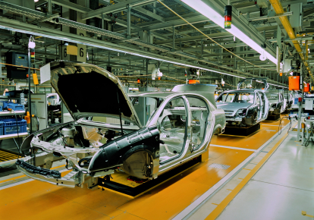
Manufacturing Data Sync
Build from the background image on prior slide
Geographically distributed
100% delivery guarantee required
Data rate is use case specific – will assume lots of medium (< 5K) messages.
Number of endpoints use case specific, assume 10 manufacturing locations
Network Distance
Required
Latency
Number of
Messages
Delivery
Guarantee
Importance
Degree
of Distribution
Size of Messages

Slide 16

Manufacturing Data Sync;
Architecture
Applications &
Databases
Fanout
at Edge
Smart
Buffering
Maximizing
Bandwidth

Slide 17
Manufacturing Data Sync;
Similar Use Cases
Real Time Risk Management
  Smaller messages
  Latency more important
Network Distance
Required
Latency
Number of
Messages
Retail Global Inventory
  Messages can be larger
  Distribution can be more
Real Time Financials
  Messages larger
  Distribution less
  (collecting to 1 location)
Delivery
Guarantee
Importance
Degree
of Distribution
Size of Messages

Slide 18
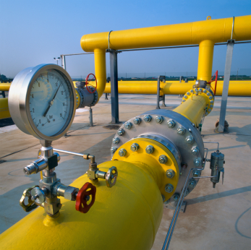
Oil & Gas Pipeline Monitoring
Wifi, Satellite, proprietary and other unreliable networks
Degree of distribution off the charts. In this case, fan-in.
Messages usually pretty small, unless batch
Latency unimportant
Level of guarantee use case specific, assume status messages (ie. guarantee not essential)
Network Distance
Required
Latency
Number of
Messages
Delivery
Guarantee
Importance
Degree
of Distribution
Size of Messages

Slide 19
Oil & Gas Pipeline Monitoring;
Architecture
Pipeline Sensors
Wireless
Collection
Caches
Unreliable Networks
Message Bus
Big Data Loading
Real Time
vs. Delayed
Analytics
Analytics
Engines
Big Data &
Databases

Slide 20
Oil & Gas Pipeline Monitoring;
Similar Use Cases
Smart Grid
  Small messages
  Massive distribution
Network Distance
Required
Latency
Number of
Messages
Transportation Monitoring
  Fewer endpoints
  Bigger messages
Retail Point of Sale
  More predictable networks
  Guarantee more important
Delivery
Guarantee
Importance
Degree
of Distribution
Size of Messages

Slide 21
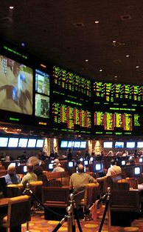
Real-Time Sports Betting
Huge message volumes
(in this case fan-out)
Low level of guarantee for any one outbound message
High level of guarantee for inbound messages
Tiny messages
Network is the internet + mobile carriers
Latency (beyond network latency) is important
Network Distance
Required
Latency
Number of
Messages
Delivery
Guarantee
Importance
Degree
of Distribution
Size of Messages

Slide 22
Real-Time Sports Betting;
Architecture
Highlight the degree of fan out, connection counts, event logging, real time analysis for odds adjustment
Mobile
Customers
Odds &
Analytics
Clickstream
& Marketing
Data Streaming
Big
Data
Streaming
Odds Data
Low Latency
Huge Connection Counts
Message Bus
Web
Customers
Customer &
Betting Apps
Security &
Fraud
Detection

Slide 23
Real-Time Sports Betting;
Similar Use Cases
Mobile Social Updates
  Latency less important
  Distribution far greater
Network Distance
Required
Latency
Number of
Messages
Real Time Travel Alerting
  Each message more important
  Volumes much lower
Market Data Distribution
  Latency even more important
  Volumes often much higher
  Loss often tolerable
Delivery
Guarantee
Importance
Degree
of Distribution
Size of Messages

Slide 24
Network Distance
Required
Latency
Number of
Messages
Delivery
Guarantee
Importance
Degree of
Distribution
Size of Messages

Slide 25
Summary
Questions?

