Slide 1
Mobile Single Sign On (mSSO) Made Easy
K. Scott Morrison
SVP & Distinguished Engineer
November, 2014

Slide 2


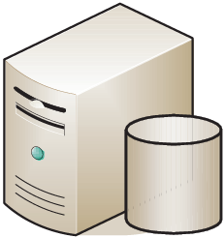
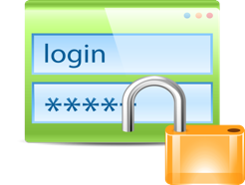


What Does Single Sign On (SSO) Mean To You?
Sign On Once…
Directory
Server A
Server B
Browser
Notes:
APIs come with their own problems.
You never have just one API. So quickly the issue is scaling access and management.

Slide 3
A Short History of SSO

Slide 4

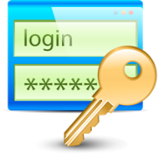

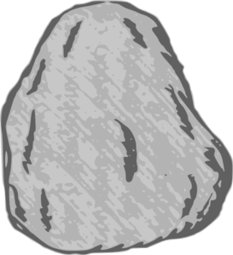
The Paleoproterozoic Era
LDAP
Replay credentials
bind()
Authorization:
Server A
Server B
1800-2300M years ago…
Browser

Slide 5

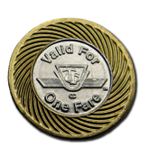
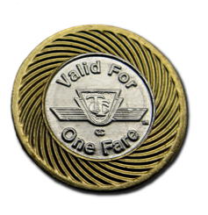
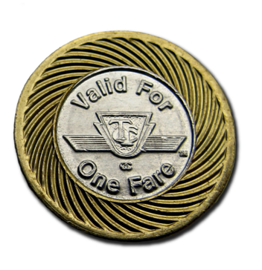
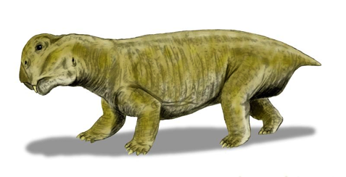
The Triassic Period
SSO
Token-based SSO with
Centralized validation
validate()
Custom HTTP header
201.3 to 252.17M years ago…

Slide 6
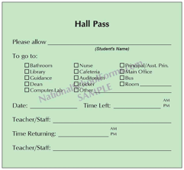
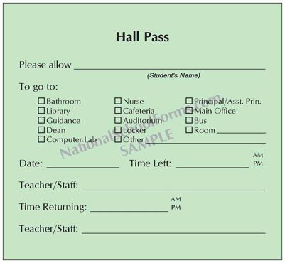
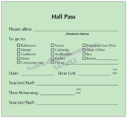
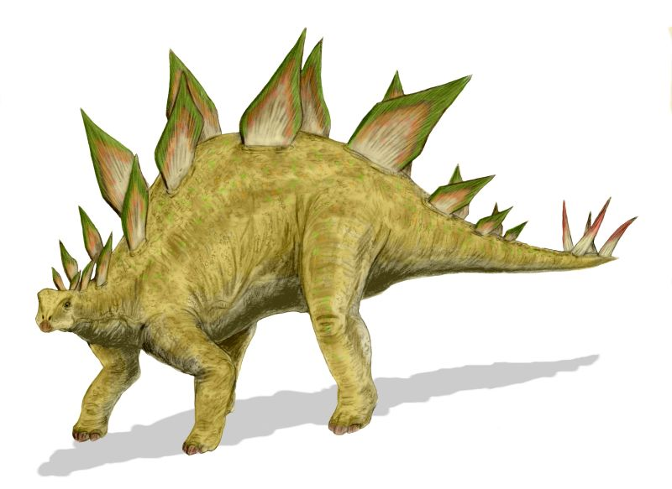
The Jurassic Period
SSO
Token-based SSO with
Local validation
validate()
Trust
Custom HTTP header
145 to 201.3M years ago…

Slide 7


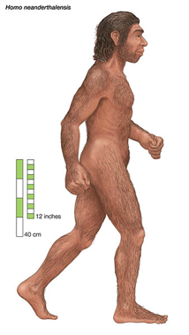
The Quaternary Period
SAML-based SSO with
Local validation and domain trust
Firewall
Enterprise A Network
Trust
Internet
Enterprise B Network
0 to 2.588M years ago…
Notes:
APIs come with their own problems.
You never have just one API. So quickly the issue is scaling access and management.

Slide 8
In Essence, It All Comes Down To This
Proof of
Identity
Authorization
Server
Client
2. Token
Resource
Server
3. Token

Slide 9
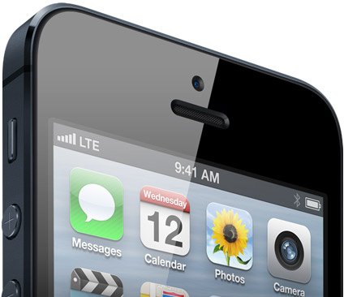
Agent
Change
Notes:
WORD ASSOC NEXT

Slide 10
See If You Can Guess Why SAML Failed For Mobile

Slide 11
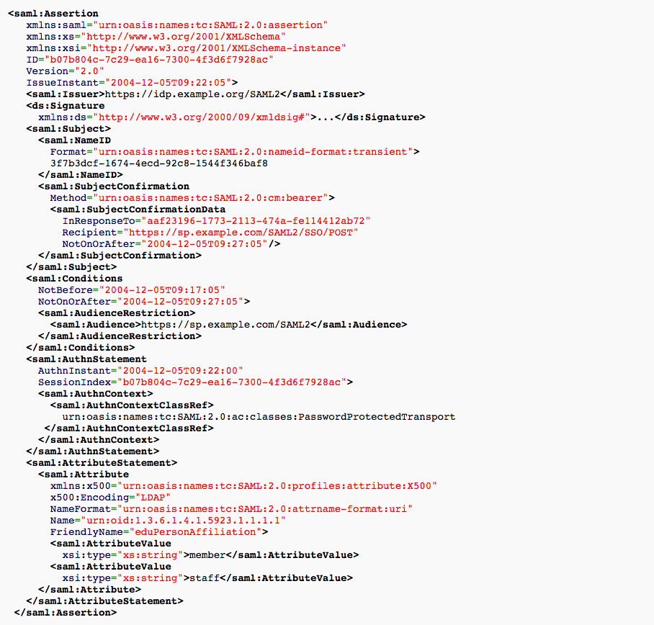
Security Assertion Markup Language (SAML)

Slide 12
OAuth
"access_token":"2YotnFZFEjr1zCsicMWpAA"

Slide 13
ID Token
(From OpenID Connect)
eyJhbGciOiJSUzI1NiIsImtpZCI6IjQ4OWRmMzE3YzIyYzY3NTZkOTUyMTVk
YjQ1NTA5MjY0N2RmNWIxNmEifQ.eyJpc3MiOiJhY2NvdW50cy5nb29nbGUuY
29tIiwiZW1haWwiOiJ0aW1icmF5QGdtYWlsLmNvbSIsImVtYWlsX3Zlcmlma
WVkIjoidHJ1ZSIsInN1YiI6IjEwNzYwNjcwMzU1ODE2MTUwNzk0NiIsImF1Z
CI6IjQwNzQwODcxODE5Mi5hcHBzLmdvb2dsZXVzZXJjb250ZW50LmNvbSIsI
mF0X2hhc2giOiJyTC1jVml3OTJtYW5EUU1MdU1tTEt3IiwiYXpwIjoiNDA3N
DA4NzE4MTkyLmFwcHMuZ29vZ2xldXNlcmNvbnRlbnQuY29tIiwiaWF0IjoxM
zY1MDk5MTUxLCJleHAiOjEzNjUxMDMwNTF9.GeqJOTJSMaQjo33wxM-3f5k5
FIEADqxd3K4zS0pWgWjtqwDldbpGgmxwTytgvtXKjFu7dtZx6TUXPnDhLBti
MjtkTyPGZbm65RwG0arSLqH-iDelceDR5HDABhOBqXjsi19rdnC3TAWf5Dpe
QYZt9uSSgPseGW2wh6OO5izat48
Source: Tim Bray, Ongoing
https://www.tbray.org/ongoing/When/201x/2013/04/04/ID-Tokens

Slide 14
ID Token (cont.)
It’s Just A JSON Web Token (JWT)
        {
        "issuer": "accounts.google.com",
        "issued_to": "407408718192.apps.googleusercontent.com",
        "audience": "407408718192.apps.googleusercontent.com",
        "user_id": "10315112535234507946",
        "expires_in": 3089,
        "issued_at": 1365099151,
        "email": "example@gmail.com",
        "email_verified": true
        }
Source: Tim Bray, Ongoing
https://www.tbray.org/ongoing/When/201x/2013/04/04/ID-Tokens

Slide 15

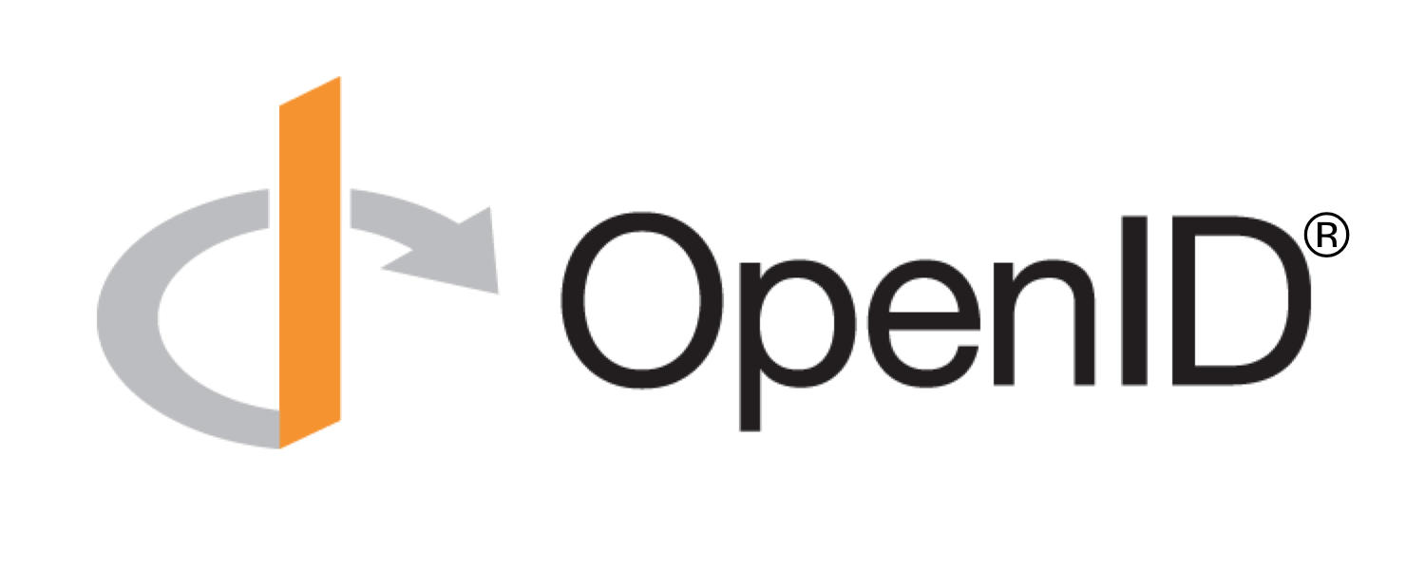
The Winners

Slide 16
So No Surprises Here.
But…
What If We Were To Extend Our Definition Of SSO?

Slide 17
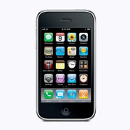
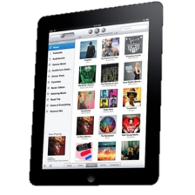
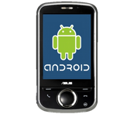
Our Problem: Secure Mobile Access to Apps and Data
API/Service Servers
How Do We Make APIs Available?
Firewall mazes
Diversity of clients and back end systems
Clients and servers change at different rates
Firewall 2
Firewall 1
Directory
Enterprise Network
Internet
Of Interest Today
Authentication, Authorization & SSO
Secure Transmission
API/Service Client
Notes:
APIs come with their own problems.
You never have just one API. So quickly the issue is scaling access and management.

Slide 18

We Want: Classic SSO In An Active Profile For REST
API/Service Servers
Could leverage WS-Fed here
SAML’s second act?
Directory
Internet
Apps making RESTful API calls
Notes:
APIs come with their own problems.
You never have just one API. So quickly the issue is scaling access and management.

Slide 19
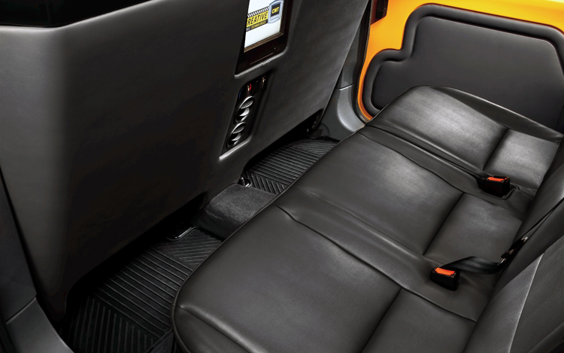

Self Service: If the device is lost or stolen, the user should be able to log out

Slide 20
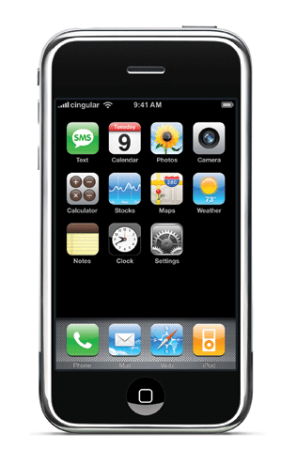

We Also Want Local App SSO
“Like a VPN… but with an experience that doesn’t suck”
API/Service Servers
Single Sign On App Group (these apps will share sign-on sessions)
A
B
C
So now it’s getting interesting…

Slide 21
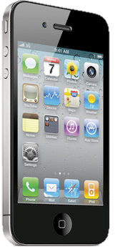
Mobile OS Isolation is an issue
The mobile OS sandbox makes inter-app communication challenging
App layer
Persistence layer
Silos

Slide 22
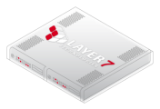

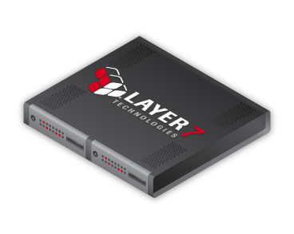

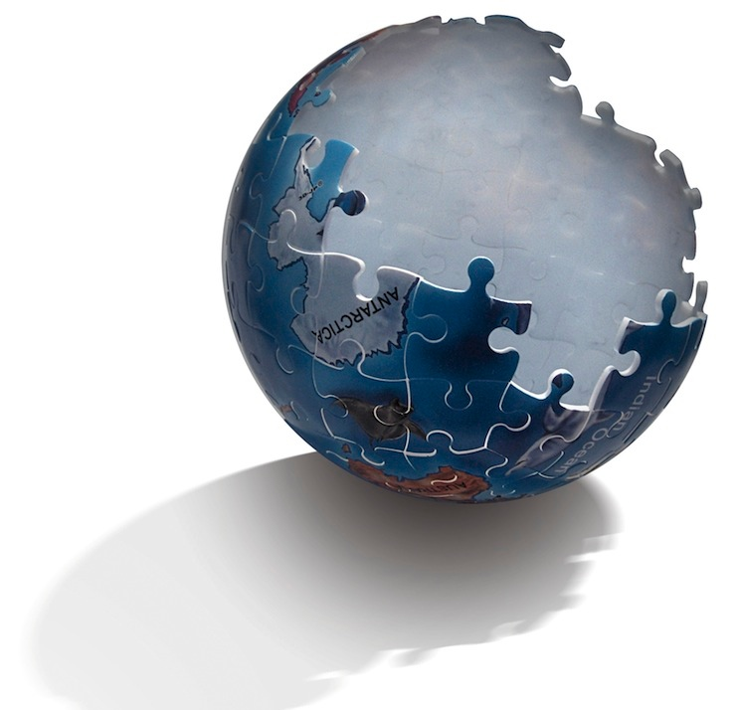





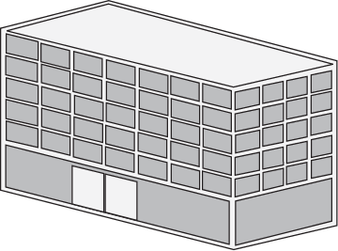


Motivations: Many of our customers have architectures like this
API/Service Servers
Gateway Cluster at Edge of Network
DMZ deployment
Hardware appliance, virtual appliance or software
Firewall 2
Firewall 1
…
Directory
Enterprise Network
Cloud
API Security Gateway
Mobile Devices
API/Service Client
Partners

Slide 23


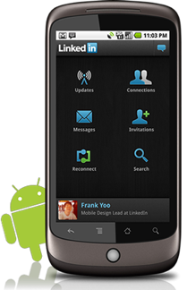


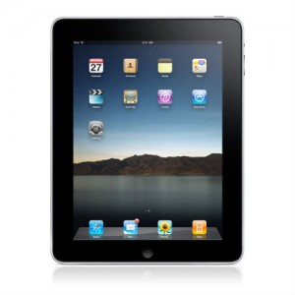
Native Single Sign-On SDK For Mobile Developers
Strong Security for Mobile Apps
  Cross-platform and built for a consumer or BYOD world
  100% Standards-based using OAuth+OpenID Connect
  X-app SSO with multi-factor auth & secure channel
  X.509 Certificate provisioning for strong auth and transaction signing
API Servers
One time PIN
SMS, APNS, call
Enterprise Network
Standards-based
iPhone
App-sharable Secure Key Store
Android
iPad

Slide 24
Client Deployment Strategy
Don’t make me work hard
  But give me a strong and extensible security model
Transfer of security responsibility
  Let developers do what they do best
Simple SDK
  Align with common development time environments
    iOS, Android, Javascript, etc
Mirror REST frameworks
Future
  Aspects, wrapping, etc.

Slide 25

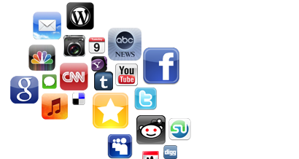
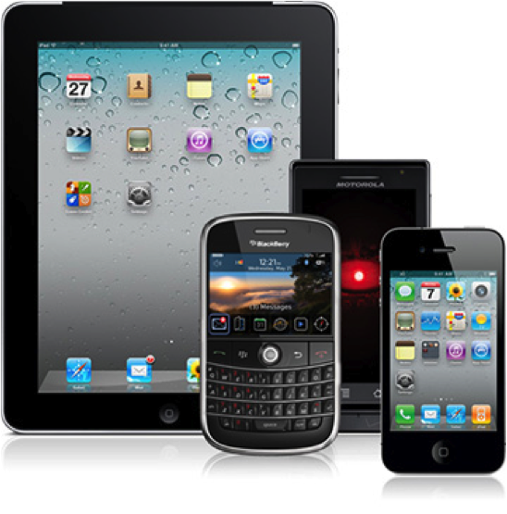
Three Important Entities
All three are managed by the SDK+MAG
User
Apps
Devices

Slide 26
Protocol Strategy
OAuth + OpenID Connect
  Profiled for mobile
  Clear distinction between device, user and app
Authorization Server
username/password
A
B
C
ID Token
Access Token/Refresh Token
Per app

Slide 27
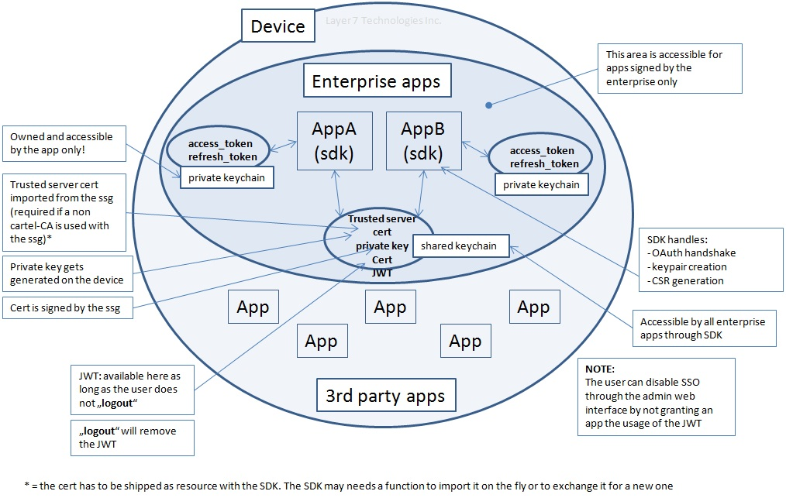
Overall Architecture

Slide 28
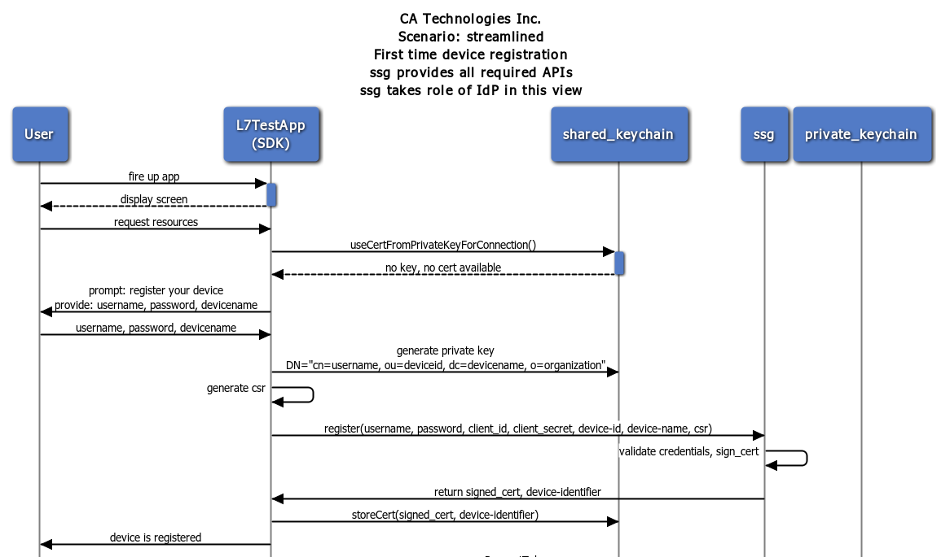
Register device, streamlined, first usage

Slide 29
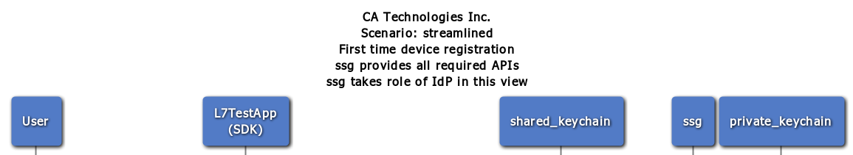
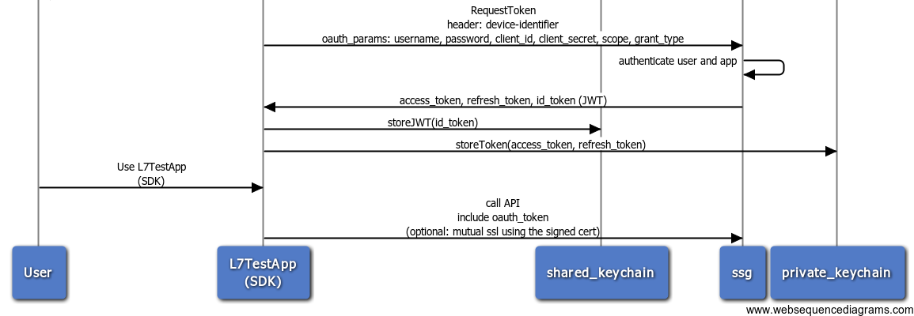
Register device, streamlined, first usage (cont.)

Slide 30
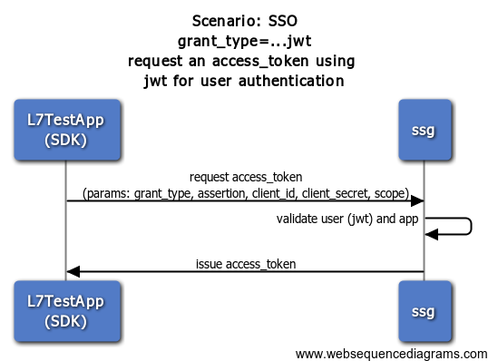
Request an access_token using JWT (SSO)

Slide 31
Server-side APIs
Server side API ID | Operation | URL path
request_token | Request access_token / id_token (JWT) | /l7cadr/auth/oauth/v2/token
request_token_sso | Request access_token using id_token (JWT) which is the SSO scenario | /l7cadr/auth/oauth/v2/token
request_token_basic | Request access_token/ id_token (JWT) | /l7cadr/auth/oauth/v2/token
request_token_sso_basic | Request access_token using id_token (JWT) which is the SSO scenario | /l7cadr/auth/oauth/v2/token
revoke_token | Revoke an access_token or refresh_token | /l7cadr/auth/oauth/v2/token/revoke
register_device | Registers a device for a user | /l7cadr/connect/device/register
resource_owner_logout | The resource_owner logs out of the device by invalidating his current id_token (JWT) | /l7cadr/connect/session/logout
resource_owner_session_status | The client requests the session status by passing in the id_token | /l7cadr/connect/session/status
remove_device_x509 | Removes a registered device using ssl mutual authentication | /l7cadr/connect/device/remove
userinfo | The endpoints returns claims about the current user. The result depends on the SCOPE that was requested with the access_token | /l7cadr/openid/connect/v1/userinfo
list_devices | Lists registered devices | /l7cadr/connect/device/list

Slide 32
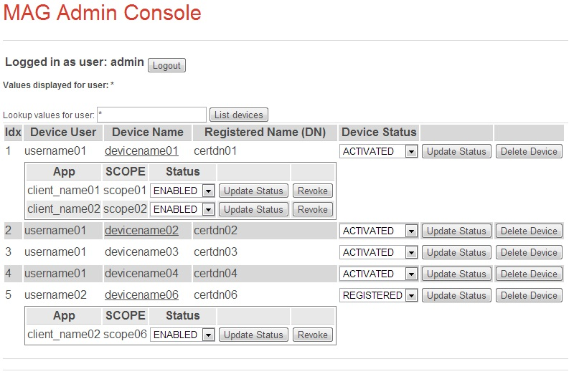
Token Administration

Slide 33
What Does The SDK Look Like On Android?
MobileSso mobileSso = MobileSsoFactory.getInstance(context, ssoConf);
String uri = "https://<MAG Host>:8443/app/secureApi";
HttpGet get = new HttpGet(uri);
mobileSso.processRequest(get, new ResultReceiver(null) {
@Override
protected void onReceiveResult(int resultCode, Bundle resultData) {
// Callback to get the endpoint result
// and perform your task
}
});

Slide 34
Demo

Slide 35



K. Scott Morrison
SVP & Distinguished Engineer
Scott.Morrison@ca.com
@KScottMorrison
slideshare.net/CAinc
linkedin.com/KScottMorrison
ca.com

Slide 36
Copyright © 2014 CA. All trademarks, trade names, service marks and logos referenced herein belong to their respective companies.
THIS PRESENTATION IS FOR YOUR INFORMATIONAL PURPOSES ONLY. CA assumes no responsibility for the accuracy or completeness of the information. TO THE EXTENT PERMITTED BY APPLICABLE LAW, CA PROVIDES THIS DOCUMENT “AS IS” WITHOUT WARRANTY OF ANY KIND, INCLUDING, WITHOUT LIMITATION, ANY IMPLIED WARRANTIES OF MERCHANTABILITY, FITNESS FOR A PARTICULAR PURPOSE, OR NONINFRINGEMENT. In no event will CA be liable for any loss or damage, direct or indirect, in connection with this presentation, including, without limitation, lost profits, lost investment, business interruption, goodwill, or lost data, even if CA is expressly advised in advance of the possibility of such damages.

