Slide 1
Efficient Data Storage for Analytics
with Apache Parquet 2.0
Julien Le Dem @J_
Processing tools tech lead, Data Platform
@ApacheParquet

Slide 2
Outline
Why we need efficiency
Properties of efficient algorithms
Enabling efficiency
Efficiency in Apache Parquet

Slide 3
Why we need efficiency

Slide 4
Producing a lot of data is easy
Producing a lot of derived data is even easier.
Solution: Compress all the things!
Notes:
hmmm, I’ll just join A with B…

Slide 5
Scanning a lot of data is easy
1% completed
… but not necessarily fast.
Waiting is not productive. We want faster turnaround.
Compression but not at the cost of reading speed.
Notes:
that’s why bzip2 is not necessarily a good idea here.

Slide 6
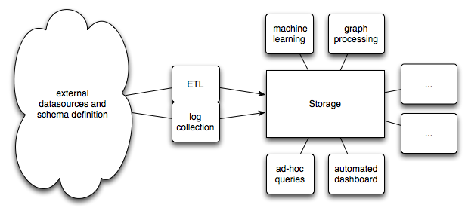
Trying new tools is easy
We need a storage format interoperable with all the tools we use
and keep our options open for the next big thing.
Notes:
Many tools are available and used.
Many different teams with different expertise and skills.
Constant innovation in the analytics space.
Typical use case:
import data in storage
several tools interact, queries, machine learning, etc.
need to keep options open.
no vendor lock in, no language lock in.

Slide 7
Enter Apache Parquet

Slide 8
Parquet design goals
Interoperability
Space efficiency
Query efficiency

Slide 9
Parquet timeline
Fall 2012: Twitter & Cloudera merge efforts to develop columnar formats
March 2013: OSS announcement; Criteo signs on for Hive integration
July 2013: 1.0 release. 18 contributors from more than 5 organizations.
May 2014: Apache Incubator. 40+ contributors, 18 with 1000+ LOC. 26 incremental releases.
Parquet 2.0 coming as Apache release

Slide 10
Interoperability

Slide 11
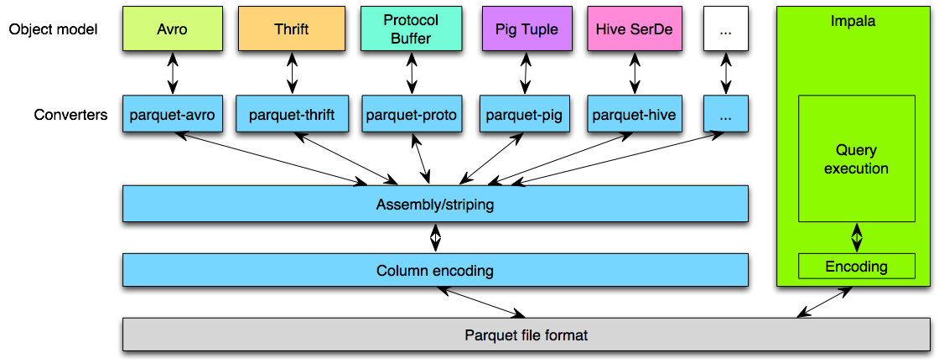
Interoperable
Java
C++
Model agnostic
Language agnostic
Notes:
No intermediate representation
Event based apis
Convert directly to your object model
easy to add converters
Parquet is already integrated with:
Pig, Hive, Impala, Spark, MapReduce, Cascading, HAWQ, Drill, Tajo, Crunch, Presto, Scalding, Avro, Thrift, ProtocolBuffers, Hive, Pig, POJO
Most of then coming from the community.
Multiple java, scala and C++ projects.

Slide 12
Frameworks and libraries integrated with Parquet
Query engines:
Hive, Impala, HAWQ,
IBM Big SQL, Drill, Tajo,
Pig, Presto
Frameworks:
Spark, MapReduce, Cascading,
Crunch, Scalding, Kite
Data Models:
Avro, Thrift, ProtocolBuffers,
POJOs
Notes:
Most contributed by the community
Easy to add more

Slide 13
Enabling efficiency

Slide 14
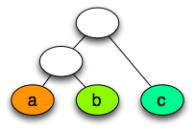
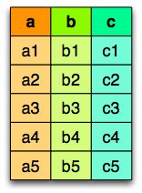
Columnar storage
Logical table
representation
Row layout
Column layout
Nested schema
encoding
Notes:
Enables:
- read only columns you need
- better brute force compression on homogenous data
- Type specific encodings compress better and faster

Slide 15
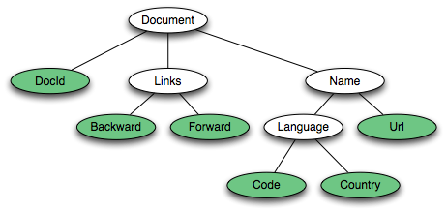
Parquet nested representation
Borrowed from the Google Dremel paper
Schema:
Columns:
docid
links.backward
links.forward
name.language.code
name.language.country
name.url
https://blog.twitter.com/2013/dremel-made-simple-with-parquet
Notes:
One column per leaf in the schema.
Columns identified by the path to the leaf.
Nodes can be one of: optional, required, repeated.
Null can happen at any non required node.
Repetition can happen at any repeated node.
Typical flat schema representation of NULL values:
NULL encoded as one bit: 0 undefined, 1 defined
use a bit field to encode NULL values
Parquet nested schema representation is a generalization.
the Definition Level (0 to n) encodes at which level the node is null:
0: NULL at the root
n: defined
the Repetition Level (0 to n) encodes at which level the node is repeated:
0: new record
0 < i ≤ n : new element in list at level i

Slide 16
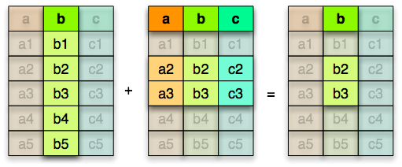
Statistics for filter and query optimization
Vertical partitioning
(projection push down)
Horizontal partitioning
(predicate push down)
Read only the data
you need!
+
=
Notes:
Parquet provides row group and page level statistics.
This enables implementing filters at the metadata level.
We can skip reading and deserializing entire row groups
Even better than efficient deserialization is skipping deserialization altogether.
a columnar layout with statistics on optionally sorted data provides vertical and horizontal partitioning thus keeping IO to a minimum.

Slide 17
Properties of efficient algorithms
Notes:
CPU efficient
talk about minimizing IO.

Slide 18
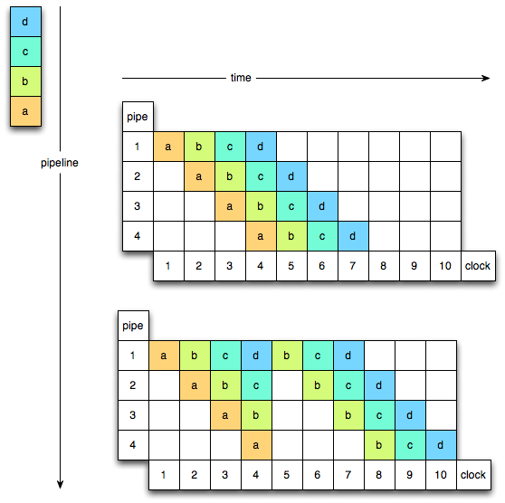
CPU Pipeline
Ideal case
Mis-prediction
(“Bubble”)
Notes:
To increase throughput, instruction execution is broken up in several steps.
Different steps from multiple instructions are executed concurrently.
Which means the CPU starts preparing the next instruction
before the previous one is finished.
When conditional branching happens, the CPU needs to predict what next instruction to prepare.
When that prediction is wrong the pipeline is flushed and clock cycles are wasted. (these days about 12 cycles)

Slide 19
Optimize for the processor pipeline
“Bubbles” can be caused by:
virtual
calls
data
dependency
ifs
loops
cost ~ 12 cycles
Notes:
A loop with no branching inside is predictable.
Impala uses code generation to eliminate virtual calls.
Encodings avoid conditionals and data dependencies (fix width).
Columnar representation helps.
A loop with no branching inside is extremely predictable: it always does the same thing except that one time when it’s done.
Impala does code generation to eliminate virtual calls
Encodings try to avoid conditionals.
Columnar representation helps.

Slide 20
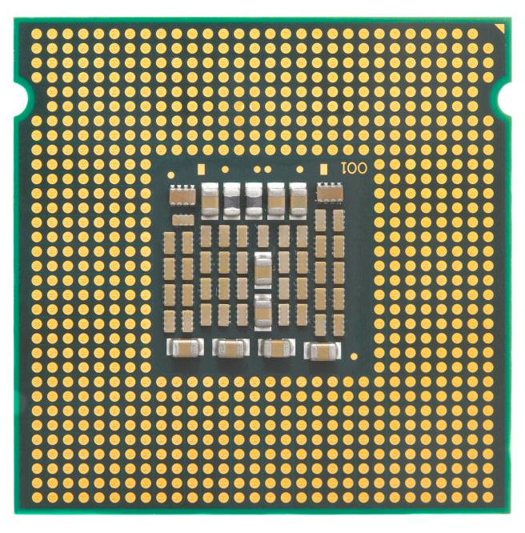
Minimize CPU cache misses
CPU
Cache
RAM
Bus
a cache miss costs 10 to 100s cycles depending on the level
Notes:
CPU clock speed is much faster than the bus between the CPU and main memory.
several layers of on-chip cache to make them faster.
execution is faster when the entire working set fits in cache.
cache miss costs from 10 to 100 cycles depending on the cache level.
Cache locality vs random access in memory.
columnar decoding by page can be very efficient.

Slide 21
Encodings in Apache Parquet 2.0

Slide 22
The right encoding for the right job
Delta encodings:
for sorted datasets or signals where the variation is less important than the absolute value. (timestamp, auto-generated ids, metrics, …) Focuses on avoiding branching.
Prefix coding (delta encoding for strings)
When dictionary encoding does not work.
Dictionary encoding:
small (60K) set of values (server IP, experiment id, …)
Run Length Encoding:
repetitive data.
Notes:
Delta encoding:
especially efficient on sorted data.
Delta encodings will benefit situations where dictionary encodings would not work.

Slide 23
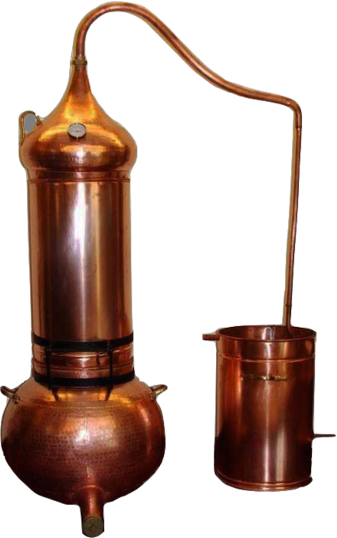
Delta encoding
Notes:
compute deltas

Slide 24
Delta encoding
Notes:
binary packing per block (if suddenly a big gap, only temporary effect)

Slide 25
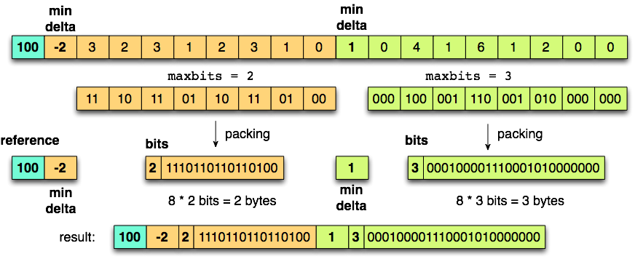
Delta encoding
Notes:
every n ints compute max bit
binary pack those n elements

Slide 26
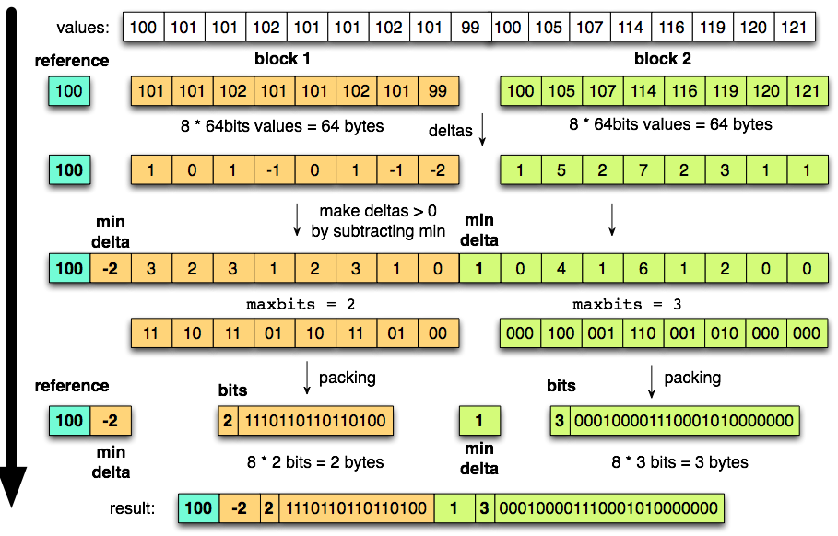
Delta encoding
Notes:
fix n to a multiple of 32 => align on word boundary
use code generation

Slide 27
Binary packing designed for CPU efficiency
naive maxbit:
max = 0
for (int i = 0; i<values.length; ++i) {
current = maxbit(values[i])
if (current > max) max = current
}
better:
orvalues = 0
for (int i = 0; i<values.length; ++i) {
orvalues |= values[i]
}
max = maxbit(orvalues)
even better:
orvalues = 0
orvalues |= values[0]
…
orvalues |= values[32]
max = maxbit(orvalues)
Unpredictable branch!
Loop => Very predictable branch
no branching at all!
see paper:
“Decoding billions of integers per second through vectorization”
by Daniel Lemire and Leonid Boytsov

Slide 28
Binary unpacking designed for CPU efficiency
int j = 0
while (int i = 0; i < output.length; i += 32) {
maxbit = input[j]
unpack_32_values(values, i, out, j + 1, maxbit);
j += 1 + maxbit
}
Notes:
Similarly bit packing uses code generation to avoid branching.
If number of values is a multiple of 32, it always ends on word boundaries.
say maxbits = n
32 values * n bits = n * 32 bits
- code generation for packing n values at once
- stateless algorithm, no branching except for the loop => very predictable

Slide 29
Compression comparison
TPCH: compression of two 64 bits id columns with delta encoding
Notes:
SNAPPY: at most 500 MB/s (60 million rows/s)
Delta: easily 10x (TO BE VERIFIED)
Delta & Snappy:
l_orderkey: 3.79 MB
l_partkey: 13.72 MB
Plain & Snappy:
l_orderkey: 8.98 MB
l_partkey: 27.02 MB
Delta & None:
l_orderkey: 16.95 MB
l_partkey: 14.30 MB
Plain & None:
l_orderkey: 45.81 MB
l_partkey: 45.81 MB
Parquet 2.0 w/ snappy
l_orderkey: 4.01 MB
l_partkey: 13.88 MB
Parquet 1.0 w/ snappy
l_orderkey: 9.12 MB
l_partkey: 27.09 MB

Slide 30
Compression comparison
TPCH: compression of two 64 bits id columns with delta encoding
Notes:
SNAPPY: at most 500 MB/s (60 million rows/s)
Delta: easily 10x (TO BE VERIFIED)
Delta & Snappy:
l_orderkey: 3.79 MB
l_partkey: 13.72 MB
Plain & Snappy:
l_orderkey: 8.98 MB
l_partkey: 27.02 MB
Delta & None:
l_orderkey: 16.95 MB
l_partkey: 14.30 MB
Plain & None:
l_orderkey: 45.81 MB
l_partkey: 45.81 MB
Parquet 2.0 w/ snappy
l_orderkey: 4.01 MB
l_partkey: 13.88 MB
Parquet 1.0 w/ snappy
l_orderkey: 9.12 MB
l_partkey: 27.09 MB

Slide 31
Decoding time vs Compression
Notes:
PLAIN:
compression ratio = 100% (fraction of original data)
decode speed = ~1.3 Billion / second
PLAIN w/ Snappy
compression ratio = 46%
decode speed = 106 Million / second
PLAIN w/ lz4
compression ratio = 47%
decode speed = 178 Million / second
Delta Bit Pack
compression ratio = 23.67%
decode speed = 410 Million / second

Slide 32
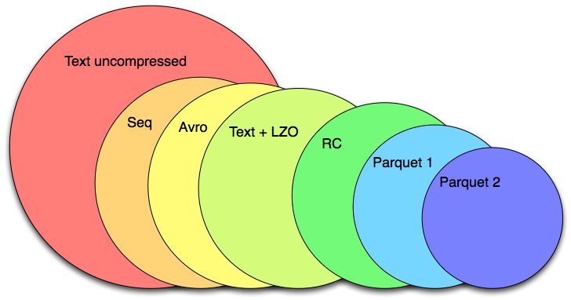
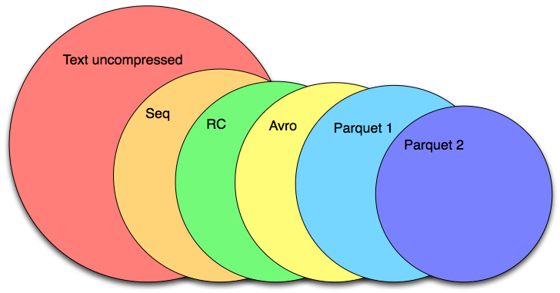
Size comparison
TPCDS 100GB scale factor (+ Snappy unless otherwise specified)
Lineitem
Store sales
The area of the circle is proportional to the file size
Notes:
Lineitem 1000GB scale factor
Text: 733GB
Seq: 409.6GB
Avro: 386.8 GB
Text Lzo: 367.3 GB
RC: 316.7 GB
Parquet 1: 245.5GB
Parquet 2: 182.2GB
TPCDS Store Sales 1000GB scale factor:
Text: 1.1 TB
Avro: 574.0 GB
Parquet: 829.9 GB
RC: 580.9 GB
Seq: 654.8 GB
Parquet 2: 447.2 GB

Slide 33
Parquet 2.x roadmap
Even better predicate push down.
Zero copy path through new HDFS APIs.
Vectorized APIs
C++ library: implementation of encodings
Decimal, Timestamp logical types
Notes:
TODO: move to 2.0 roadmap

Slide 34
Community

Slide 35
Thank you to our contributors
1.0 release
Open Source announcement
Notes:
Growing community of contributors
1st git commit on 8/31/2012 but had started before.

Slide 36
Get involved
Mailing lists:
dev@parquet.incubator.apache.org
Parquet sync ups:
Regular meetings on google hangout

Slide 37
Questions
@ApacheParquet
Questions.foreach( answer(_) )

