Slide 1

Enterprise APIs with Node.js
Al Tsang, Co-Founder & CTO

Slide 2
Agenda
Intros
Why Node.js?
Enterprise APIs
  Define some terms
  History of APIs
Best Practices for Enterprise APIs
Solutions from StrongLoop
Abbreviated Demos
Sneak Peak!
Wrap-up

Slide 3
Intros

Slide 4


About Al
Over 20 Years of Enterprise and Consumer Software
  practitioner
  producer
Product Acceleration through Platforms
Cut by technology’s bleeding edge
  enterprise social networking (km, ml & collaboration)
  structured and un-structured data (xml)
  real time personalization (streams and rules engine)
  WOA at scale (REST based SOA using SCA and MongoDB)
The Rise of the API Economy – StrongLoop and Node.js

Slide 5


Who is StrongLoop?
About StrongLoop:
Thoughts leaders in the API Economy
Co-founders are main
core contributors to Node.js
25 employees including 50% of the top 10 contributors to Node.js
Publishers of 100+ Node.js modules and corporate sponsors of ExpressJS
Over 20 enterprise customers in our first 18 months
Advisors include former CEO’s
from MySQL and WebLogic
Headquartered in Silicon Valley, CA
Backed by Ignition Partners & Shasta Ventures
Notes:
Go around and make intros… JC Informatica, Sun – JH AppFog, Salesforce – IR Red Hat, CA

Slide 6
Why Node.js?

Slide 7
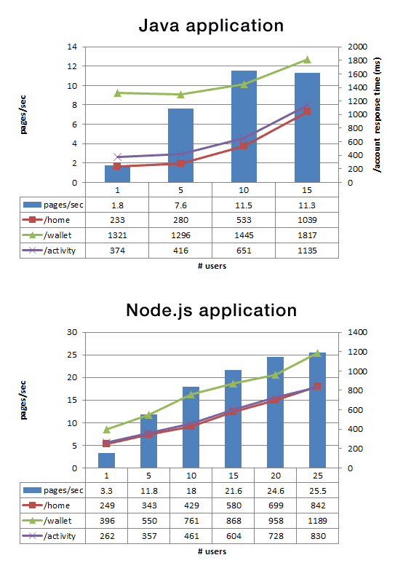

Node’s Core Strengths
Node is FAST
…and highly concurrent!
Node is built for I/O
Node is perfect for APIs
Node powers full-stack JS

Slide 8
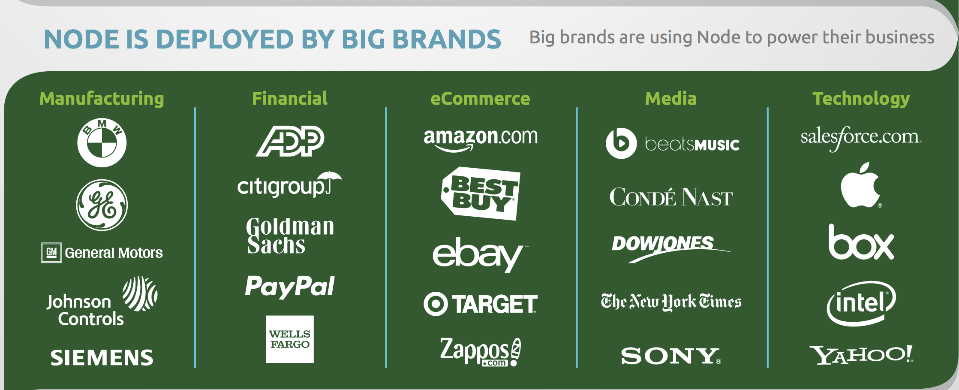













Nodies are not just Silicon Valley hipsters !
And most recently….
#1 Retailer

Slide 9
Enterprise APIS

Slide 10
This isn’t your father’s “enterprise”
Enterprise
[en-ter-prahyz]
noun.
latin; inter + prehendo
a company organized for commercial purposes; business firm.
a project undertaken or to be undertaken, especially one that is important or difficult or that requires boldness or energy:
boldness or readiness in undertaking; adventurous spirit; ingenuity.

Slide 11




Simple Web
Browser
HTML
App Server
Database

Slide 12


The Backend Multiplies
Browser
HTML
Web Apps
Database
ERP
Databases
ESB

Slide 13

B2B
Browser
B2B
HTML
SOAP
Web Apps
Web Services
Databases
SOA
ERP
ESB

Slide 14



Mobile and Cloud
Browser
B2B
Mobile
HTML
SOAP
REST
Web Apps
API Gateway
Databases
NoSQL
SOA
ERP

Slide 15




The Rise of the API Economy
SPA Web
SaaS
Mobile
IoT
JSON
API Gateway
Node
API Service Bus
SOA
Databases
NoSQL
Legacy Systems

Slide 16

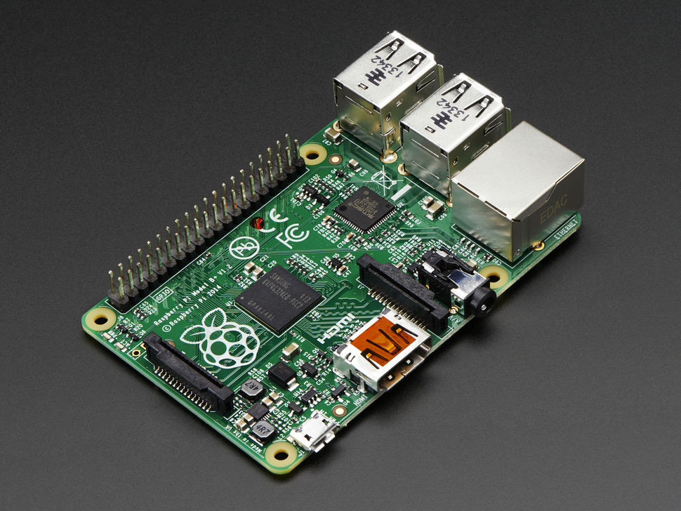
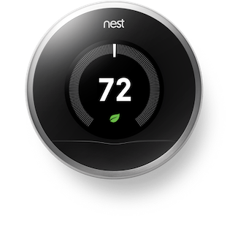
New Challenges in The API Economy
Omni-Channel (browsers, mobile, devices, etc…)
  sheer number of clients has increased!
  clients are becoming increasingly sophisticated
  JSON sent to back models on clients to support many views
V V V V
{
“car” : {
“make” : “Honda”,
“model” : “Accord”,
“class” : “coupe”,
“year” : 2014
}
}
M

Slide 17

New Challenges in The API Economy – Cont’d
The Cloud blurs the line between what was internal vs. external
???

Slide 18
API Best Practices for a New Era
Build and optimize toward YOUR use cases not everyone else’s!
Standardize on Node conventions and tooling
  callbacks? promises?
  flow control?
  mocha, chai, jasmine?
Build and analyze your data hierarchy
  data locality: co-locate your backend as service as close to the data as possible
  data consistency: revisit your CAP theorem per your use cases
  data de-normalization: pull in a flat structure and figure out your graph on the client
  data type: master, transactional, transient

Slide 19
Sample Data Hierarchy
Entity | Type | Related | Depth | Consistency | Locality | Master SOR
customer | master | addresses | d=1 | eventual | redis/cust[id] | oracle-db1/cust_mast
product | master | category | d=2 | eventual | redis/catalog[cat_id] | mysql-db1/products
order | transactional | customer | d=0 | atomic | redis/order[cust_id] | mysql-db1/order
cart | transient transactional | customer order | d=0 d=1 | atomic | redis/cart [cust_id]

Slide 20
API Best Practices Cont’d
Define canonical models as Node objects and JSON
  what’s are the single sources of truth to compose my APIs?
    declarative
    discoverable
    plainly understood
    composable through inheritance, aggregation, mashups
Build strategies around composition as a KEY enabler
  micro-services
  fine grained, composable to meet the enormity of the client challenges
Service the front-edge as much as possible starting from the front of your stack
  Define Pipelines/Layers
  Divide and conquer within each layer
    QoS (AAA)
    Cache at highest layer, eTag at the lowest layer, invalidate distributed
  Compose at the right level based on your data hierarchy

Slide 21
Solutions

Slide 22
How we work @ StrongLoop
Contribute to Node
Evangelize Node
Work closely with the Community and our Customers
Utilize libraries and frameworks
  Open source
  Cloud and on-premises friendly
  Integrated full stack (client, channel, backend, persistent store)
  SDLC taken into consideration in tooling
  Optimized for speed and user experience equally
Build great products using the above strategy
Rinse…
… and Repeat

Slide 23

What we work on @ StrongLoop

Slide 24
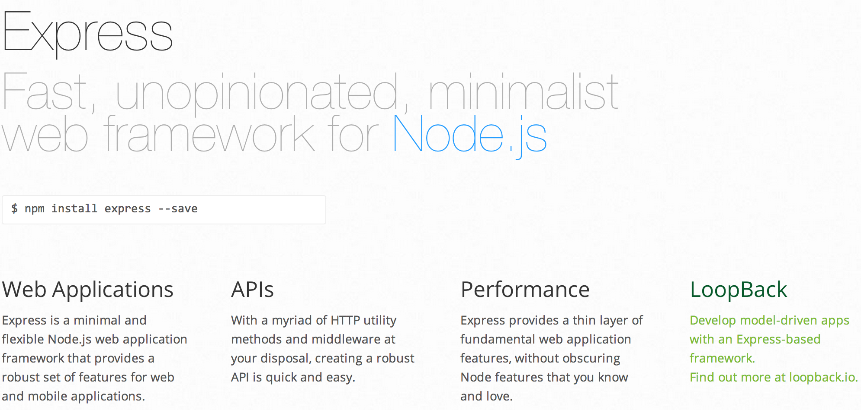
EXPRESS

Slide 25

LoopBack Open-source Node.js Framework
Built on Top of Express
Optimized for APIs
Model Driven Architecture
Enterprise Superglue
Full Stack
e2e SDLC Tooling

Slide 26
LoopBack Cont’d
Auto REST API Engine
Modern ORM (Juggler)
Aggregations & Mashups
API Explorer (Swagger)
Fine grained access control (ACLs)
Data Replication
Isomorphic JS and Mobile Client SDKs
Studio GUI Interface
API Gateway
Prebuilt Mobile Components and Services

Slide 27
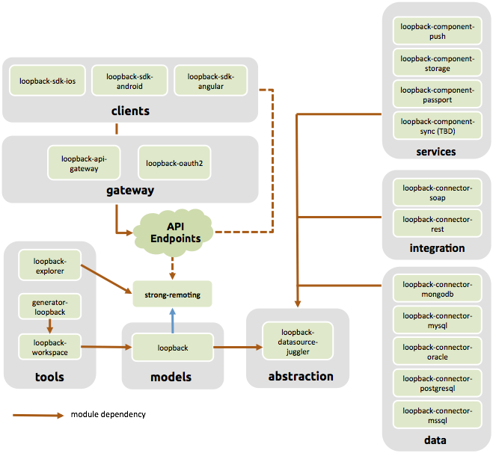
LoopBack Cont’d

Slide 28
Demos – Part 1
slc
scaffold a simple API (0 - 60)
utilize the API through API Explorer
customize the model and the API on the fly
studio
define models and data sources
use discovery to auto-generate models

Slide 29
Node.js APIs actually have a life cycle
Reliable API Solutions powered by Node.js
Compose
Deploy / Scale
Monitor
Secure / Manage
API Studio
Controller
StrongOps
API Gateway
Development
Production

Slide 30
Demos – Part 2
slc and strong-agent
monitor your Node application
run your Node application clustered
studio (modules coming soon)
Build and Deploy
Profilers

Slide 31
A Sneak Peak

Slide 32
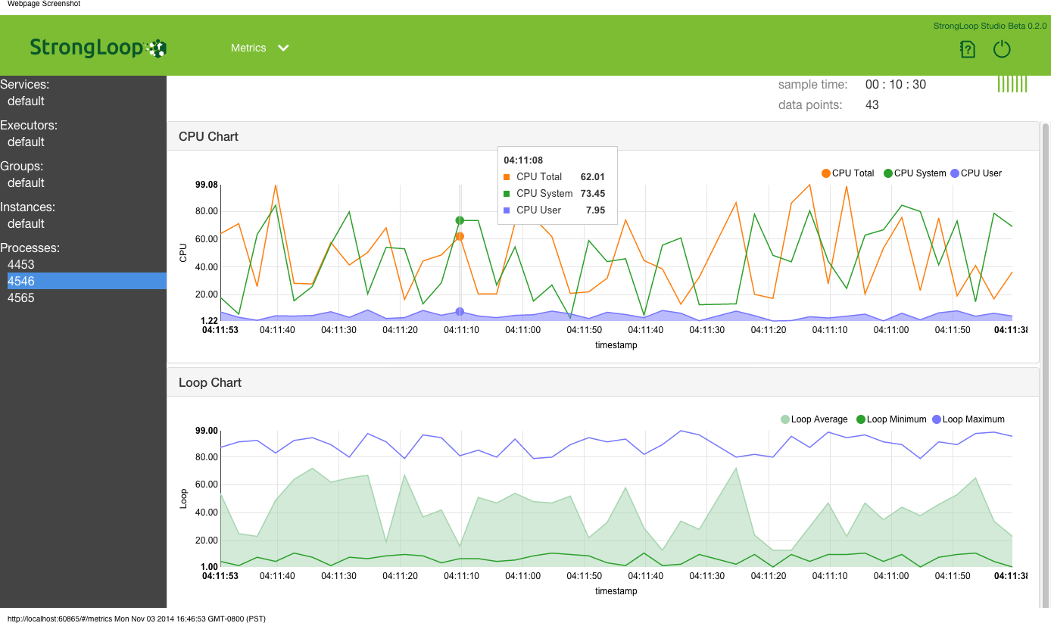
Metrics
CPU Usage
Heap
Concurrent connections
Event Loop

Slide 33
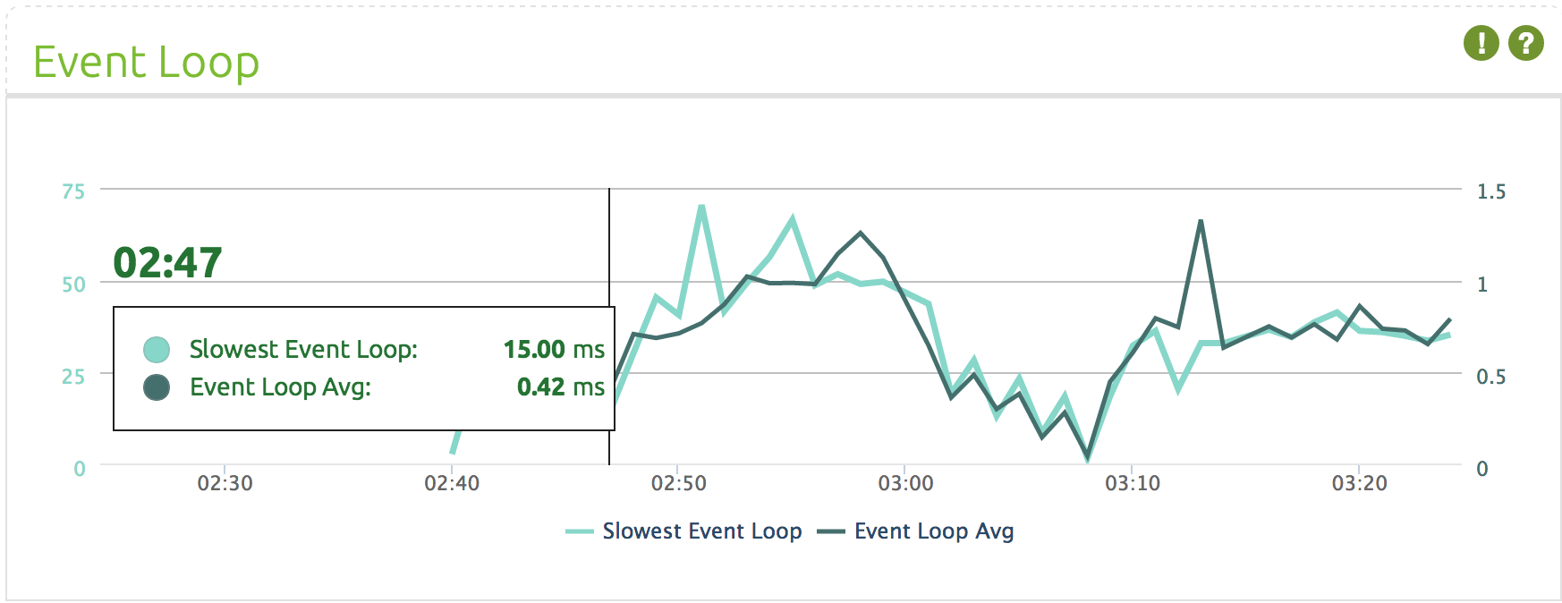

On-Demand Dynamic Instrumentation
Live Edit
Line Level Instrumentation
Any package, any framework, any code
Custom logic
Counters, Gauges and Timers
HA rollback
Agent
Monkey
Patching
App
Agent
Dynamic
Instrument
App

Slide 34
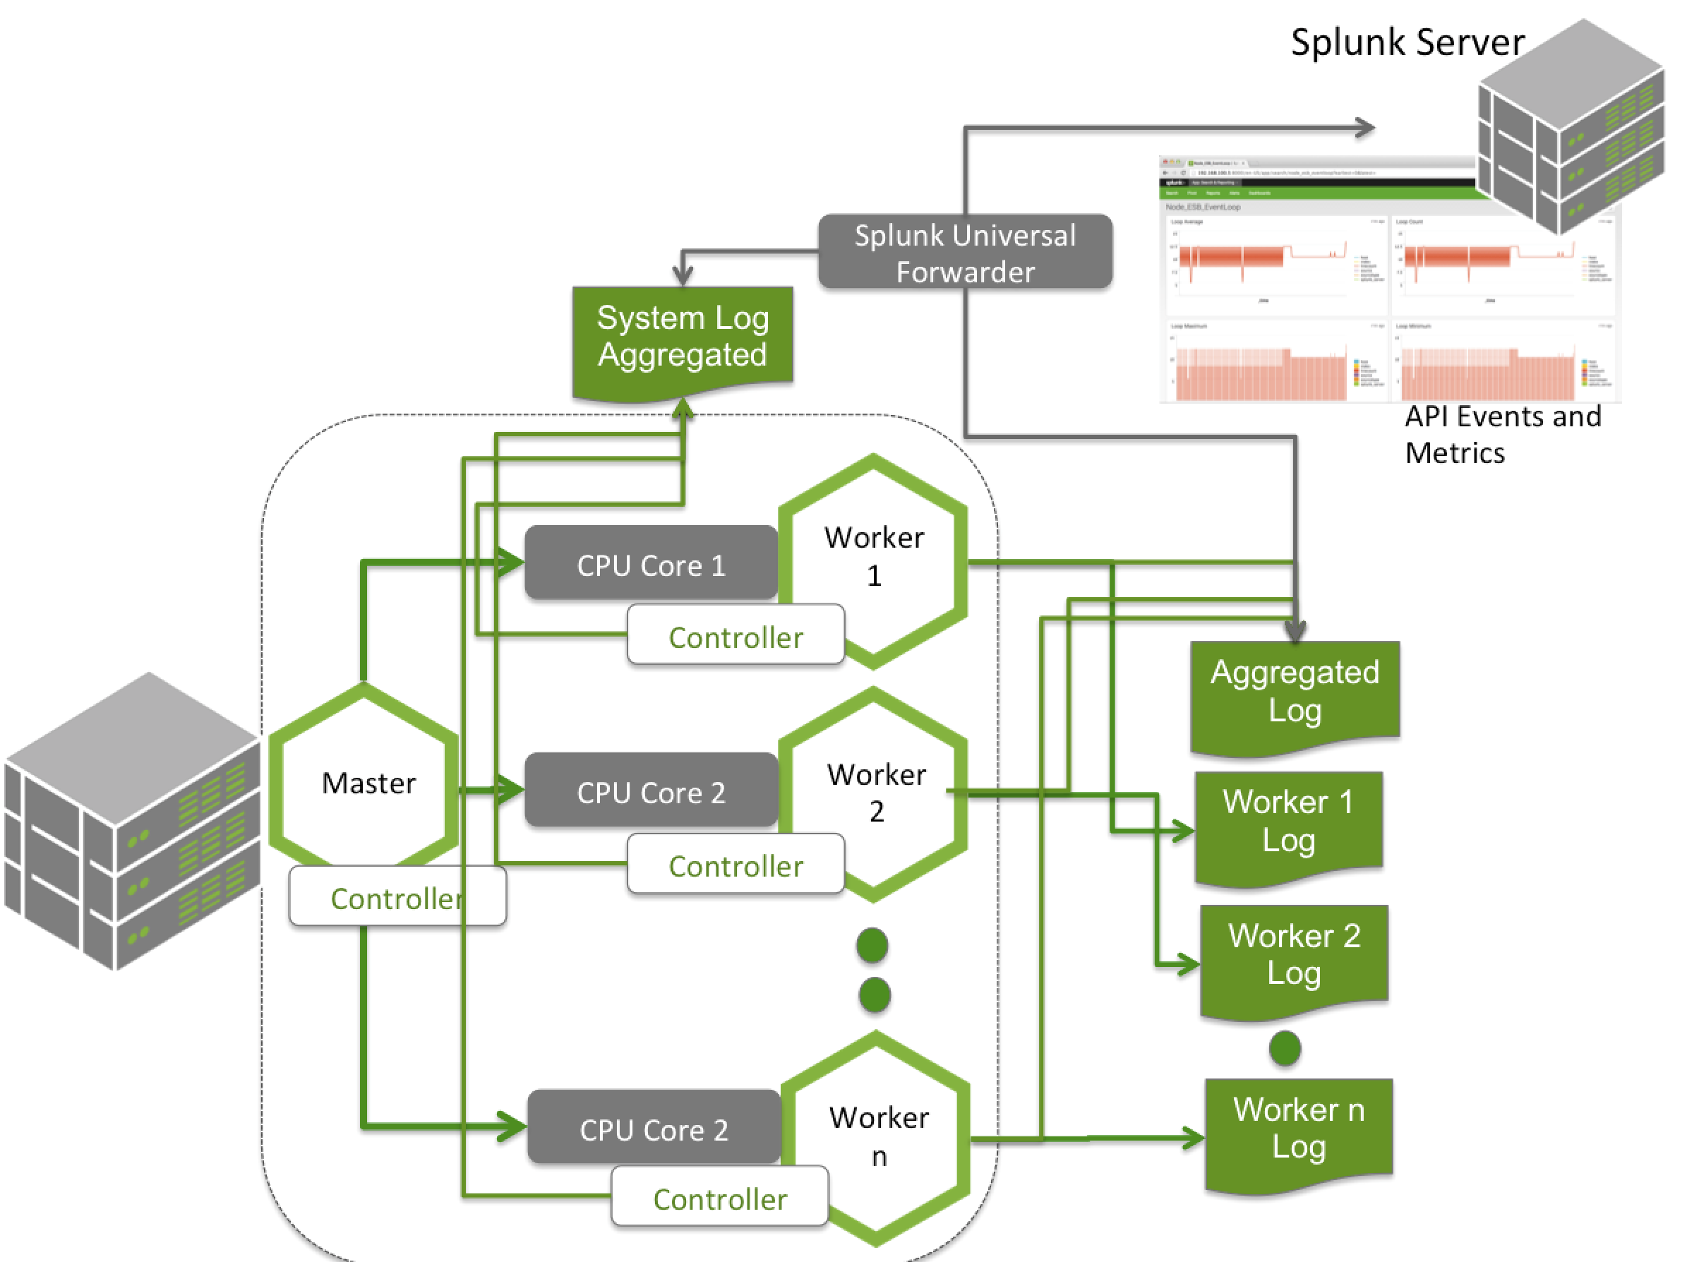
Log Aggregation
OSS Controller
Structured Logging
Log Aggregation
3rd Party Integration

Slide 35
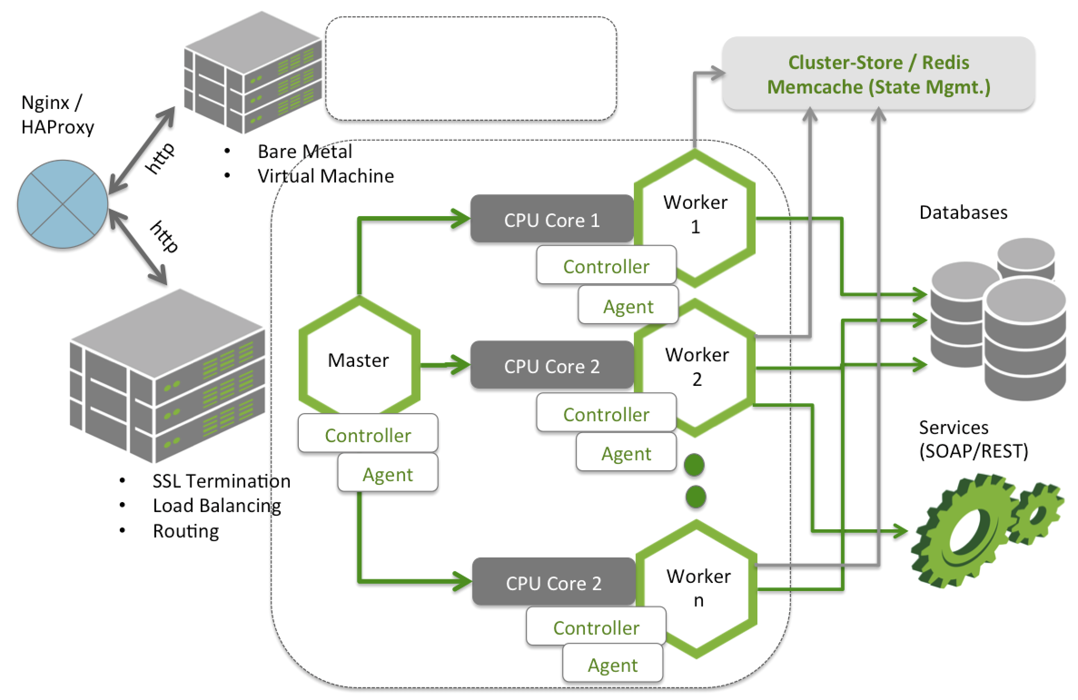
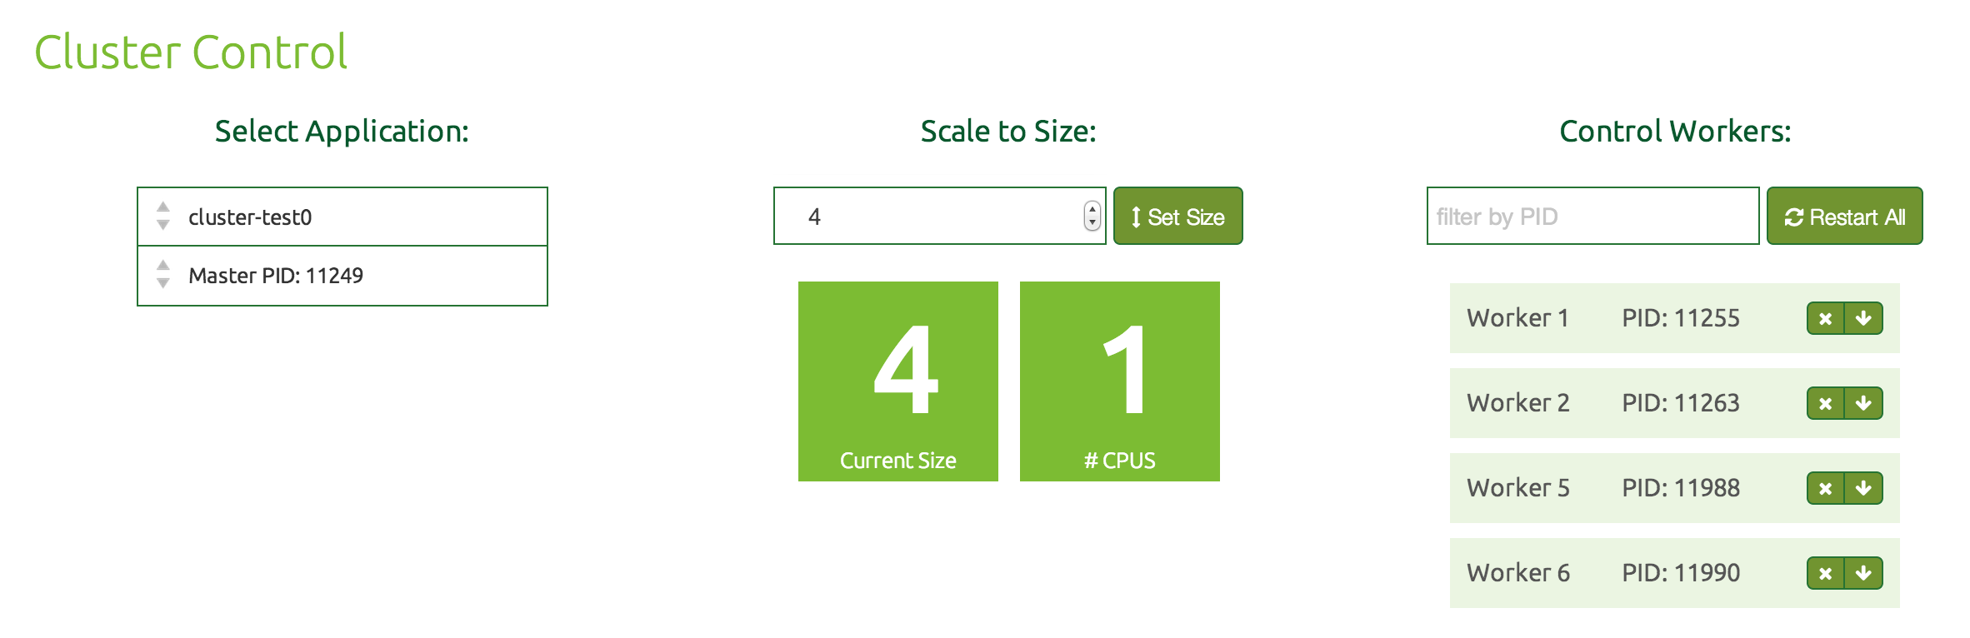
Vertical and Horizontal Scaling
OSS Controller
Cluster Mgmt.
Hot Deploy
Rolling Restart
Cluster State Mgmt.
Process Mgmt.
Deploy

Slide 36
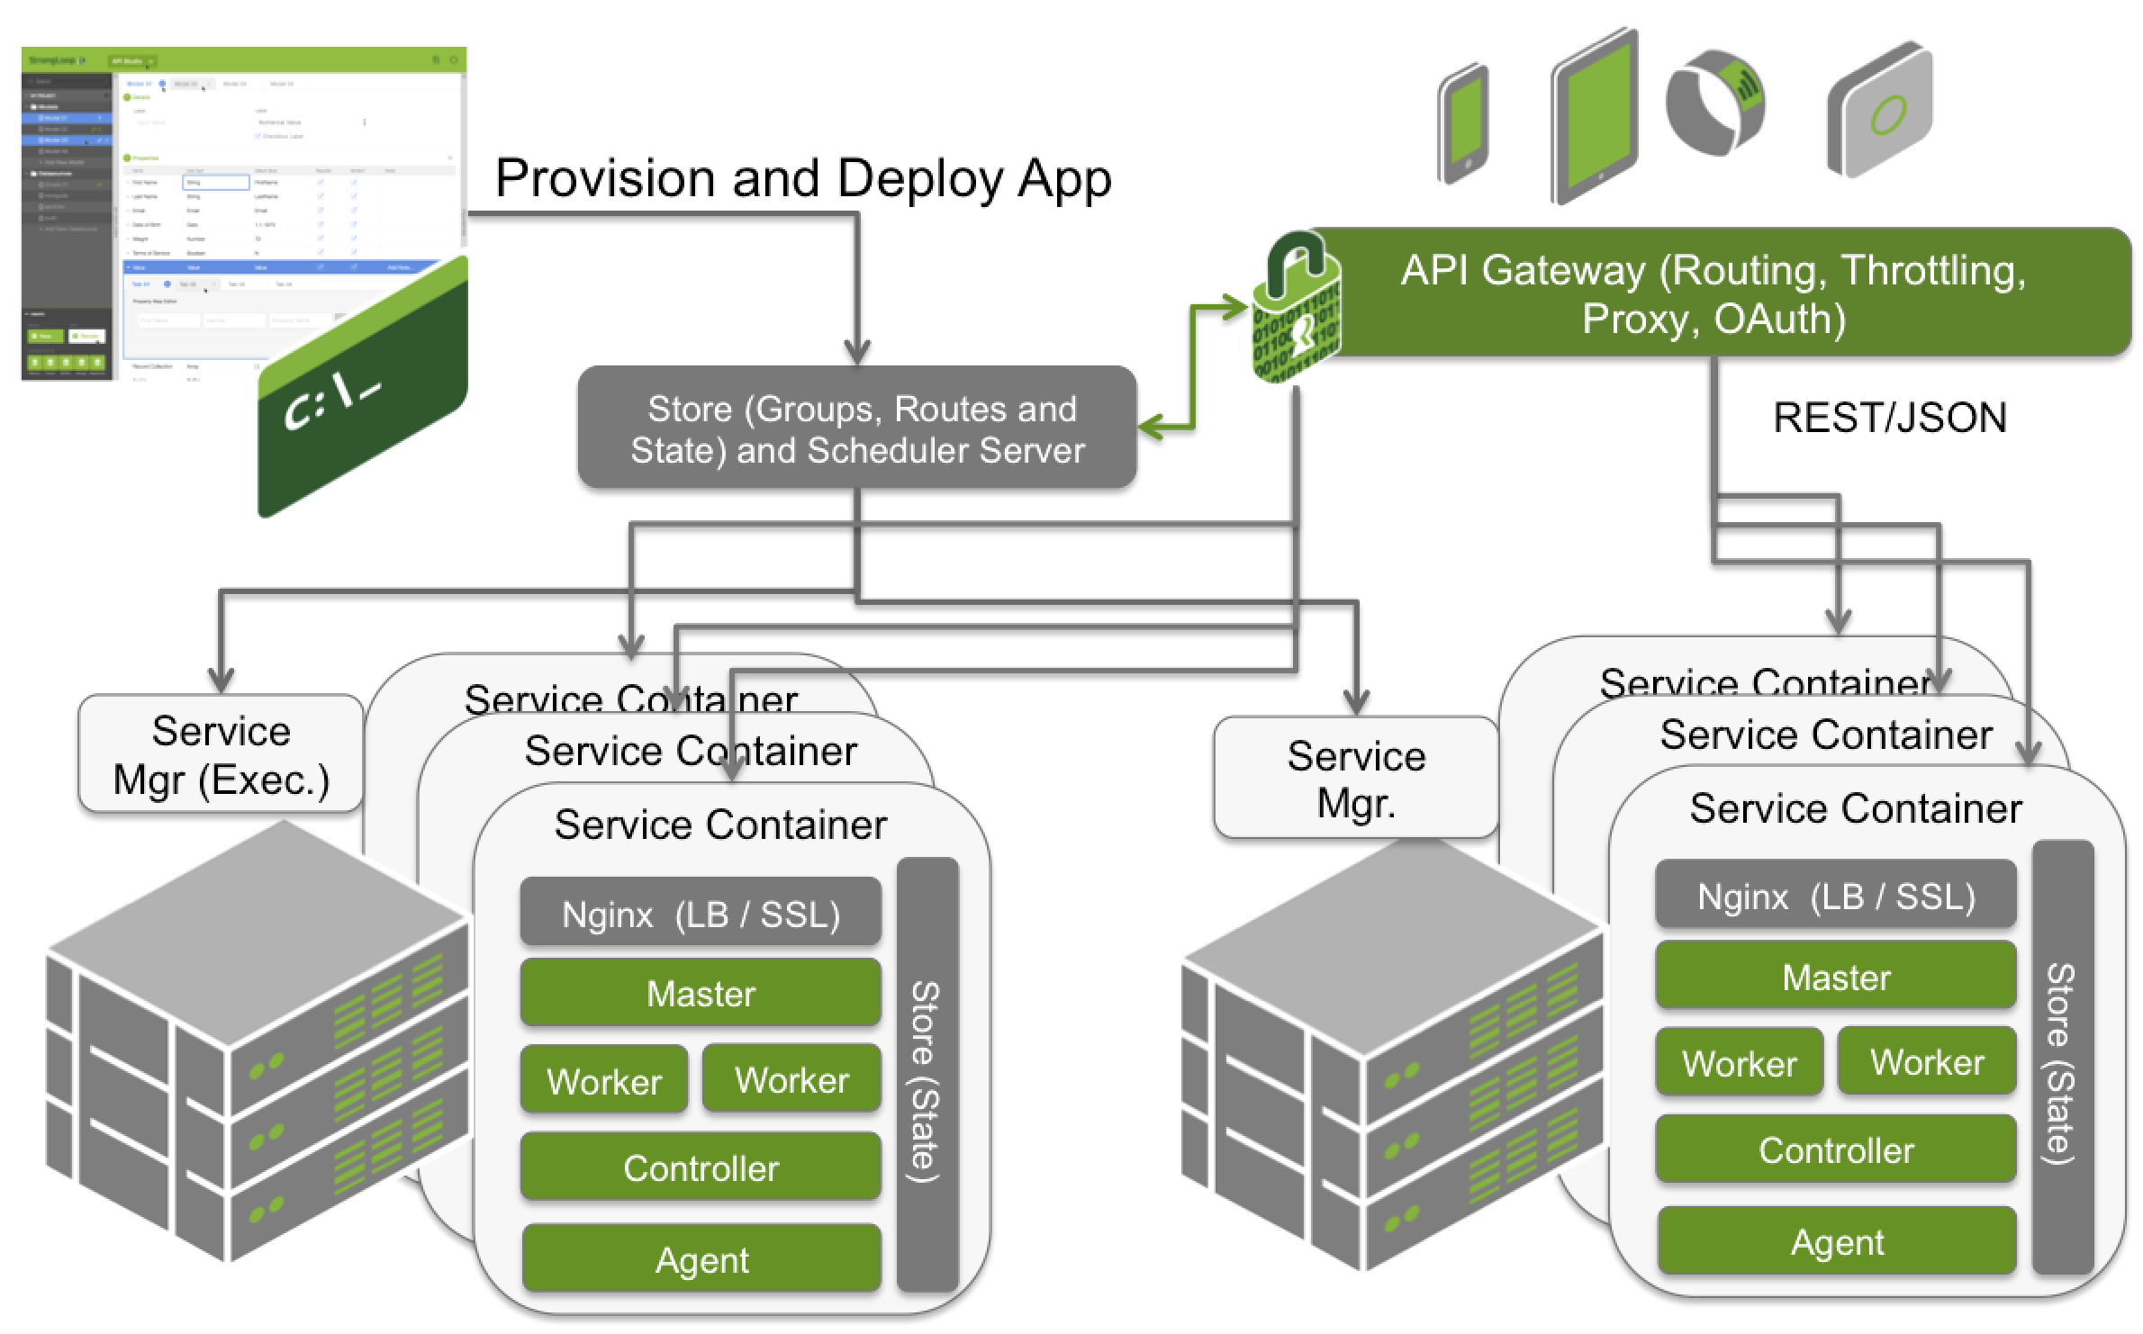
Mesh - All Things Distributed
Distributed Deploy
Cross MC state
HA
Docker Containers
Auto Scaling
Process Mgmt.

Slide 37

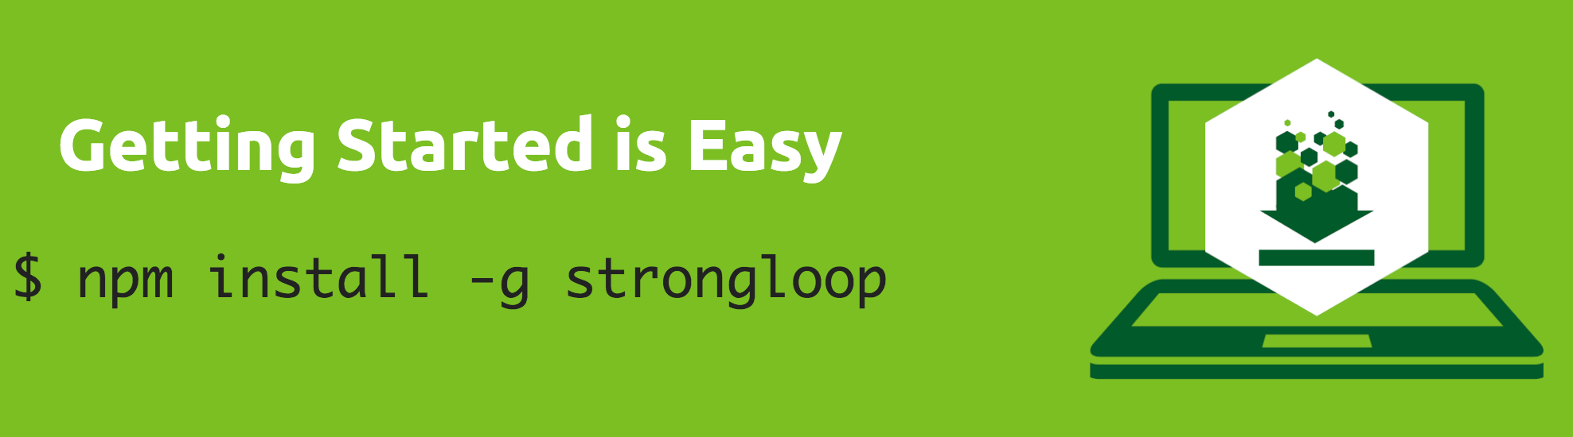
THANK YOU!
For more information…
www.strongloop.com
www.loopback.io
Check out our blog - http://strongloop.com/strongblog
Find us on GitHub – https://github.com/strongloop
…and Twitter @strongloop
Contact Al - @altsang or http://www.linkedin.com/in/altsang

