Slide 1
Infrastructure For Real-Time Video Call Service

Slide 2

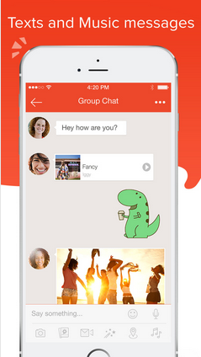
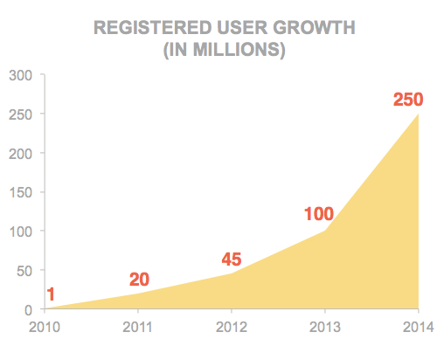

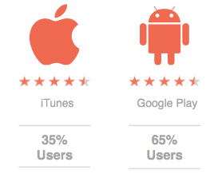
Tango – Communications, Social, Content

Slide 3
What is SWIFT?
SWIFT stands for -
“Secured Wireless session Initiate Framework for Tango”
Innovated and patented protocol by Tango
Supports Tango’s infrastructure of real-time video call service

Slide 4
Outline
Why was SWIFT developed?
Overview of SWIFT Protocol
Authentication
Firewall Traversal
Geographic Load Balancing
Stateless Server Design
Network Switch without Call Drop
Smart Relay Routing

Slide 5
What is protocol to establish a call over Internet
Parties
  Caller: initiate a call
  Callee: receive a call
  Server: help set up real-time channel
Goal
  Quickly set up the best high-quality channel between caller and callee to transmit voice and video

Slide 6
Traditional Protocol
Jingle/SIP + TURN Overview
Jingle/SIP + TURN
  Jingle/SIP: signaling protocol to exchange metadata including peer-to-peer candidates (internal/external/relay addresses) between caller and callee
  TURN (Traversal Using Relays around NAT): used for NAT traversal (peer-to-peer, i.e., P2P) and relay
Protocol Deficient
  Too many round trips to establish a call, particularly bad over wireless networks

Slide 7
Jingle+TURN solution Tango used before SWIFT
Push Service
XMPP Server
Push request
Login
Push
Exchange meta data
Caller
Callee
UDP channel set up
(peer-to-peer or relay)

Slide 8
Tango: Jingle+TURN before SWIFT
Round Trips:
Push Request
Push Notification
(Apple/Google/Tango)
TURN
Authentication
Login (several RTTs)
Authentication
TURN
TURN
P2P Candidate
Presence
Presence
P2P Candidate
TURN
Initiate (P2P cands)
Initiate
Waiting Call
Accept (P2P cands)
Accept
P2P Negotiation
P2P Negotiation
CalleR
XMPP Server
CalleE

Slide 9
Issues of Jingle+TURN solution
Jingle+TURN solution
  Too many client-server round trips to establish a call
    TCP: 1.5 RTTs
    SSL: 2.5 RTTs
    Authentication (SASL): ~7 RTTs
    Other RTTs (push/P2P/jingle session msg): ~6 RTTs
  TCP has retransmission timeout exponential back-off (from 1.5 sec)
    Particularly poor on wireless network
    Difficult to control this at the application layer

Slide 10
SWIFT protocol design target
Fast
  Less round trips (3 client-server round trips)
  Fast retransmission (UDP by default)
  All-in-one server (connecting/NAT traversal/relay)
Robust
  STATELESS server design
  Near-seamlessly Cellular/WiFi switch support
Easy to scale and geo-localize
  Servers are independent to each other

Slide 11
SWIFT protocol (1st round trip)
Push Notification Service
Apple
Google
Microsoft
Tango
Backend
Callee Information & Call Configuration
Push Request
SWIFT Server
Push Notification
(SWIFT public address)
Opportunistic
SWIFT Push
Push
Request
Push Response
Caller
Callee

Slide 12
SWIFT protocol (2nd round trip)
Backend
Configuration
Response
Configuration Request
SWIFT Server
Callee’s External Address
& Configuration
Connect to Caller
Configuration
Caller
Callee

Slide 13
SWIFT protocol (3rd round trip)
Connection is established in 3 round trips
A relay channel is ready to use
UDP based protocol (control retransmission ourselves)
SWIFT Server
Connect Ack
Connect Ack (Caller’s External Address)
Caller
Callee

Slide 14
SWIFT peer-to-peer channel
If NAT traversal (P2P) succeeds, we will seamlessly switch to P2P channel
SWIFT Server
Relay channel
SWIFT Regular NAT Traversal
Caller
Callee
SWIFT NAT Symm Traversal

Slide 15
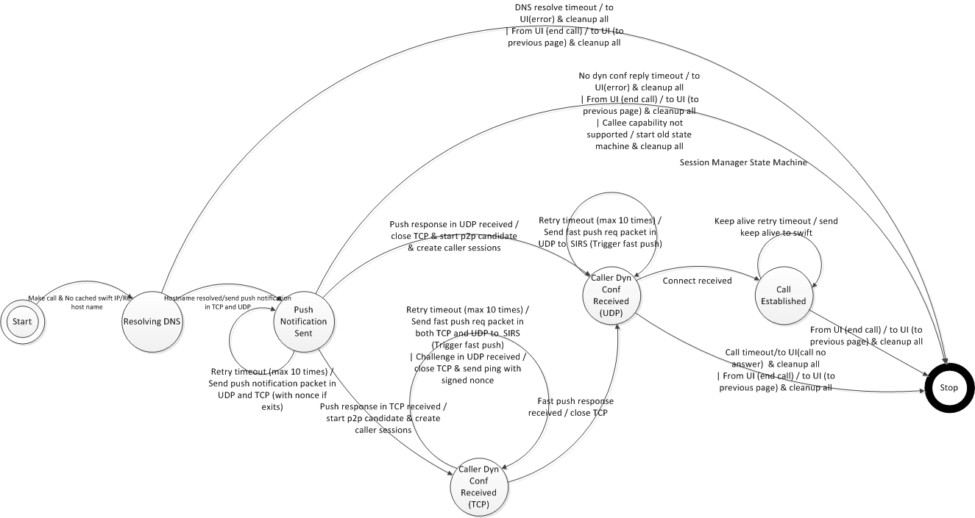
Protocol State Machine
(client only)
Handle communication between server and client
Handle retransmission on UDP
Handle NAT traversal

Slide 16
Authentication
Based on auth token, which is inside every control packet
  No extra authentication round trips needed
  No database access needed
  Timestamp/sequence is used to prevent packet replay attack
Server Shared Key
Server Shared Key
Decrypt:
Use shared key decrypt SWIFT auth token
Use password decrypt payload
Verify hash
Verify timestamp/sequence
Registration server
SWIFT server
SWIFT auth token:
Signed username
Signed password
Username/
password
SWIFT auth token in packet header
Packet payload/timestamp/sequence is encrypted by password
Hash of payload in packet header
Client

Slide 17
Firewall Traversal
How to connect if UDP is blocked?
  Use TCP with port 443 (SSL port)
  Client will connect to the server using UDP and TCP at the same time
    No delay in terms of firewall traversal
  TCP will be disconnected immediately after UDP goes through
SWIFT server
UDP
TCP
TCP
UDP
Caller
Callee

Slide 18
Geographic Load balancing
Singapore
Servers
US
Servers
Ireland
Servers
Each server is independent
Push notification
Contains public IP:port of SWIFT server
Geo-aware DNS with round robin
By CEDEXIS
Pulled to the same server
In US
In China
Caller
Callee

Slide 19
SWIFT Performance
Faster connecting
  5x~10x faster than Jingle+TURN Protocol
Higher connection success rate
Over 30% more calls connected daily than Jingle+TURN Protocol

Slide 20
Stateless Design on Server
No session/presence states kept on server
We only keep a simple routing table
    The table can be rebuilt even if the SWIFT server restarts.
    No calls will be dropped.
Key to the service robustness
      - WiFi/Cellular switch in call
      - WiFi/Cellular initiating and receiving call
      - Some phones may disconnect WiFi when the phone is asleep
  - Smart relay routing
client username | address
usernameA | IP:port of A
usernameB | IP:port of B

Slide 21
Handle Network Switch
Purpose - no call drop when switching network (either in call or calling)
  Enter a WiFi from the cellular network
  Moving out of a WiFi area to the cellular network
SWIFT Server
Re-auth with keep-alive
Switch to new P2P channel
Keep alive heartbeat
Back to relay channel
Keep alive heartbeat
Client A
WiFi
Client B
P2P channel
LTE
P2P channel

Slide 22
How to find the best server to relay?
We have 30%~40% relay calls (not P2P)
Geo-aware DNS result is not working well
  Observation 1: Relay server is not equivalent between sites (US vs China)
  Observation 2: US servers are better for the Middle East clients than Ireland servers, though it is geographically further
  Observation 3: Sometimes two-hop relay is faster than a one-hop relay
SWIFT Server (US)
SWIFT Server
(China)
300 ms
30 ms
50 ms
600 ms
Client A (US)
Long delay link
Client B (China)

Slide 23
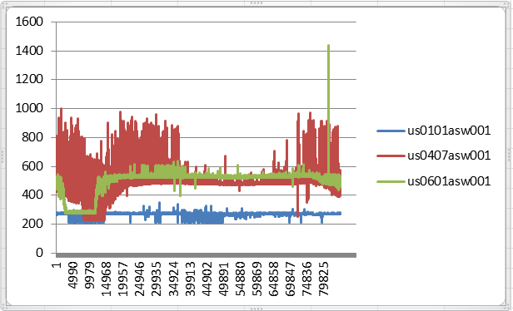
Geo-Aware DNS issues (cont.)
Geo-aware DNS result is not working well (cont.)
  Observation 4: Latency could be quite different between a single client and different servers even in one country
  Observation 5: Delay between one client and one server could be variable over time
    Below is a network “ping” result from a China machine to 3 different US servers

Slide 24
SWIFT Smart Routing for Relay Traffic
First location the 4 best “candidate SWIFT servers”
  A) The server DNS returns (usually close to caller)
  B) The closest server to caller (Server 1)
  C) The closest server to callee (Server 3)
  D) The closest middle server in terms of the sum of delays to caller and callee (Server 2)
Server 1
Server 2
Server 3
130 ms
120 ms
350 ms
30 ms
300 ms
20 ms
Caller
Callee

Slide 25
How to find the best server to relay?
Search the best path among all possible 1-hop and 2-hop paths through the 4 candidate servers
  Probing packets are sent every 30 seconds end-to-end through different paths
  The path would be seamlessly switched if a better one is found
Server (caller)
Server (callee)
Caller
Callee
Server (DNS)
Server (middle)

Slide 26
RTT improvement (A/B test)
kbps

Slide 27
Bitrate Improvement (A/B test)
kbps

Slide 28
Smart relay routing result
End-to-end round trip time
  In most countries, it has 5% ~ 30% reduction compared to traditional geo-aware DNS
Video bit rate
  In most countries, it has 5% ~ 70% increase compared to traditional geo-aware DNS

Slide 29
Thank You
The presentation slides will be on our blog tomorrow: www.tango.me/blog
Questions: meng@tango.me
Visit our Tango Table for a Tango
T-shirt and speak to our recruiters!

