Slide 1
Growing Up Spotify
Qcon San Francisco 2014
Simon Marcus – Head of People Operations / Tribe Lead for Social
@lycaonmarcus #qconsf
Notes:
Hi everyone, I want to start by thanking Dianne, for giving me the chance to kick this track off today, I’m really looking forward to all the talks we’re going to hear, and to the open space that follows!
So, I want to start by taking a show of hands, a lot of my peers at Spotify have given talks around the world about how we work at Spotify, and there’s a famous article – how many of you have either seen one of these talks or read that article?
Ok great, so – even for all of you, I’ m hoping you’ll get something new today.
I’ve been with Spotify a year this month, and I’ve had a pretty unusual opportunity to see how things work in that time. I started out heading up the Agile practice in NYC, where we have about 200 engineers, then I shifted to head up the team that is working on our Social features, and a few weeks ago I took over our People Operations group. I also serve as a member of the tech leadership team that helps guide Spotify’s overall tech practice.
I’ll talk more as we go about what each of those things mean, but moving through those roles has let me see everything from what it’s like to work with a single squad trying to build a single feature to what it’s like to try to plot out a comprehensive tech and product strategy.
I’ve been around long enough to get a good feel for things on the ground, but I don’t think I’ve been fully indoctrinated yet. This gives me a pretty great position to be able to talk with you all about how things REALLY work at Spotify. And that’s the approach I’m going to take today. I’m not a huge fan of talks where someone stands up and tells you about how they have it all figured out, I’m going to try to give you a good sense of the pros and cons of what we’ve been up to.

Slide 2
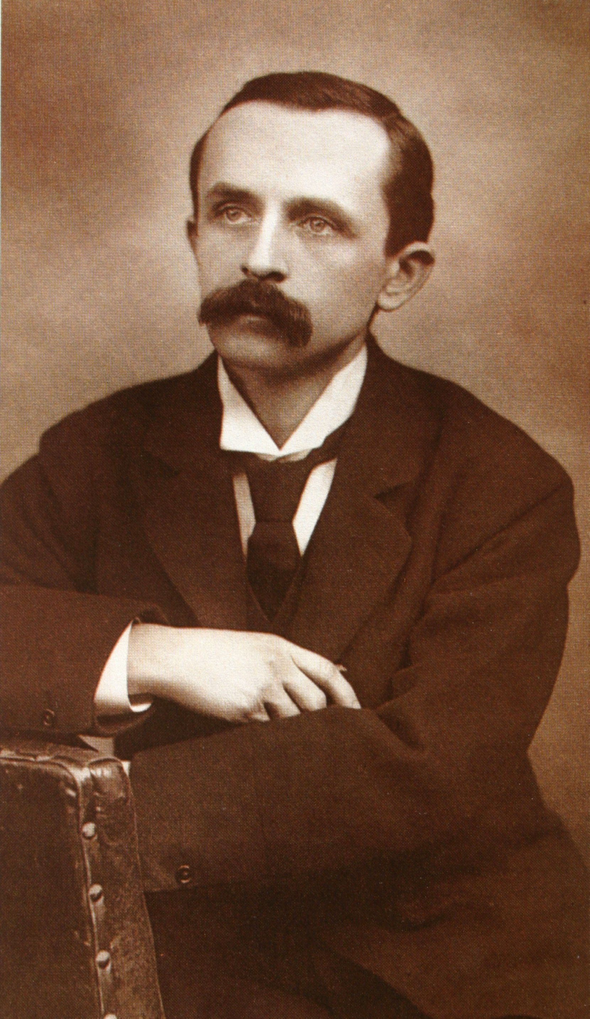
“If growing up means it would be beneath my dignity to climb a tree, I'll never grow up, never grow up, never grow up! Not me!”
Notes:
My topic today is one that is really close to my heart – in fact, it’s the entire reason I came to Spotify. In my last job, as chief operating officer at The Library Corporation, I had a chance to help revitalize a company that had been tremendously successful for 40 years, and had begun to drag under the weight of it’s own achievements. That was a challenging, rewarding and amazing experience, but it left me wondering if it was possible for companies to avoid growing up in the usual ways. Can amazing startups grow up and take on all pressures and realities of scale without becoming lumbering, risk-averse behemoths?
I came to Spotify because I think it’s a place that is pretty serious about growing up differently. I couldn’t really give a talk about growing up without a Peter Pan reference, so there it is. My claim is that Spotify wants to grow up, but we’d like to retain the option of climbing trees.
When I started my work at The Library Corporation, I thought that was I was doing was about peeling back layers of bureaucracy that had emerged over time, and what would be left when I was done was something that would look and feel very much like a startup. This is an idea you hear about often, in fact, there are about a billion articles telling you about how important it is that big companies learn to be more like startups. I’ve come to believe that this is a fallacy, that, in fact, it’s pretty lazy and even potentially dangerous thinking.

Slide 3
What’s a Startup?
Seeking a market
Everyone knows everyone
Everyone does everything
Boundaries and Constraints are visible
Plan in days or weeks
Notes:
Let’s start by talking about what makes a startup a startup.
In a startup, you’re looking for a market – you’re trying to find out if your peddling a solution to a problem anyone really has.
People know each other. People have ready access to founders, and often ready access to early customers.
Constraints and boundaries are visible, or at least pretty easy to sense.
In an early stage startup, you don’t need to see the balance sheet to get a good feel for the company finances… it’s reflected in whether you’re working in your best friend’s kitchen, or a few desks at a co-working space, or your first 2000 foot dedicated office.
People are “Cross-functional” without even knowing what that word means – you just do what you have to do.
The greatest risk in a startup is not finding a market, short of that, unless you’re the founder who put up her kid’s college fund to get things started, there isn’t that much to loose. And if you are that founder, it probably feels like no risk is too big to take to make sure that things are going in the right direction.
Put simply, things just aren’t that complicated. You don’t need a lot of formal structure because everyone knows everyone and everyone will be happy if you manage to survive another day.

Slide 4
Spotify isn’t a Startup
1500 People / 700 in Tech, Product and Design
50mm MAU / 20mm DAU
5mm Playlists created / edited every day
60 Countries
Plan in months in years
Notes:
Spotify is not a startup. People have invested hundreds of millions of dollars in us because they believe we have found a market.
We’re 1500 people tackling a bewildering mix of problems simultaneously, not the least of which is Taylor Swift, who, as I mentioned, we really love.
You can access Spotify on your desktop, your android device. Your iOS device, your window’s phone, through your Sonos system or tons devices that use our connect service. In a couple of months you’ll be able to access us through your dashboard with Apple and Google’s in-dash plays.
20mm unique people use our service every single day, and more than 50mm unique people use it every month, and that’s grown 10mm since the last time I gave a talk like this in June.
People are accessing our service in 60 countries today, which means we’re dealing with licensing agreements in 60 countries, and financial regulators in 60 countries, and advertisers in 60 countries.
We can’t just stop doing all the things we have to do to be able to function at this scale and return to our roots in our founders 2 room apartment outside of Stockholm.

Slide 5
Spotify isn’t a Startup
Assets, markets and people worth protecting
You can’t know everyone you rely on
Boundaries are not visible
Constraints are not visible
Planning must happen on longer horizons
Notes:
All of this makes for a context that is wildly different from a startups. We’ve built a world that is worth protecting, so our appetite for certain kinds of risk is very different.
It’s not possible to know everyone, or at this point, even a significant portion of everyone.
While you might understand the boundaries of the particular project or team you are working on, it’s not impossible that you don’t. It’s reasonably likely that you can’t see the boundaries of your part of the org at all, if you are in a department (or as we call them tribes) that is 100 or more people.
Constraints are often not visible. We don’t hide our financials internally, in fact we just got a briefing last week from our CFO, but not everyone shows up, and they are pretty complex, not everyone understands them. We have a pretty fancy office, so things must be going ok.
You can’t keep all the rules you need to follow to be a Spotify employee in your head anymore, and it would be insane to try to write them all down, so the funniest thing that happens with constraints is that, once you can’t see them, you start making them up, and we’re certainly seeing some of that. People are starting to follow rules that don’t exist.
Planning is no longer about staying alive another day, it’s about managing tricky entrances to some of the trickiest markets on the planet. It’s about infrastructure changes that will effect hundreds of engineers, or UX changes involving dozens of designers. We like incrementalization and iteration as much as the next bunch, but we also want a deeper sense of where we are headed, and what it will take to get there.
Our world now is very complex, and simply trying to act like a startup isn’t going to change that.

Slide 6
Spotify is an adhocracy, and it’s awesome!
Organic organization
Resists formalization / rules / standards
Preference for decentralized decision making
Encourages dissent / consensus seeking
Fluid Roles
Notes:
So if Spotify can’t just peel back all the bureaucracy and become a startup again, what can we do?
The people I work with, particularly my boss, CTO Oskar Stal, make fun of me because I believe in theory driven practice, which leads me to use a lot of big words, so I don’t think Oskar would call it this, but Spotify at it’s best is what futurist Warren Bennis called an Adhocracy.
Adhocracy’s are organizations that are intentionally designed to emphasize flexibility and adaptation. These organizations are more likely to surface great new ideas, and less likely to meticulously extract every last dollar out each of their activities.
In practice, at Spotify, this means that we have organized ourselves to allow for distributed decision making through our tribes / squads /chapter and guild model, which I’ll go into detail about in a minute. Each tribe has a ton of autonomy over how things work in their domain, and the same is true of each squad.
It also means that we are resistant to formalization and rules and standards. We’re huge fans of the “goat path” model of process development. Where ever we can, we let things emerge, and if they go well, maybe we’ll codify them. If they go poorly, we try to figure out why. What we rarely do is try to design what we hope will be a perfect approach up front. We’re willing to risk letting sub-optimal things emerge as the price of increasingly the likelihood that awesome things will emerge.
We try to encourage dissent. You are way more likely to get in trouble for half-assing something you don’t believe in than you are for expressing your concerns about it. We encourage dissent by, among other things, creating safe spaces for it, and by modeling it.
Not surprisingly, given our Swedish roots, we also seek consensus on most important decisions. Lot’s of critical things get worked out in gang-written google docs that have 5 or 10 or 20 people contributing to them.
Alright, so there’s a lot to like about our ad-hocratic nature….

Slide 7
Execution
A lot of Talking
Notes:
This is how I often describe how we arrive at answers at Spotify. It’s not unusual for a problem to start as a discussion between 2 or 3 people and eventually pick up 20 or 30 or 40 people who feel like they need a say before we can actually make decision. It can take a LONG time, and a lot of emails and meetings to arrive at a decision. On the upside, when we finally do make a decision, both the problem and the solution tend to have been very well socialized, and with a great deal of common understanding, we tend to execute quickly and thoroughly.
An interesting challenge for us in the future is whether we can replace some of the debating with experimentation. There are few who don’t agree with this in principle, we have to learn how to do it in practice.

Slide 8
Spotify is an adhocracy, and it sucks!
Who does what?!?
How do we do…
SO MUCH TALKING
What am I supposed to do?
CAN SOMEONE JUST MAKE A #$%%## DECISION!?!?!
Notes:
So Spotify is an adhocracy and it’s awesome, but it also can also suck.
So I mentioned that our organization is set up so that you can kind of operate however you want within your tribe or your squad? Yeah, this is great if you can actually complete your work your org boundaries, but it begins to break down when we have to reach across the org to get things done, and the bigger and more complex our problems get, the more often we run into this problem. We do a pretty bad job, frankly, at running cross-tribe projects, and we do an even worse job of setting cross-tribe standards.
Some things do need to work consistently throughout the org. It’d be cool, for example, if it didn’t take years to agree on Java vs Python for production systems, or a single code repository, or a single build server, or a single group-chat tool.
For an engineer moving from squad to squad or tribe to tribe, it probably shouldn’t feel like you are changing companies... In fact, something we’re really worried about is how to encourage mobility. It can be difficult to make sure that the right people are getting to work on the right problems at the right times.
It can take FOREVER to get a decision made. It can be very difficult to figure out who your stakeholders are, who needs to know what you are doing versus who gets to have a say. There are email threads that go on for months as we try to solve pretty pressing issues, and others that sort of Peter out and than return with a vengeance once a year or so.

Slide 9
Today’s playlist
Growing up our org chart
Growing up our strategy
Why’s this all work?
Notes:
So there’s a price we are paying for our emphasis on emerging practices and local autonomy. Itt’s a bet, really, one that we feel has generally paid off pretty well so far, but we also recognize that we need to keep maturing. The things that worked for us when we were 200 people don’t all work today, and certainly won’t work tomorrow.
So, now I want to get into specifics about how we’re trying to stay true to our roots while taking on the challenges of scale. I could have pulled a lot of different threads, but I’ve only got a little bit of time today, so I’m going to focus on these areas. I’ll talk about our organization structure, and how it’s holding up after being the backbone of our scaling efforts for more than 2 years. I’m also going to talk about how we’ve organized into groups that focus on infrastructure and others that focus on feature development. This has been one of the more controversial and difficult things we’ve done inside the company, and it’s not something that I think we talk about too often outside the company.
Next, I’ll talk a little bit about what I’ve been working on recently, which is our first ever effort to establish a standard model for developing and deploying strategic direction, while still trying to allow for as much productive autonomy as possible.
After that, I want to talk about some of the things we’re doing to try to make sure that Spotify continues to be a really humane place to work, which is a huge challenge as we grow.
Finally, I’ll wrap up with some observations about the cultural underpinnings of all this. Despite all our foibles, some of which I’ll try to be really up front about today, my money – and I mean literally my money - is on Spotify managing to pull off the seemingly impossible. I’d bet I’m going to still like working at Spotify 3 or 4 or 5 years from now, when we’re 500mm users and who knows how many staff. This is because there are things that are part of our DNA that are going to thankfully be very hard to stamp out, and what’s more, I think there are a lot of people like me, who will fight really hard to protect them.

Slide 10
Growing up Our Org Chart
Notes:
So, back when Spotify really was a startup, everyone just used whatever tooling they wanted and built whatever features they wanted and shipped them however they wanted whenever they wanted. This worked really well, until it started to work not so well.
Once we had multiple teams trying to ship to the same clients, we started running into problems. If a team wanted to ship a new iOS feature, they essentially took ownership of planning the next release. Once other squads heard that a release was building steam, they’d try to pile on board, and then maybe 3 or 6 months later something would finally get pushed out the door.

Slide 11
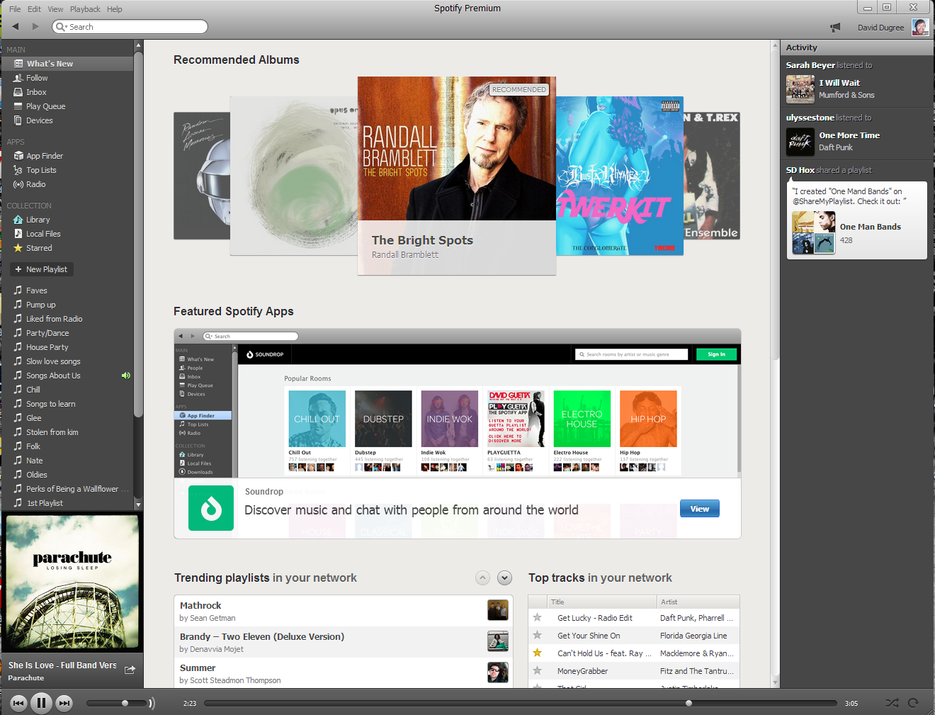
Organizations which design systems ... are constrained to produce designs which are copies of the communication structures of these organizations – Melvin Conway
Notes:
If you used our product anytime between say, 2010 and early 2014, you could see the results of this lack of thoughtful structure in our software. It was hard to keep quality high, and our software was an extraordinary example of a phenomenon known as Conway’s law: which means roughly that you can see the org chart in the software.
We had a discover tab in the left hand nav bar because we had a discover team. Same with Radio, and a ton of other features. When you clicked through into those tabs, you might be greeted with entirely different design and interaction standards.
All of this might have been a reasonable set of tradeoffs as we found our initial market fit and gained our first few million users. In those early days, what mattered most was that we were able to deliver the world’s music to you on demand – and frankly the kinds of people who were really wanted that a few years ago were willing to put up with a lot to get it.
But as we moved beyond early adopters, these visible problems became a bigger problem, and what’s more the problems we were experiencing, weren't just the ones you could see. As I alluded to before, the same degree of autonomy that let engineers take concepts from ideation to delivery with very little friction in the early going translated to a bunch of technical and organizational debt that eventually started to really get in everyone’s way.

Slide 12
Client Infrastructure
Release train, platform design, developer experience
Feature Squads
Social, Search, Browse, Your Music, Discover
IO
Provisioning, SRE, Monitoring, GHE
Notes:
So, at some point about 2 years ago, a decision was made to essentially split the tech organization into three levels: The first level would focus on client infrastructure. This group owns our desktop and web and mobile clients. A huge part of what they do is help us ship through Apple’s amazing app store process on a 3 week release train. But they also include the UX and design teams that helped us develop, implement and maintain the look and feel that you now see across all of our interfaces – a single design language, a single set of interaction standards, properly modulated to different platforms.
The second level is feature squads. These are the teams that focus on building new experiences or moments within our apps. This includes teams that are constantly testing new ways to deliver content that has been put together by our cyborg editors, humans with an array of machine learning tools that give them crazy super-powers. It also includes teams like the Social Tribe, which I work with, which focuses on pushing features that let you know what your friends are listening to and be guided by their interests.
The third level is Infrastructure and Operations, or IO. They form the backbone of our tech. They make sure we have servers and bandwidth and Hadoop clusters and monitoring systems and code repositories and a million other things that I don’t understand because I’m what engineers kindly refer to as “non-technical.”

Slide 13
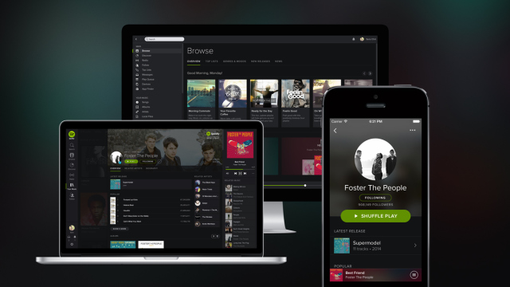
Notes:
This new structure helped us pull off a project that we undertook in late 2013 and early 2014 to begin to establish a single design and UX language across all of our interfaces. This work is by no means done yet, but we’ve made pretty great strides, and the Spotify of 2012 or even early 2013 wouldn’t have been able to pull this off.

Slide 14
How’s this work? Pros:
Higher quality
Ship most platforms at least every 3 weeks
More consistent user experience
Better tooling and infrastructure
Feature squads can focus on building awesome features
Notes:
So, let’s talk about some of the pros and cons of this aspect of our organization. First, there’s no question that we are pushing out higher quality today, and we’re doing it much faster. On some of our platforms we can push out at will, on others, we have release trains that run pretty consistently on time. We have people in a position to dedicate time and energy to things like continuous delivery, which our old structure had no way to invest in.
There’s no question that we are delivering a more consistent user experience. We regularly maintain a very high app store rating.
We’re also providing a much better and much more sustainable developer experience than we were in our toddler days.

Slide 15
How’s this work? Cons:
Tyranny of the release train
Loss of autonomy for feature squads
Infra squads can feel like they are stuck being quality gates
IO can find it difficult to ensure they are building what people need
Notes:
On the flip side, this model has a lot of problems too.
Feature teams can feel like they’re work is too dictated by the relentless release train.
Infrastructure teams can feel like they do nothing but clean up other people’s messes and don’t actually have enough time to work on infrastructure.
Both feature teams and infrastructure can get frustrated by how hard it is to ensure that we’re building the right tooling and support to make everyone’s lives easier. We’re experiencing some of what lean experts would tell us we should expect to see if we break our work down into specializations.
Having said that, I think there is general a feeling like we continue to make headway against these problems, and there is no grass-roots movement to try to ovethrow this structure, which is generally a pretty good sign that all in all, we feel like it’s working.

Slide 16
Tribes, Chapters, Squads and Guilds
Notes:
So probably the most famous thing about Spotify in terms of company culture is our model for scaling the org, and I want to get into that today. Though this ground has been covered many times before, I’ll try to bring some new aspects and perspectives out, but I’ll also try to get through this stuff pretty quickly.
The model I’ll describe today emerged in 2012, when it began to become clear that Spotify was going to need to scale up very, very quickly. The people who helped design this wanted to figure out an approach allow us to spin up new teams to focus on new missions really quickly, with as little organizational friction as possible. The people who led this effort also wanted to optimize for letting people move pretty easily through the org, and for making sure that we balanced a strong focus on delivering value with a strong investment in the personal and professional growth of individuals. Here’s what they came up with, which in it’s broad strokes, remains how we are structured today.

Slide 17
Tribe: Squads with a shared purpose
Notes:
The largest element in our org structure is the tribe, which is simply a collection of squads that share a broader mission. So, for example, if you are in the SRE squad, you are also part of IO tribe I mentioned earlier. For a while, some tribes were more geographically than mission bound, but we found that this didn’t produce optimal results, and we are now allowing tribes to be more geographically disperse in favor of mission clarity.
Tribes are made up of anywhere between 5 and 20 squads. There are currently something around 9 tribes, but this can change at any time.
Tribes tend to be led by a team that reflects the same structure as squads: with a tribe lead who has a technical background, a product partner, a design partner and an Agile Coach chapter lead rounding out the group. One way we talk about tribes is as incubators. The tribe leadership is responsible for making certain that squads have the resources, information and infrastructure they need to be successful. This includes overseeing the recruiting function for the squads, as well as managing physical spaces, budgets, etc.
Tribes have so far been kept well below Dunbar’s number - or the outer limit of the number of people with whom you can sustain a real social relationship. This means most tribes stand somewhere between 70-130 people, though some are smaller, including the Social Tribe, which I lead, which is under 30 people.
As I mentioned, there are fairly significant dependencies across squads at this point, though I think that is something we were hoping to avoid when this model was first envisioned. We try to minimize the friction caused by these dependencies by fostering relationship building between engineers across the org. For the most part, no one proxies engineers between squads. When we need collaboration, engineers reach out to each other directly.
One fairly recently and hugely promising emerging practice is something we call “embedding.” When a squad in one tribe needs help from really needs help from squad in another tribe, one of the squads will often send people to “embed” in the other from anywhere between a few days and a few months.
It’s now becoming common practice, in particular, for our IO tribe, to embed engineers in feature squads whenever they are trying to build out a new piece of infrastructure. We’ve loved the results of this so far.
Being a member of a tribe can be awesome because you get exposed to so much cool stuff happening around you, and you can find great new opportunities without changing your boss or experiencing huge cultural shifts by having to move into an entirely different environment. It can be frustrating because sometimes you are asked to participate in things, like weekly tribe-wide demos, where much of what is being shared doesn’t feel super relevant to your current work. At this point the biggest tribes are small companies, and it can be hard to get a grip on what’s happening around you.

Slide 18
Release train, platform design, developer experience
Chapter: Skills team, within a tribe
Notes:
The next level down from the tribe is called a Chapter. As a member of a tribe, you are also a member of a chapter, which is generally a group of 5-15 people who share a skill set and a manager who is a respected practitioner in that skill area. So, if you are backend engineer, your chapter is made up of backend engineers from anywhere between 2 and 10 squads, and your manager is almost certainly an active backend engineer themselves – we call these people Chapter Leads.
Many chapter leads spend about half their time working directly with a team as a contributing member. Though they may have some organic authority on that team by virtue of their technical seniority, they generally don’t have any managerial role at the team level, though there are both intentional and unintentional exceptions to this.
There is a huge range of approaches that people can take to being a chapter lead. You are always responsible for helping with the professional growth of the members of your chapter. You can chose to do this through pairing with them regularly, making sure they get the right external training, pairing them with other senior people, regularly meeting with them in 1:1s, challenging them to try new things, challenging them to teach others, or some combination of all of those things.
At it’s best, being a member of a chapter means being part of a team that is not only focused on delivery, but actually cares about helping you grow while ensuring you have the best possible environment to do so. At it’s worse, being a member of a chapter can feel like you are being pulled in different direction by different masters- your squad wanting you to focus on one set of things while your chapter wants you to focus on another. Your chapter lead may do an awesome job of staying up on what’s happening in your day to day work, or they may be largely absent and focused elsewhere, unable to give you practical guidance around the problems you are facing.
I think being a chapter lead at Spotify is one of the hardest jobs I know of in our industry. Spotify hires a lot of young people directly out of college or their first job. We believe in giving people big opportunities and challenges. Many of our chapter leads, my guess is well over half, are experiencing people management for the first time, and are, in turn, managing a lot of people who don’t have a ton of professional experience. Matters are even more complicated by the fact that you are likely managing people who work in squads you don’t work in, which can make it hard to keep up with their context. Finally, you don’t have an operating responsibility for the most part… we leave all that to self organizing teams. This all adds up to a pretty huge challenge, and I think we generally agree that we haven’t got this one figured out yet.

Slide 19
Squad: Where the work happens
Notes:
For an engineer, the center of your life at Spotify will be your squad. It likely consists of a few backend devs, a few front end devs, a designer, a QA person or two, an agile coach and a PO. There might be a data analyst and a user research.
From an execution standpoint, we want squads to be as autonomous as possible,
Product Owners generally set the direction for the squad, but ideally with a great deal of input and engagement from the team, as well as in concert with the larger product organization. Tech and Product are separate organizations at Spotify, throughout the org you’ll find partnerships that generally consist of a tech rep, a product rep, a design rep and often an agile coach. Because we like to come up with our own langauge for everything, we call this group a POCLAC, or a TRIO, depending on it’s exact make up.

Slide 20
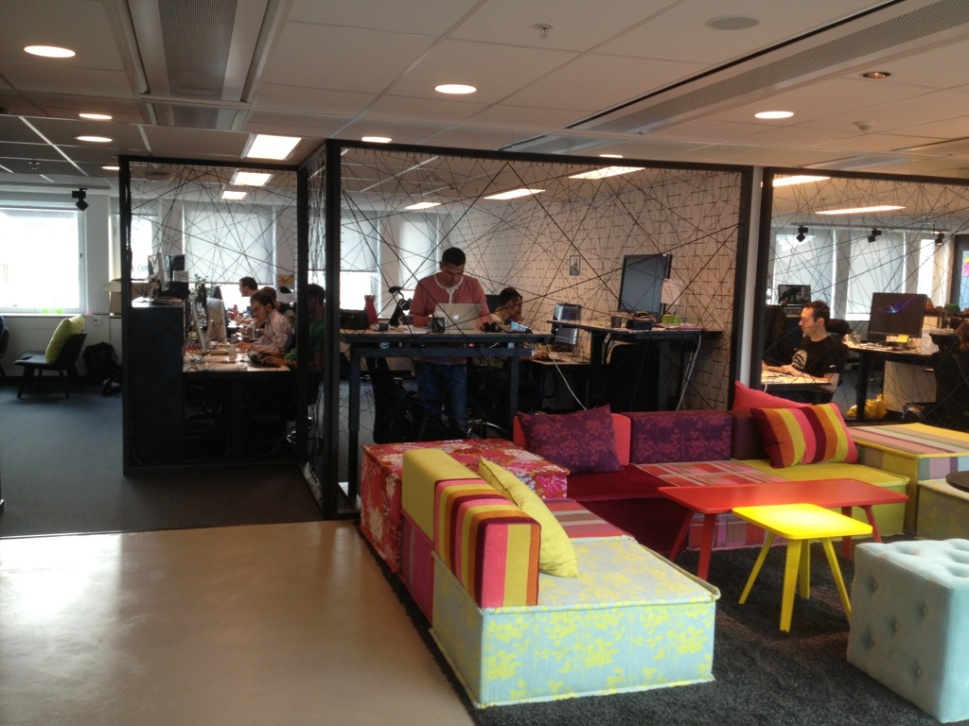
Life in a Squad
Notes:
As a member of a squad you work in a squad room. These are generally open spaces with a number of desks, in some squads you stay at the same desk for a long time, in others, you tend to move around to be closest to the few people you are working with at the moment. Squad rooms have white-boards everywhere, they tend to have little break out rooms big enough for private 1:1s, and an area with comfortable chairs so that you can have a more relaxed conversation. Squad rooms are set up largely the same at all of our offices, particularly between our Stockholm and NYC offices – we want engineers to feel at home wherever they are.
Most squads do not have an identified “leader,” the squad is responsible for it’s own operations and performance. Being a member of a squad can be awesome because you have more control over your own work than you might encounter just about anywhere else. At it’s worst, you can feel kind of like you are on your own, particularly if whatever you are working on right now doesn’t happen to be of huge interest to senior management.

Slide 21
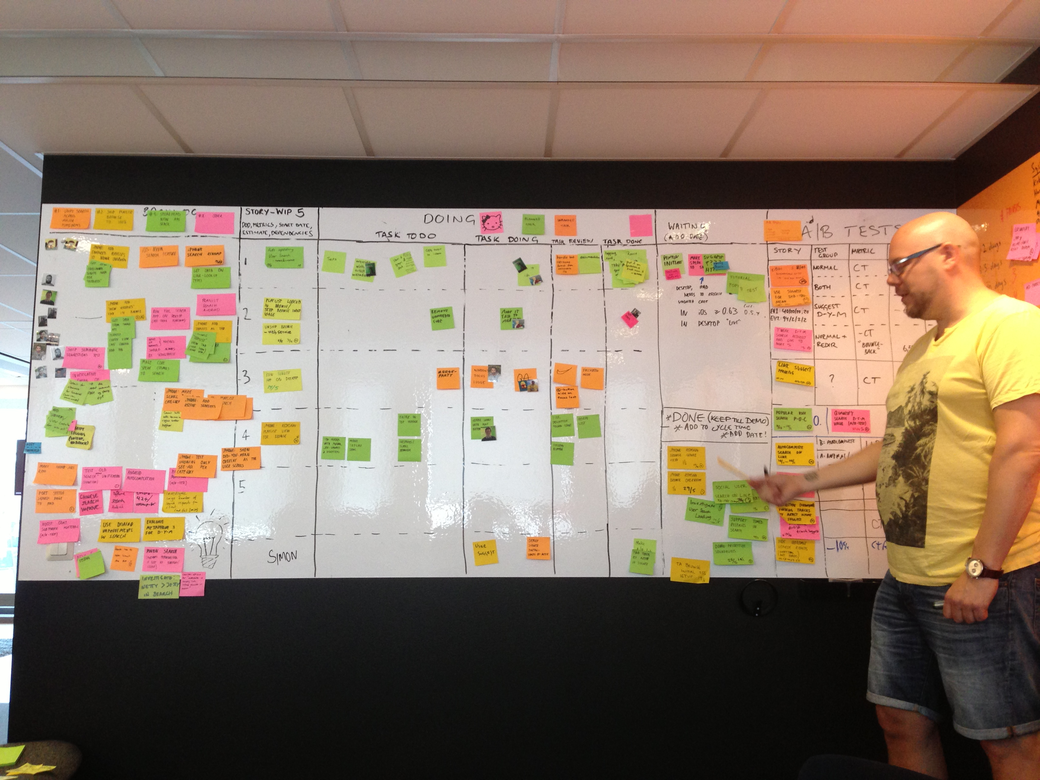
Life in a Squad
Notes:
In terms of day to day operations, squads have great leeway in the tools they use. They have great leeway in the practices they use. As I’ve alluded to, this can feel great in terms of optimizing for local effectiveness, and getting to experiment with some pretty edgy stuff, but it can also make interfacing with the rest of the org sometimes pretty frustrating – for example, you might have to figure out for yourself if the best way to reach someone you are really depending on is through IRC or Slack or Hipchat.
And this points back to a common refrain both in this talk and at Spotify: the relationship between Autonomy and Alignment. We’ve traditionally indexed heavily in favor of team autonomy, sometimes at the cost of overall alignment. We’ll talk more about this in a bit.

Slide 22
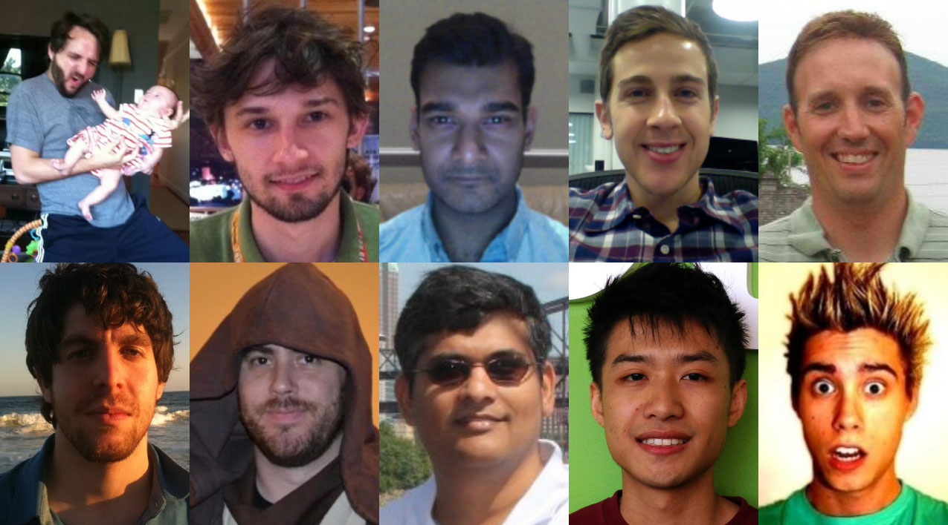
Teams are Scaling...
Notes:
One of the things I want to really drive home is what this scale means at the human level. These guys here are part of the social tribe, the team I mentioned that I am currently leading. And specifically, this is what the team looked like in December of 2013.

Slide 23
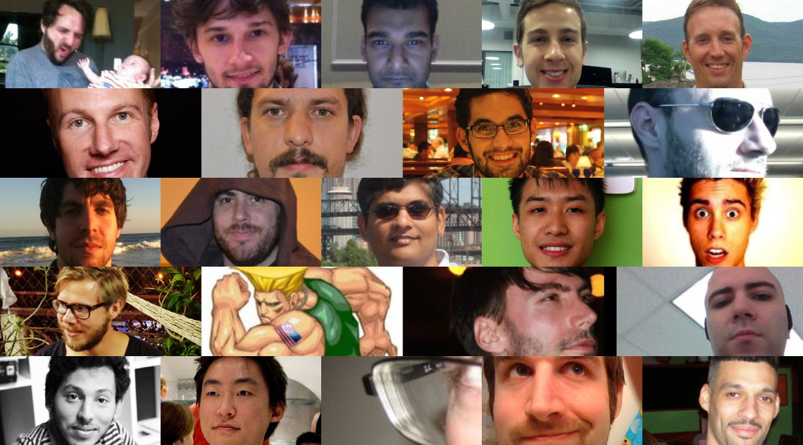
Teams are Scaling...
Notes:
This is what the team looked like in May 2014, just 5 months later, more than doubling in just 5 months. Growth for this team has slowed down substantially since then, but it’s picked up in similar ways for other teams.
Just think for a minute about what is involved for the people on this team to experience so much change so fast. You’re meeting new people on Monday and relying deeply on them by Wednesday. Scaling isn’t an abstract concept for the average Spotify engineer – if we get it right we make their life better, if we get it wrong it’s going to make for a very difficult experience for that person.

Slide 24
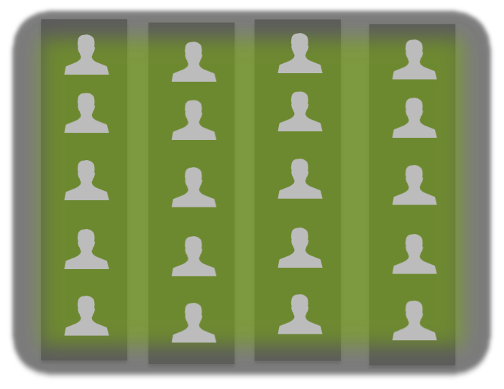
Release train, platform design, developer experience
Guild: Community of interest, cross tribes
Notes:
The last piece of the org structure is the least formal: the concept of guilds. Guilds are self-organizing communities of interest. There is a backend guild and a front end guild and an agile guild, but there are also language specific guilds, and a project management guild, and a CI/CD guild…
Guilds can be as lightweight as a mailing list or as substantial as a group that organizes trainings and even unconferences. Our data guild recently held an unconference attended by nearly 100 people in NYC.
Guilds tend to gain steam when something interesting is afoot and loose steam if they aren’t driving towards something concrete. It can be a little too easy to get sucked into a bunch of guild and other cross-org initiatives and find you don’t really have enough time to attend to your day job. Still, for the most part, Guilds are a great way to share information and experiences, and sometimes they help us get very important things done.

Slide 25
How’s this work? Pros:
High autonomy within tribes / squads
Clear missions within tribes / squads
Healthy tension between delivery and people management
Easy to spin up new parts of the org, model seems to continue to scale well
Initial signs that model can support fast restructuring
Notes:
Teams do retain a high degree of control over how they work day to day, and even a substantial degree over what they work on, though this differs widely
Both tribes and squads have clear missions that people general understand. At the tribe level, I think it’s also relatively easy to see how all the missions roll up together to form a whole.
On the best of days, there really can be a benefit to having managers whose primary concern is the happiness and growth of the members of their chapter. We don’t just tromp on someone’s needs in a rush to get something done, in part because there is a layer of the org dedicated to reminding us not to do that. Agile coaches often join Chapter Leads in this role.
The scaling aspect just works. We recently spun up two new tribes, mine included, and it was rather amazing how simple it was, everyone just sort of new the drill.
We’ve also got some sign that, as our scaling has slowed down a little bit recently, and we’re more likely to want to spin up a new tribe or a new squad by breaking it off from an existing part of the org, the model seems to support this well too.

Slide 26
How’s this work? Cons:
Hard to get things done across tribes
Squads (tribes) can outlive their usefulness
It can be hard for individuals to move between tribes
The matrix model can diffuse responsibility to an infuriating degree
Notes:
It can be difficult to get things done when it involves 2 or more tribes, though we’ve been doing a lot to improve on that recently.
Sometimes it feels like squads are sticking around because they’ve been around, not because they are still serving a particularly important mission. This situation doesn’t last forever, but it can last longer than it should. We experienced this at least once at the tribe level, though we eventually addressed it.
It can be harder for engineers to move across the org than either they or we might like it to be. Once Tribes hardened into things like cost centers, it became even more difficult.
The last con is common to most matrix organizations: Sometime there are just way too many decision makers around.
Right now we’re doing some experimentation with 5 teams that have essentially had all of the structure and constraints of the standard org structure removed from them, so we can see what emerges absent those constraints. I think our product people are mostly hoping that they are going to hit on the next 10x idea, but I’m really hopeful that we’re going to learn some interesting things that can help us tweak the way we organize to support teams.

Slide 27
Planning and Alignment
Notes:
That leads to the next thing I want to talk about today, which is work that my team, People Operations, is doing to experiment with how we establish a repeatable, broadly applicable model for planning, one that will help us work with greater alignment where it matters, without robbing teams of their agency.

Slide 28
The wages of autonomy
Haphazard guidance from above
Poor deployment of strategy once announced
Low visibility into progress and learning
Little sense of how to influence strategy productively
Lack of understanding of system-wide capacity
Teams don’t know how to apply priorities
Notes:
So this is a good place to tell you about the autonomy drinking game….
Here’s some of what we have been facing until very recently. With the exception of a few examples that proved the rule, like our shift to mobile, which has gone very well, or our role out of the mobile free tier, which has also been a huge success, it has been very difficult to make longer-horizon strategic decisions and see them actually have an impact on the ground level.
In fact often a pretty big shift in strategy would be announced and you’d see almost no sign of it on the ground. Even if it was having an impact in some corners of the organization, that impact wasn’t made visible.
Though Spotify remains a place where you can get Daniel or other members of senior leadership’s ear and make your case, it’s also true that we’ve lacked any formal structure or transparency that would give people confidence that they were being heard. You were welcome to scream to the rafters, but you’d have no way of knowing if you were screaming to the right people at the right time in the right room.
Because teams don’t have to follow any rules for making their own work visible to the org, we also have little sense of our actual capacity, which leaves us all in the dark about the breadth of problems we can tackle simultaneously.
And lacking clear guidance from above, teams have little context for prioritizing between things at a tactical level, where it’s easy to feel like every problem is as important as the next.

Slide 29
Awesome?
Alignment
Autonomy
Notes:
How’d we get here?
For much of Spotify’s history, I think Autonomy and Alignment have been thought of as opposite poles. We reached a point maybe a year or so ago, where I think this kind of thinking was actually starting to make life pretty hard both for the people responsible for guiding Spotify’s direction, but also for an engineer. For some time we’d been talking about squads as if they were little startups, if you see the early write ups on tribes and squads you’ll find that comparison being made there. But just as I think talking about full-blown companies as startups doesn’t make a great deal of sense, there came a time when it wasn’t really making sense for individual teams either. Because we hadn’t been attentive to alignment, we had things happening like infrastructure squads building tools that feature squads really needed but didn’t know about. We also had infrastructure squads building stuff that no one needed. We even had multiple teams working on the same problem without knowing it. We had other teams that desperately needed help but couldn’t figure out who they needed help from, or how to get on those people’s radar.
Finally, we had senior product and technical management who could see global problems or opportunities, but didn’t really have mechanisms to help steer the organization away from the problems or into the opportunities.

Slide 30
Alignment
Awesome!!!
Autonomy
Notes:
What I think is starting to happen now though, is that there is an emerging understanding that alignment and autonomy actually aren’t polar opposites. Pursued correctly, alignment can empower far more impactful and meaningful autonomy.
For a tactical example, I’ll return to the CAT project I mentioned earlier, in which we implemented a single look and feel across all of our interfaces. Part of that project was the creation of a version of Twitter Bootstrap that we call Glue that abstracted much of the unified design direction into a tool that any team can apply to something like 80% of the design problems they face. They don’t need to make a new button for every interaction, most of the time they just find what they need in glue and implement it. This means that they can invest more time and energy in unique and meaningful problems that we haven’t already solved.
The trick for us now is to keep figuring out how to stay true to the intent of autonomy while finding ways to make sure that we use autonomy to tackle the tough, fun problems, while using alignment to make sure we are headed in the right direction, and not wasting our time with boring problems. Having said that, we remain skeptical about how much uniformity you can effectively impose on squads made up of very different people with very different missions. We want our teams to still have a great degree of control over what they work on and how they work.
I want to talk next about some of the things we’re exploring at a more macro level to try to improve around alignment. Much of what I’m about to talk about is very much work in progress, not things that we have formally rolled out yet, but are currently experimenting with and getting feedback on.

Slide 31
Strategic Thinking
Data
Insights
Beliefs
Bets
DRAFT
Notes:
One of the most interesting things that is happening is that this model of strategic thinking appeared on the scene a couple of months ago, and like a lot of the best stuff at Spotify, it’s just taking hold because it works. I’m afraid I don’t know exactly where this model comes from, so if I’m failing to attribute it to the person who developed it, it’s only because I don’t know exactly who that is.
The model is pretty simple, and, at least given our early experience with it, incredibly useful. So, even though it starts with Data over on the left, what we’ve noticed is what decision science has known for a long time, which is humans start with beliefs. This framework sparks incredibly useful conversations in which people need to be explicit about the core beliefs that are guiding them to advocate specific bets, and they also need to explain what data they believe fuels the insights behind their beliefs.
This makes it much easier for us to challenge each other. Think someone’s being overly selective in the data they are highlighting, now it’s in black and white. Think someone’s misinterpreting the data? Now it’s in black and white. This is a lightweight model for making our positions explicit and easier to challenge, but also easier to get behind if they are super coherent.

Slide 32
Informed by everyone
Set By Lead Team
Lifecycle of 12-18 months
Core Beliefs
Strategic Framework
Informed by everyone
Set By Lead team and TPD Leadership
Lifecycle of 6-12 months
Strategic Bets
Informed by beliefs + bets
Set by Tribes + Squads
Lifecycle of 6-12 weeks
Projects and workstreams
Priorities
DRAFT
Notes:
One of the key things my team is working on is testing scaffolding for a strategic framework that should make it easier for people to understand how best to contribute to our most important goals.
What we’ve proposed is highly influenced by the work of a guy named Stephen Bungay. Bungay has done a lot of research around something called Mission Command in business settings. Mission Command comes from a military context. It was developed in the Prussian military in the mid and late 19th century, and it’s a system for planning and execution in conditions of high uncertainty and low communication, which I think are conditions that are often present in software and product development.
You can track down a talk I gave at LKNA in 2013 called Friction, Mission Command and Coherence, where I go into this in much more detail than I will here, but the gist of it is that we encounter so much friction in knowledge work that it is critical that we set a clear direction as an organization, and then all those who are close enough to the ground-truth to understand what is really happening day to day to make the critical decisions about how we get where we want to go.
This, of course, is easier said than done. Setting direction without trying to micro-manage things like what road we are going to take and what kind of car we are going to drive and where we are going to stop for dinner is a critical skill that most managers have not had the opportunity to develop. On the flip side, lots of teams sort of act like maybe they should just get in the car and start driving and maybe we’ll like where we end up.
So here’s what we’ve proposed, and I want to reiterate that this is still being discussed, so you’ll have to track me down at my next talk to see what happens with it, and you can see that is true because I put a little red DRAFT at the bottom, but I’ll run you through the key points quickly.
You can track down a talk I gave at LKNA in 2013 called Friction, Mission Command and Coherence, but the gist of it is that we encounter so much friction

Slide 33
Strategic Rhythm
Setting a cadence for the company
Regular, structured touch-points for alignment
Autonomy remains inside touch points
DRAFT
Notes:
Finally, we want to establish a predictable cadence for key elements of the strategic development and deployment process. Right not we have a grab bag of activities that happen at irregular cadences and in sub-optimal order. For example, we might run a hack week to generate new ideas a few weeks after doing a 6 month strategic planning exercise, instead of before. We’re calling this Tech Product and Design Rhythm, because we like music references.

Slide 34
The Spotify Way
Being Swemerican
Our work spaces
How we act when
things go right
How we got started
Who we hire
The roles we have
The tools we use
How we learn
Implicit rules
How we grow people
The words we use
$
The words we don’t use
How we have fun
Bringing music to the world !@#!@
Notes:
I want to wrap up in to what might be the most important part of this talk, the underlying culture at Spotify. When we go to conferences, or have people contact us asking to come visit, they often mention that they’ve heard about the Spotify way and that they want to learn how to execute on it. Here’s what I tell people who ask me about this.
First, I suggest you make sure you have amazing investors who are in it for the long haul, as well as a business model that actually generates revenue, because your going to need a lot of money to fund a culture that emphasizes long-term effectiveness over short term efficiency. Cash on hand is really critical, so make sure to have a lot of that.
Next, you should think about founding your company in Sweden, but open an office in NYC so you can get the perfect clash-up between Swedish collectivism and American capitalist individualism.
You should invent silly names for things that already have real names in the real world, to help build your sense of internal exceptionalism. A lot of smart people have noticed that really successful companies tend to be a little bit like cults, and Spotify is not an exception to this rule, so you better figure out how to emulate that as well.
You should hire a lot of young people with very little work experience, give them way too much freedom and not nearly enough access to experienced mentors. It’s worked out great for us, maybe it will work for you!
You should build a crew of professional agitators called Agile Coaches and send them around to poke their noses into everyone’s business.
I think you get my point. Our organization structure isn’t how we got where we are, we arrived at our organizational structure because of a ton of factors that add up to making us WHO we are. And to the degree that it’s been working for us, that’s also a result of who we are.

Slide 35
The Spotify Way
Being Swemerican
Our work spaces
How we act when
things go right
How we got started
Who we hire
The roles we have
The tools we use
How we learn
Implicit rules
How we grow people
The words we use
$
The words we don’t use
How we have fun
Bringing music to the world !@#!@
Notes:
You can see who we are in how we act when things go right, and we celebrate in ways that take into account the contribution that everyone has made to our successes. If something goes awesomely well, we often celebrate with a little champagne, and it’s not unusual for Daniel Ek, our CEO, to show up and share a glass with the engineers who did the work on the ground.
I don’t think I’ve heard a single example of the language of blame in my time at Spotify. I hear people talking about co-workers who seem to be struggling, but those conversations aren’t bitch sessions, they are attempts to figure out what we can do to help the person. When we talk about things that go wrong, we don’t seek to figure out whose fault it is, we seek to figure out where the system let us down. That doesn’t mean that we don’t foster a sense of personal responsibility. When you don’t play the blame game, people tend to be far more likely to be open about their own mistakes and failings – that makes it much easier to find ways of making sure we don’t make the same mistakes again.
I’ve also probably somewhat underplayed the culture of dissent at Spotify. I had a great story I wanted to tell about another org test we are running right now, but the people involved wanted me to wait because we haven’t shared this project with most of the company yet. The thing I like about the story is the role that two people are playing in it. One of them is advocating something he feels very strongly that we need, he’s been spearheading a project to design our approach to this thing since July, and it has the strong support of the CTO and many other members of Tech Leadership.

Slide 36
The Spotify Way
Being Swemerican
Our work spaces
How we act when
things go right
How we got started
Who we hire
The roles we have
The tools we use
How we learn
Implicit rules
How we grow people
The words we use
$
The words we don’t use
How we have fun
Bringing music to the world !@#!@
Notes:
As is often the case, we’ve been hashing this thing out in a google doc for months, it’s probably had a few thousand comments from maybe as much as 50 or more people. He’s getting pretty close to achieving consensus. Recently, however, someone who, btw, happens to rank lower than him in the org, has been raising a big red flag about this project. He’s got his own personal experience and a lot of research data, and he’s pretty sure that this thing could really have a bad impact on our org, maybe even damage the underlying culture. And so he’s been on something of a campaign, speaking directly with the project’s sponsor, and with other members of the team that has been guiding it, but also with influential people who have been sitting on the sidelines. No one is telling this guy to shut up, either subtlety or not. He feels no compunction to stay under the radar with his concerns, he’s broadcasting them in the open. And the project sponsor isn’t trying to brush him under the rug. He’s taking his concerns seriously – he’s broadcasting them to Tech Leadership and making his case for why he thinks the other guys worst predictions are not going to come to pass. These guys disagree – a lot. They probably aren’t going to come to agreement. At some point, the person who is against this thing is going to decide to dissent but commit. And the reality is that I think the fact that this guy exists, and that it is so safe for him to dissent, is why I think there is very little chance that his worst fears will come to pass. What’s more, I think the project’s sponsor probably believes that as well. As long as people feel safe speaking up loudly, and as long as we can have civil, constructive, productive conversations that general leave us pursuing better approaches, I think we’re going to keep growing up the right way.
Finally, I think it’s worth noting what we do for a living. We’re trying to bring music to the world. We’re kind of selling digital joy. It’s fun to have friends who tell you how much they love your product. It’s fun to love using your product. It’s fun to get free tickets to awesome concerts. Who we are can’t be separated from what we build. I don’t know what this will mean for you and your work, but I know it’s a key factor in who we are, and how we are managing to scale while staying true to that.
You can have the best organizational structure in the world, you can use the best tools, you can even hire the best people, but your culture, and your outcomes, will be a function of everything from the product you make, the customers you seek, the way your senior people behave when the going is great or when the going gets tough, and whether you are operating under conditions of scarcity or plenty. To pretend otherwise is dangerous, and to seek to adopt principles or practices that work well for other companies given their basket of conditions is risky business, particularly if you don’t spend time exploring those underlying conditions and comparing them to your own.

Slide 37
Spotify is growing up, with…
A culture of openness, feedback and even dissent
Optimized for lots of ideas, personal growth, long term effectiveness…
Challenged to find better ways of moving faster, learning more, making it easier to get things done.
Notes:
If you take a lesson away from here today I don’t want it to be: Spotify does it this way so we should too. I hope what you take away is a story about a company that has invested heavily in understanding and building on the things we care about in our culture. and one that makes conscious choices about what to optimize, and what gets de-optimized along the way. I hope you’ve also gotten a sense of what it’s really like inside Spotify. Lastly, I hope you’ve gotten a sense of how even a professional skeptic like me could come to love a place like Spotify – how many companies are going to pay me to fly across the country to tell you about everything we are doing wrong?

Slide 38
Want More?
Spotify’s Blog: http://labs.spotify.com/
My Twitter: @lycaonmarcus
Feedback: sayat.me/lycaonmarcus
Notes:
Thanks very much, I hope you’ve gotten something good out of this, I’d love to hear your feedback!

