Slide 1
Software Development & Arch @ LinkedIn
Sid Anand
QCon SF 2014
@r39132

Slide 2





About Me
Current Life…
Chief Architect @ ClipMine, a video discovery company
QCon SF Program Committee member
Dad to a very energetic 2 year old boy
Previous Life…
Architect in Search and Distributed Data @ LinkedIn
Cloud Data Architect @ Netflix
VP Engineering at Etsy
Software Developer at eBay
*
2
Notes:
2

Slide 3
A Closer Look @ LinkedIn
3
Notes:
For us, fundamentally changing the way the world works begins with our mission statement: To connect the world’s professionals to make them more productive and successful.
This means not only helping people to find their dream jobs, but also enabling them to be great at the jobs they’re already in.
3

Slide 4

LinkedIn
Then
  Created in 2002 in Reid Hoffman’s living room
  In its first month of operation, LinkedIn added 4500 members!
*
***
4
Notes:
4

Slide 5
LinkedIn
Then
  Created in 2002 in Reid Hoffman’s living room
  In its first month of operation, LinkedIn added 4500 members!
Now
  332M members in 200 countries
  2 members sign up every second
  >60% of members overseas
    In Q3’14, 75% of new members came from overseas
*
5
Notes:
5

Slide 6
LinkedIn
Then
  Created in 2002 in Reid Hoffman’s living room
  In its first month of operation, LinkedIn added 4500 members!
Now
  332M members in 200 countries
  2 members sign up every second
  >60% of members overseas
    In Q3’14, 75% of new members are coming from overseas
  Fastest growing demographic is not geographic, it’s students!
    > 10% of user base already and growing!
*
6
Notes:
6

Slide 7
LinkedIn
Member-growth started to ramp up during 2011, when we IPO’d
2010 : 55M
2011 : 90M (IPO)
2012 : 145M
Q3’14 : 332M
(note : numbers reflect start of year)
We added ~ same number of users in 2010 than over previous 6 years!
*
7
Notes:
7

Slide 8
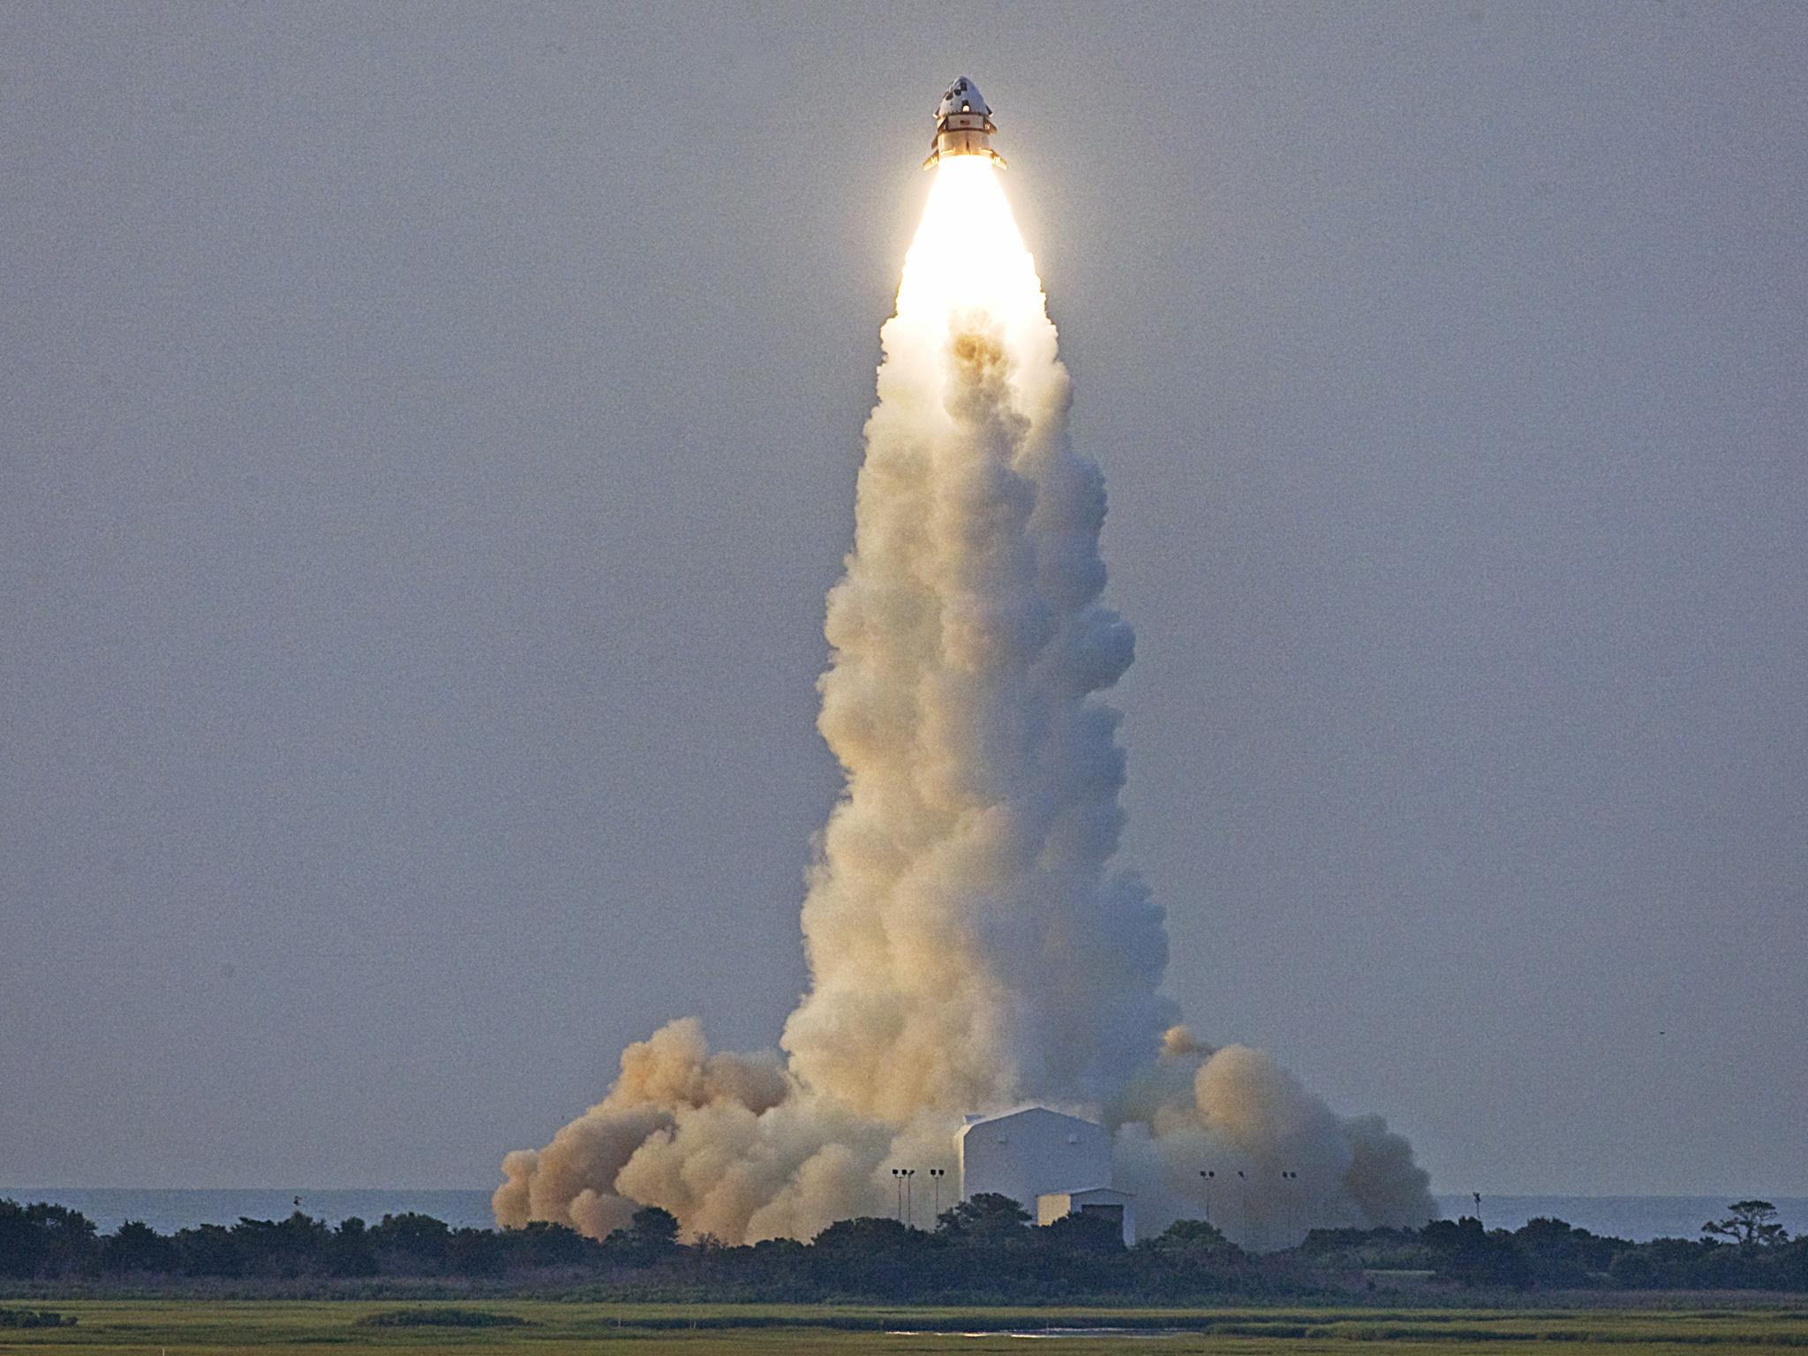
LinkedIn
Employee-growth also started to ramp up during 2011
2010 : 500
2011 : 1K (IPO)
2012 : 2100
Q3’14: 6K (25% in Engineering)
(note : numbers reflect start of year)
*
***
8
Notes:
8

Slide 9
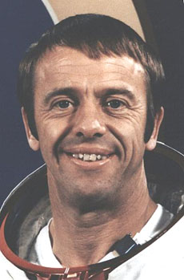
9
Notes:
9

Slide 10
Alan Shepard
2nd man in space
5th person to walk on the moon!
1st person to hit a golf ball on the moon!
10
Notes:
10

Slide 11
LinkedIn
When asked by reporters what he thought about while awaiting liftoff, he replied: "The fact that every part of this ship was built by the lowest bidder"
11
Notes:
11

Slide 12
How did LinkedIn scale for company and member growth?
12
Notes:
For us, fundamentally changing the way the world works begins with our mission statement: To connect the world’s professionals to make them more productive and successful.
This means not only helping people to find their dream jobs, but also enabling them to be great at the jobs they’re already in.
12

Slide 13
Software Development
Challenges
13
Notes:
For us, fundamentally changing the way the world works begins with our mission statement: To connect the world’s professionals to make them more productive and successful.
This means not only helping people to find their dream jobs, but also enabling them to be great at the jobs they’re already in.
13

Slide 14



Software Development : Challenges
Circa 2011
On my first day at LinkedIn, I felt pretty excited!
Linux Desktop
8 Core
64GB Ram
Mac Air

Slide 15


Software Development : Challenges
Circa 2011
On my first day at LinkedIn, I felt pretty excited!
Linux Desktop
8 Core
64GB Ram
Mac Air

Slide 16


Software Development : Challenges
Circa 2011
Then I tried to compile the code on my laptop!
Linux Desktop
8 Core
64GB Ram
Mac Air

Slide 17
Software Development : Challenges
Circa 2011
300+ code projects in a single SVN Repo
  SVN checkout world & go-to-lunch
Needed a server-grade machine to compile it!
  Ant build (world) & go-make-espresso
    Almost every WAR was built from source not intermediate JARs
To test your code locally, you needed to locally deploy every service that your code depended on! (maybe 20)
  So, yes, you need a machine that typically lives in your data center!
Notes:
It could take 3 hours to write and test code and 3 days to get it successfully committed and built!

Slide 18
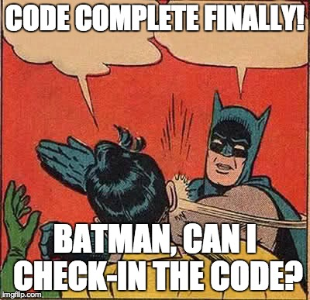
Software Development : Challenges
Circa 2011
Assume that your code is now
  Written
  Compiled
  Locally Tested
What Next?
Notes:
It could take 3 hours to write and test code and 3 days to get it successfully committed and built!

Slide 19
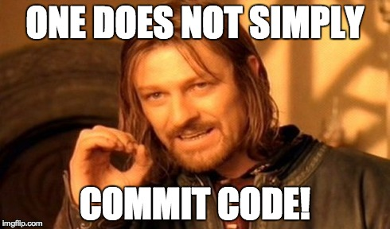
Software Development : Challenges
Circa 2011
500+ developers were checking code into the master branch on the single repo!
  So, someone broke master every day!
  So
    3 hours to write, build, and locally test code
    3 days to commit it!
Notes:
It could take 3 hours to write and test code and 3 days to get it successfully committed and built!

Slide 20

Software Development : Challenges

Slide 21

Software Development : Challenges
Now (Solved)
Do what the open-source world does with some improvements!
  Break the monolithic repo into many individual Git Repos!
  Have WARs depend on intermediate JARs – don’t not build the world!
  Do not deploy the world for local testing – just connect your Dev machine to a test environment!
  What are the improvements?

Slide 22
Software Development
Life Cycle
22
Notes:
For us, fundamentally changing the way the world works begins with our mission statement: To connect the world’s professionals to make them more productive and successful.
This means not only helping people to find their dream jobs, but also enabling them to be great at the jobs they’re already in.
22

Slide 23





Software Development
Code Reviews
Alice commits code to Git
Alice sends a Review Board request to Bob & Cathy, owners of the files!
Both Bob & Cathy give ship-its
Alice amends her commit message with :
RB=<review board id>
BUILD-WAR=<list of wars to build>

Slide 24


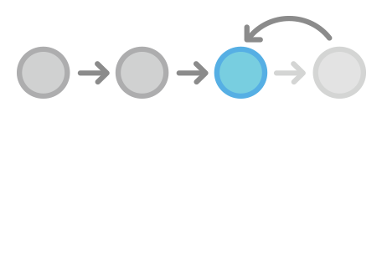
Software Development
Code Push (Git Push)
Alice pushes code to our Gitorious server where the following verifications:
  Pre-push Sanity Checks! Must pass of push rejected!
    Have all owners of the changed files given ship-its?
    Does the code build?
  For JAR builds, also build upstream WARs!
  Run Integration Tests!

Slide 25


Software Development
QA
Test / Staging
Assuming that all checks passed, the WAR is now available
Our system automatically deploys all wars to test servers
QA verifies the new builds

Slide 26



Software Development
Production - Canary
Service owner Dave canaries the new WAR
Our EKG system then compares the canary machine to one control machine for 1 hour of product traffic for the following:
  CPU, Memory increase
  Fan-in/Fan-out increase
  Error rate increase
  Latency increase

Slide 27

Software Development
Production - Promotion
Service owner Dave reviews the EKG report
If it looks acceptable, he promotes the build to the rest of the cluster in all data centers

Slide 28
How did LinkedIn scale for company and member growth?
28
Notes:
For us, fundamentally changing the way the world works begins with our mission statement: To connect the world’s professionals to make them more productive and successful.
This means not only helping people to find their dream jobs, but also enabling them to be great at the jobs they’re already in.
28

Slide 29
Architectural
Practices
29
Notes:
For us, fundamentally changing the way the world works begins with our mission statement: To connect the world’s professionals to make them more productive and successful.
This means not only helping people to find their dream jobs, but also enabling them to be great at the jobs they’re already in.
29

Slide 30

LinkedIn Architecture
Proto-typical Use – Case
A member updates her profile with new skills, job title, and education
She also accepts a connection request from another member
Behind the scenes
Web servers commit data to Oracle
What Happens Next?
Web Servers
Oracle

Slide 31
LinkedIn Architecture
What Happens Next?
Profile Updates
She should should become instantly searchable by her new skills, job title, & education!
New groups and job ads should be recommended to her
Connection Updates
The news feed should instantly reflect content updates from her new connection!
Also, based on the new connection, the PYMK widget should discover a new 2nd degree neighborhood!
Web Servers
Oracle

Slide 32
LinkedIn Architecture
Streams
Downstream
Web Servers
(writers)
DW
Search
Oracle
Databus
Caches
Graph
Recommender Systems (PYMK, Jobs)

Slide 33
LinkedIn : Architecture
We also have a data pipeline to capture high-throughput events that we need to count!
Databases are not a good place to do high-TP atomic counting!
Kafka is!
This is typically used for ranking signals
  E.g. counts member page views to determine who are “hot”

Slide 34
LinkedIn Architecture
Streams
Downstream
Web Servers
(writers)
DW
Kafka
Search Systems
Oracle
Databus
Caches
Graph Systems
Recommender Systems

Slide 35

LinkedIn Architecture : Single Data Center!

Slide 36
LinkedIn : Architecture : Single Data Center!
Notes:
2 Major Reasons 2 have MDC:
What happens if a DC goes down!
Planned : PL/SQL (Triggers, Stored Procedures) cannot be updated online. Can’t do a rolling push for every thing! MySQL upgrade!
Unplanned : Bad code push, power outage, network outage
Need to scale beyond your current DC
DC have a fixed max capacity!
Also, sometimes it becomes important to have close proximity to users

Slide 37
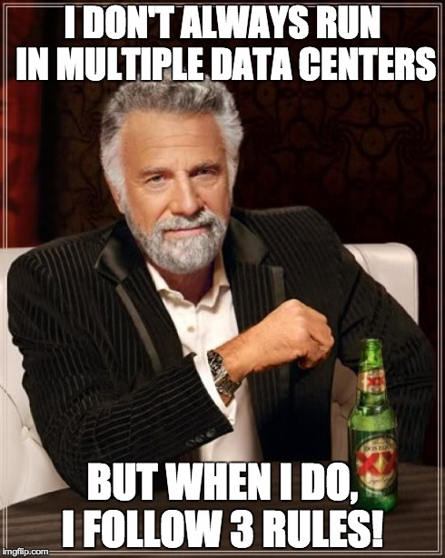
LinkedIn : Architecture : Multi-data Center Project
Notes:
When I think about data centers going down, I think about drinking.. Dos equis beer specifically! And then I listen the advice of this man!

Slide 38
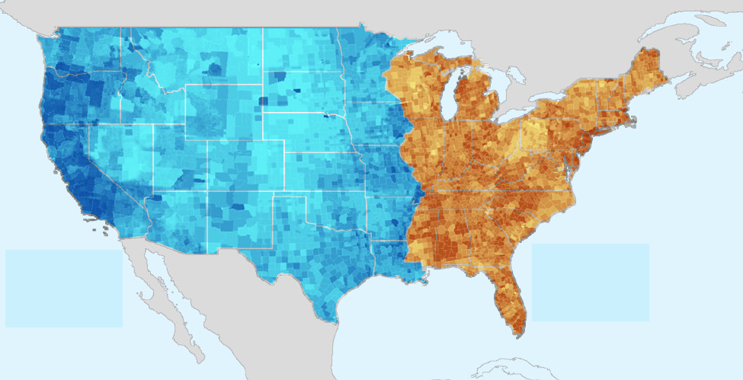
LinkedIn Architecture : Rule 1
Partition your user base across the data centers!
e.g. using Akamai GTM

Slide 39


LinkedIn Architecture : Rule1
Problem!
User 1 (mapped to DC1) updates his profile! How will User 2 (mapped to DC2) see it?

Slide 40
LinkedIn Architecture : Rule 2
Link your data centers together at the data fabric level!
Not a new concept! Cassandra has been doing it for a few years now in the OLTP database space!

Slide 41


LinkedIn Architecture : Rule 2
Link your data centers together at the data fabric level!
Not a new concept! Cassandra has been doing it for a few years now in the OLTP database space!
LinkedIn’s Sources of Truth →
We have to make both work in across multiple data centers!

Slide 42
LinkedIn Architecture : Rule 2
Link your data centers together at the data fabric level!
Not a new concept! Cassandra has been doing it for a few years now in the OLTP database space!
LinkedIn’s Sources of Truth →
We have to make both work in across multiple data centers!
Oracle is fairly easy : we use Oracle Golden-gate!
Kafka is also pretty easy!

Slide 43
LinkedIn : Kafka Multi-Data Center
Kafka Data Center 1
Producer
Kafka Local
Consumer
of Local Events

Slide 44
LinkedIn : Kafka Multi-Data Center
Kafka Data Center 1
Kafka Data Center 2
Producer
Producer
Kafka Local
Kafka Local
Consumer
of Local Events
Consumer
of Local Events

Slide 45

LinkedIn : Kafka Multi-Colo
Kafka Data Center 1
Kafka Data Center 2
Producer
Producer
Kafka Local
Kafka Local
Consumer
of Local Events
Consumer
of Local Events
Consumer
of Global Events

Slide 46
LinkedIn : Kafka Multi-Colo
Kafka Data Center 1
Kafka Data Center 2
Producer
Producer
Kafka Local
Kafka Local
Kafka Global
Consumer
of Local Events
Consumer
of Local Events
Consumer
of Global Events

Slide 47
LinkedIn : Kafka Multi-Colo
Kafka Data Center 1
Kafka Data Center 2
Producer
Producer
Kafka Local
Kafka Local
Kafka Global
Kafka Global
Consumer
of Local Events
Consumer
of Local Events
Consumer
of Global Events
Consumer
of Global Events

Slide 48
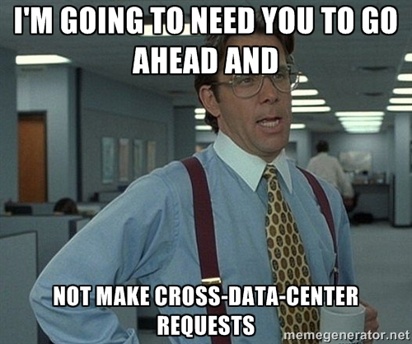
LinkedIn Architecture : Rule 3
Don’t make any web service calls between data centers!
It kills latency, which kills availability!

Slide 49

LinkedIn : Architecture

Slide 50
How did LinkedIn scale for company and member growth?
50
Notes:
For us, fundamentally changing the way the world works begins with our mission statement: To connect the world’s professionals to make them more productive and successful.
This means not only helping people to find their dream jobs, but also enabling them to be great at the jobs they’re already in.
50

Slide 51
LinkedIn Search
51
Notes:
For us, fundamentally changing the way the world works begins with our mission statement: To connect the world’s professionals to make them more productive and successful.
This means not only helping people to find their dream jobs, but also enabling them to be great at the jobs they’re already in.
51

Slide 52
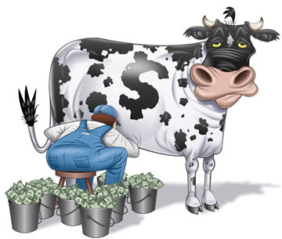
LinkedIn Search
Why is Search important to LinkedIn?
Search is a significant income driver!
  332M members that recruiters pay to find! (Recruiter Search)
  2M+ jobs that companies pay to list so you can find them! (Job Search)

Slide 53
What Makes LinkedIn Search Unique?
53
Notes:
For us, fundamentally changing the way the world works begins with our mission statement: To connect the world’s professionals to make them more productive and successful.
This means not only helping people to find their dream jobs, but also enabling them to be great at the jobs they’re already in.
53

Slide 54
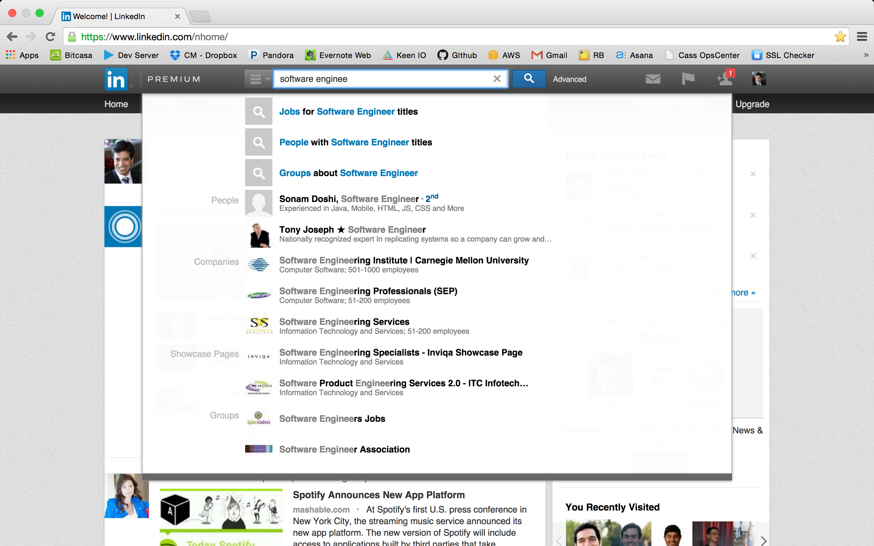
LinkedIn Search : Federated

Slide 55
LinkedIn Search : Federated
We index many entities
  members, jobs, companies, groups, universities, articles, slides, etc..
  These are separate (vertical) search-engines!
Notes:
We approach this by targeting specific verticals using our Intent Detection Algorithm!
E.g. john smith looks like a person, only hit member index
E.g. IBM looks like a company or a job title in members or in jobs, hit company, member, and jobs
E.g. Stanford looks like a university that someone works at, attended —> hit university, company, member
E.g. Software Engineer : if we infer user is a recruiter or hiring manager, show candidates, else show jobs!

Slide 56
LinkedIn Search : Federated
We index many entities
  members, jobs, companies, groups, universities, articles, slides, etc..
  These are separate (vertical) search-engines!
When a user enters “sr software engineer”, which index should we look in?
  Jobs, members, groups?
Notes:
We approach this by targeting specific verticals using our Intent Detection Algorithm!
E.g. john smith looks like a person, only hit member index
E.g. IBM looks like a company or a job title in members or in jobs, hit company, member, and jobs
E.g. Stanford looks like a university that someone works at, attended —> hit university, company, member
E.g. Software Engineer : if we infer user is a recruiter or hiring manager, show candidates, else show jobs!

Slide 57
LinkedIn Search : Federated
We index many entities
  members, jobs, companies, groups, universities, articles, slides, etc..
  These are separate (vertical) search-engines!
When a user enters “sr software engineer” , which index should we look in?
  Jobs, members, groups?
Can we simply send the request to all of the search engines and then show the most relevant results?
  No
    Ranks (scores) are not comparable across verticals
Notes:
We approach this by targeting specific verticals using our Intent Detection Algorithm!
E.g. john smith looks like a person, only hit member index
E.g. IBM looks like a company or a job title in members or in jobs, hit company, member, and jobs
E.g. Stanford looks like a university that someone works at, attended —> hit university, company, member
E.g. Software Engineer : if we infer user is a recruiter or hiring manager, show candidates, else show jobs!

Slide 58
LinkedIn Search : Federated
We index many entities
  members, jobs, companies, groups, universities, articles, slides, etc..
  These are separate (vertical) search-engines!
When a user enters “sr software engineer” , which index should we look in?
  Jobs, members, groups?
Can we simply send the request to all of the search engines and then show the most relevant results?
  No
    Ranks (scores) are not comparable across verticals
What if we pick a vertical based on a user feature?
  Job seeker sees jobs, recruiter sees members
Intent Detection : done by Federator
Notes:
We approach this by targeting specific verticals using our Intent Detection Algorithm!
E.g. john smith looks like a person, only hit member index
E.g. IBM looks like a company or a job title in members or in jobs, hit company, member, and jobs
E.g. Stanford looks like a university that someone works at, attended —> hit university, company, member
E.g. Software Engineer : if we infer user is a recruiter or hiring manager, show candidates, else show jobs!

Slide 59
LinkedIn Search : Query Rewriting
Say a recruiter searches for “sr software eng”
  There are 20+ ways to represent this title
    senior swe
    sr swe
    senior software engineer
Notes:
R2
User types in “Senior software Engineer”, but member represent this title in 20+ different ways!
sr swe, senior swe, senior software eng, etc..
To solve this, we have a title standardizer! However, it may not standardize for every title.
So, we need to rewrite the query before hitting Lucene, our core search engine!
title:senior AND title:software AND title:engineer
if standardized title exists,
stdtitle:sswe2331
This is also called synonym expansion!
So, we need some smart rewriter!
Rewriters also handle spelling correction!
“Senior sofware Enginer” —> “Senior software Engineer”
The goal is to expand the search space and to also sometimes target results for more efficient retrieval

Slide 60
LinkedIn Search : Query Rewriting
Say a recruiter searches for “sr software eng”
  There are 20+ ways to represent this title
    senior swe
    sr swe
    senior software engineer
  To solve this, we can use a title standarizer, though not every title may have a canonical form!
  If a standardized title exists, we can rewrite the user query
    title:sr AND title:software AND title:eng → std_title:sswe234
Notes:
R2
User types in “Senior software Engineer”, but member represent this title in 20+ different ways!
sr swe, senior swe, senior software eng, etc..
To solve this, we have a title standardizer! However, it may not standardize for every title.
So, we need to rewrite the query before hitting Lucene, our core search engine!
title:senior AND title:software AND title:engineer
if standardized title exists,
stdtitle:sswe2331
This is also called synonym expansion!
So, we need some smart rewriter!
Rewriters also handle spelling correction!
“Senior sofware Enginer” —> “Senior software Engineer”
The goal is to expand the search space and to also sometimes target results for more efficient retrieval

Slide 61
LinkedIn Search : Query Rewriting
Say a recruiter searches for “sr software eng”
  There are 20+ ways to represent this title
    senior swe
    sr swe
    senior software engineer
  To solve this, we developed a title standarizer!
  If a standardized title exists, we can rewrite the user query
    title:sr AND title:software AND title:eng → std_title:sswe234
  Query Rewriting helps by expanding the search space by methods such as synonym expansion, spell correction, etc… So we need it!
Notes:
R2
User types in “Senior software Engineer”, but member represent this title in 20+ different ways!
sr swe, senior swe, senior software eng, etc..
To solve this, we have a title standardizer! However, it may not standardize for every title.
So, we need to rewrite the query before hitting Lucene, our core search engine!
title:senior AND title:software AND title:engineer
if standardized title exists,
stdtitle:sswe2331
This is also called synonym expansion!
So, we need some smart rewriter!
Rewriters also handle spelling correction!
“Senior sofware Enginer” —> “Senior software Engineer”
The goal is to expand the search space and to also sometimes target results for more efficient retrieval

Slide 62
LinkedIn Search : Flexible Scoring
We index many entities!
  Companies, Members, Universities, etc…
We use different scoring formulas and signals for each vertical
We need a way to easily plug-in different custom scorers!
Notes:
R3
Flexible scoring/ranking per vertical!
For example, if you have heard about search, then you have heard about TF-IDF, a measure of how well a document matches a search query based on text in both query and document! This is typically used for ranking in web search.
However, we are doing entity search across a social graph!
If you search for “Mark”, we don’t just show all people named Mark! We can only show results in your 1-2-3 degree network!
We prioritize results based on a combination of social network signals and text similarlity (TF-IDF)
For example, we sort results by connect weight : the % of first degree connections the searcher has in common with each retrieved member!

Slide 63
LinkedIn Search : Open Source
Leading open source alternatives (e.g. Lucene, ElasticSearch, SOLR) do not offer these!
  Search Federation
  Pluggable Query Rewriting
  Pluggable and Flexible Scoring
They DO offer some distributed system management, which we will have to re-invent unfortunately
Notes:
We approach this by targeting specific verticals using our Intent Detection Algorithm!
E.g. john smith looks like a person, only hit member index
E.g. IBM looks like a company or a job title in members or in jobs, hit company, member, and jobs
E.g. Stanford looks like a university that someone works at, attended —> hit university, company, member
E.g. Software Engineer : if we infer user is a recruiter or hiring manager, show candidates, else show jobs!

Slide 64
LinkedIn Search : Open Source
Leading open source alternatives (e.g. Lucene, ElasticSearch, SOLR) do not offer these!
  Search Federation
  Pluggable Query Rewriting
  Pluggable and Flexible Scoring
They DO offer some distributed system management, which we will have to re-invent unfortunately
So, we created Galene, LinkedIn’s new search architecture!
  https://engineering.linkedin.com/search/did-you-mean-galene
Notes:
We approach this by targeting specific verticals using our Intent Detection Algorithm!
E.g. john smith looks like a person, only hit member index
E.g. IBM looks like a company or a job title in members or in jobs, hit company, member, and jobs
E.g. Stanford looks like a university that someone works at, attended —> hit university, company, member
E.g. Software Engineer : if we infer user is a recruiter or hiring manager, show candidates, else show jobs!

Slide 65

y Questions?
65
Notes:
For us, fundamentally changing the way the world works begins with our mission statement: To connect the world’s professionals to make them more productive and successful.
This means not only helping people to find their dream jobs, but also enabling them to be great at the jobs they’re already in.
65

Slide 66
Bonus Slides
66
Notes:
For us, fundamentally changing the way the world works begins with our mission statement: To connect the world’s professionals to make them more productive and successful.
This means not only helping people to find their dream jobs, but also enabling them to be great at the jobs they’re already in.
66

Slide 67
Galene Architecture
67
Notes:
For us, fundamentally changing the way the world works begins with our mission statement: To connect the world’s professionals to make them more productive and successful.
This means not only helping people to find their dream jobs, but also enabling them to be great at the jobs they’re already in.
67

Slide 68
Galene Architecture : Querying
Browser
Frontend
Query Intent Detection
Result Blending
Federator
Query Rewriting (Pluggable)
Scatter-gather across shards
Vertical
Broker
Other
Verticals
….
Lucene (optionally sharded)
Scoring (Pluggable)
Vertical Search Node

Slide 69
Galene Architecture : Indexing (Offline)
Batch-oriented, built daily
  Builds offline ranking and rewriting models
  Rebuilds Indexes when new fields added
Browser
Frontend
Federator
Vertical
Broker
Vertical Search Node
Hadoop
Offline Index Building and Distribution
Index Distribution Service
Vertical Indexer Node

Slide 70
Galene Architecture
Bit-Torrent-based Index Distribution Service
  Pushes new indexes and models to running services
Browser
Frontend
Federator
Vertical
Broker
Vertical Search Node
Hadoop
Offline Index Building and Distribution
Index Distribution Service
Vertical Indexer Node

Slide 71
Galene Architecture
Online (near-real-time) indexer
  Updates indexes between Hadoop builds
Browser
Frontend
Federator
Samza
Vertical
Broker
Vertical
Live Updater
Databus
Kafka
Kafka
Vertical Search Node
Online Index Updates
Hadoop
Index Distribution Service
Vertical Indexer Node

Slide 72
Galene Architecture
Browser
Frontend
Federator
Samza
Vertical
Broker
Vertical
Live Updater
Databus
Kafka
Kafka
Vertical Search Node
Hadoop
Snapshots live data into a compact format
Send ss-index to search nodes over bit-torrent
Index Distribution Service
Vertical Indexer Node
Periodic Index Optimization

Slide 73
y Questions?
73
Notes:
For us, fundamentally changing the way the world works begins with our mission statement: To connect the world’s professionals to make them more productive and successful.
This means not only helping people to find their dream jobs, but also enabling them to be great at the jobs they’re already in.
73

