Slide 1
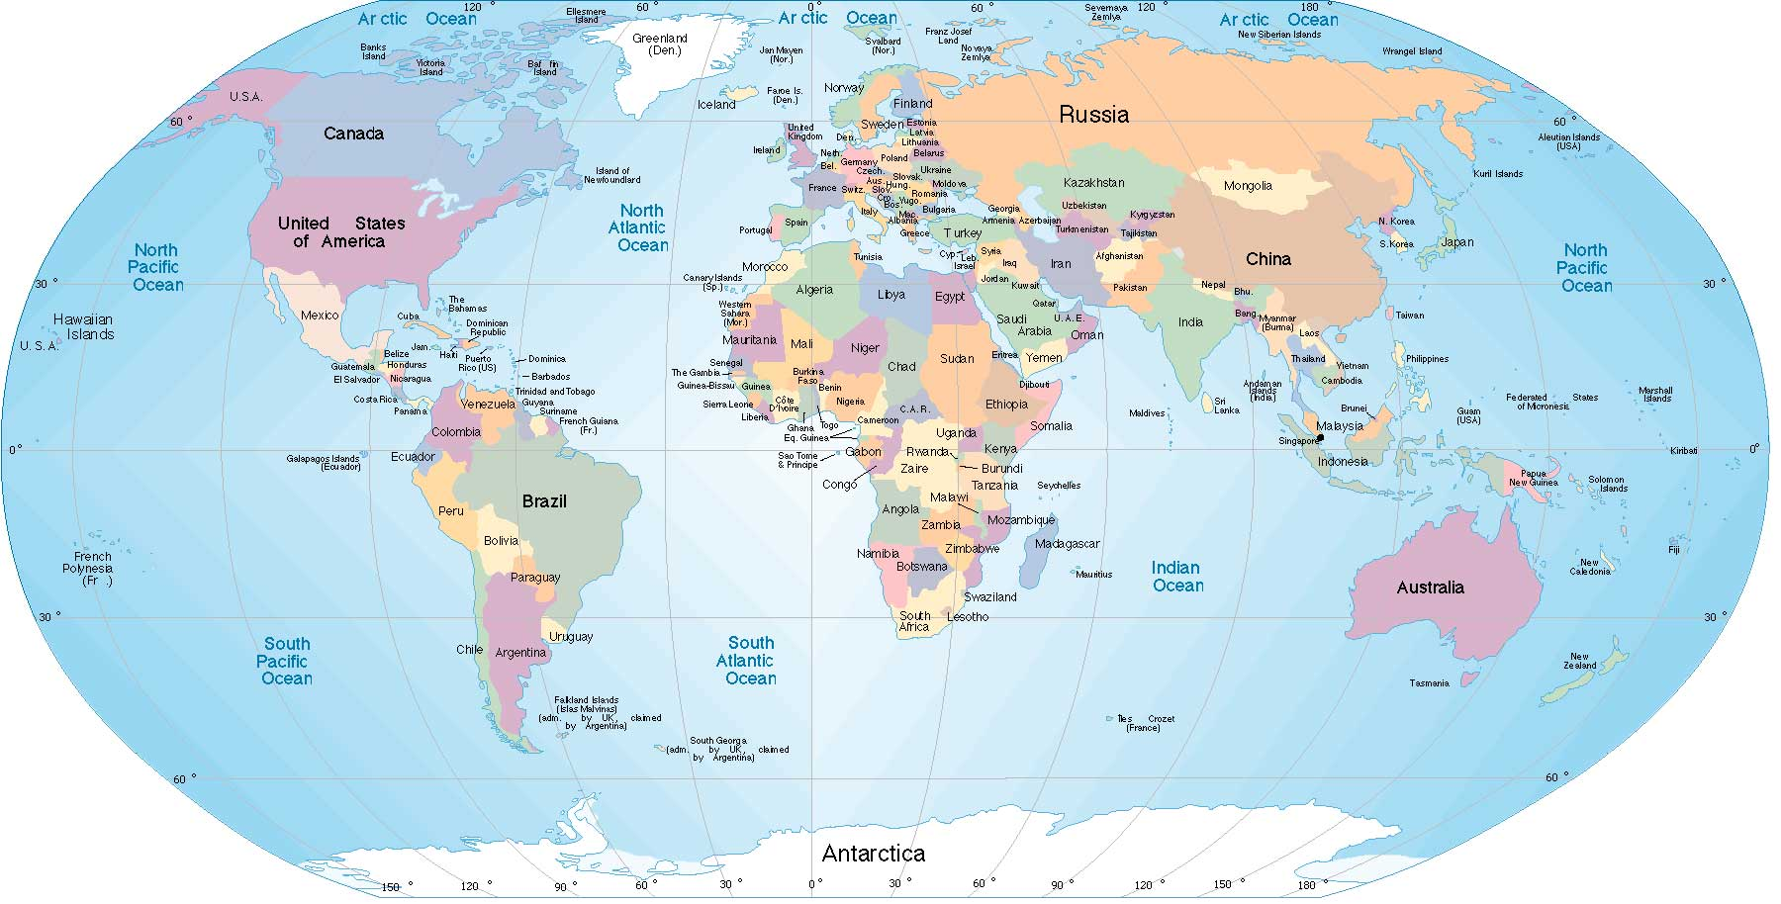
Building Groupon’s Global Engineering Culture
Sri Viswanath
SVP of Engineering and Operations, Groupon

Slide 2
Groupon Growth

Slide 3
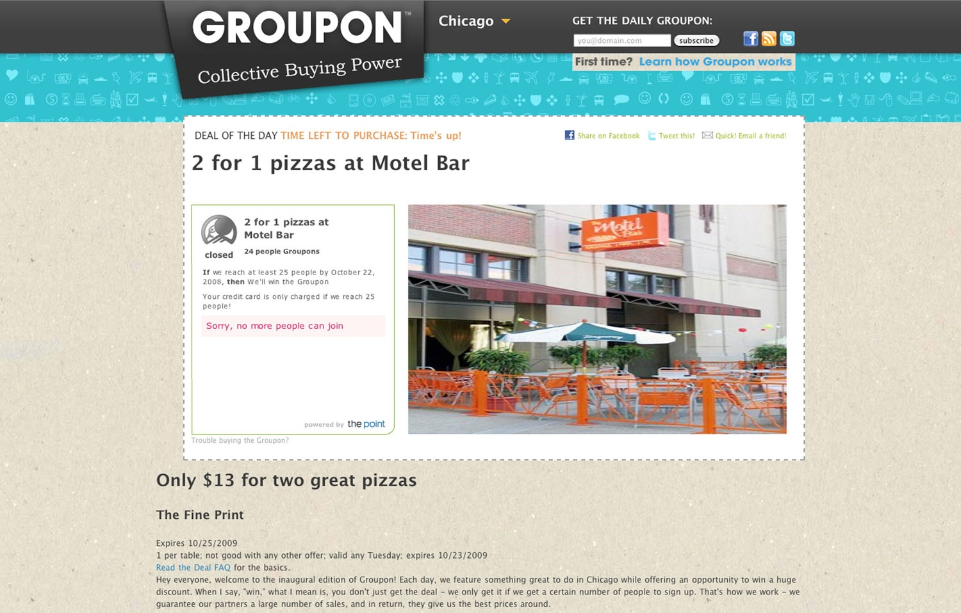
November 2008

Slide 4
2008
10 Employees

Slide 5
2010
300+ Employees

Slide 6
2012
10,000+ Employees

Slide 7
Groupon is the leader in local commerce,
making it easy for people around the world to search and discover great businesses at unbeatable prices.
WORLDWIDE
250M+ subscribers nearly 53M active customers 500+ markets
$7b+ in annual billings 600M+ deals sold nearly 12,000 global employees
Source: Internal data,, June 2014

Slide 8
Building Groupon’s Global Engineering Culture

Slide 9
Org culture
behavior of humans within an organization and the meaning that people attach to those behaviors.
Includes organization's vision, values, norms, systems, symbols, language, assumptions, beliefs, and habits.

Slide 11
Megamind
Gnome
Seamless Redemption
G2
Snap
Breadcrumb
SmartDeals
Widgets
Getaways
G3
Ideel
PULL
iTier
Freebies
Sidetour
Mobile
RTR
Basics
bPOS
Deal builder
Hotels
Payments
Nearby
Goods
Gift Cards
Stores
CRM
Shopping Cart

Slide 13
Team Ethos

Slide 14
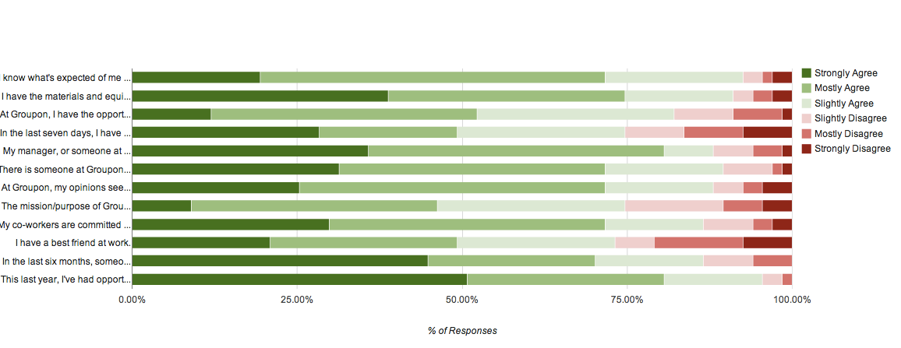

Slide 15
Connection
Excellence
Autonomy
Principles

Slide 16
GEEKon Global Internal Hackathon

Slide 17
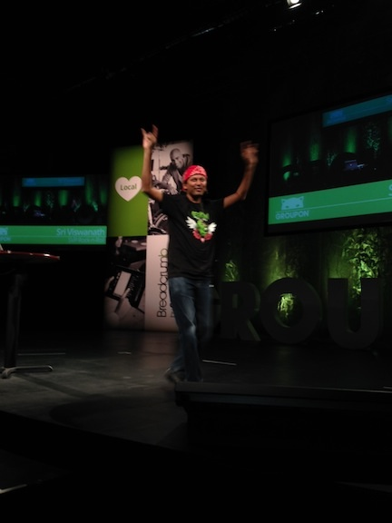
GEEKon Global Internal Hackathon
275+ techies from 8 countries on 5 continents spent 96 consecutive hours hacking = 106 projects

Slide 18
GEMs Mentoring Program

Slide 19
By The Numbers

Slide 20
Mentor/Mentee Retro Feedback
Quoted Highlights.
I liked that the mentor was entirely removed from mentee’s org tree.
I learned different philosophies and work practices. I learned a different perspective on how to manage frustrations.
Slightly surprised at what I was able to share and that it was so high impact. I was able to add value in places I didn’t expect to.
This highlighted some of the org challenges to me; I was able to help increase competency in how to work at a company like Groupon.
It was good to have someone who followed up with me during a change of manager.

Slide 21
Build a real tech ladder

Slide 22
Innovation & Execution

Slide 23
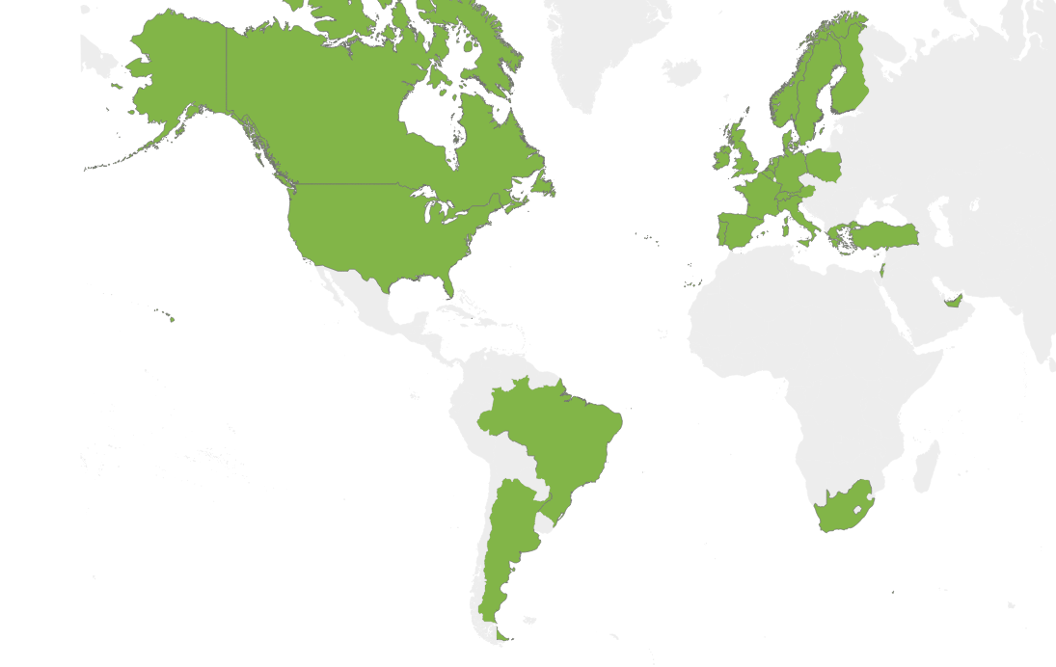
I-Tier: Serving 25 Countries and Growing

Slide 24
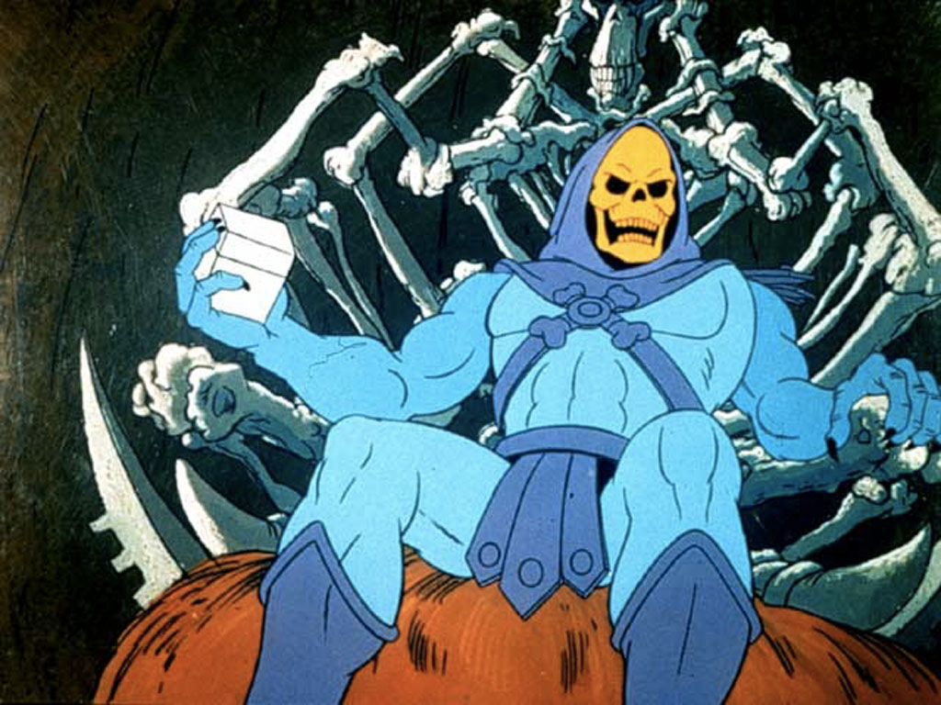
Internal “open sourcing” – Eg: Skeletor

Slide 25
How do you create
a true Data Driven culture?

Slide 26
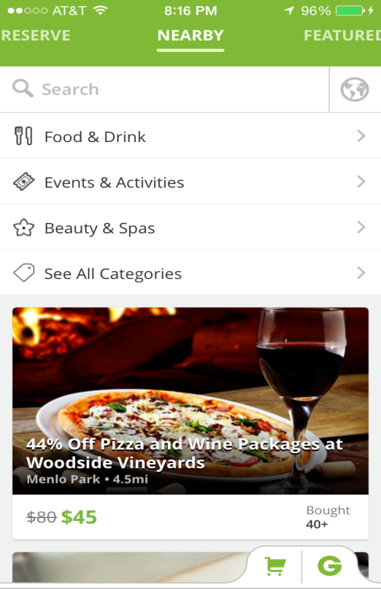
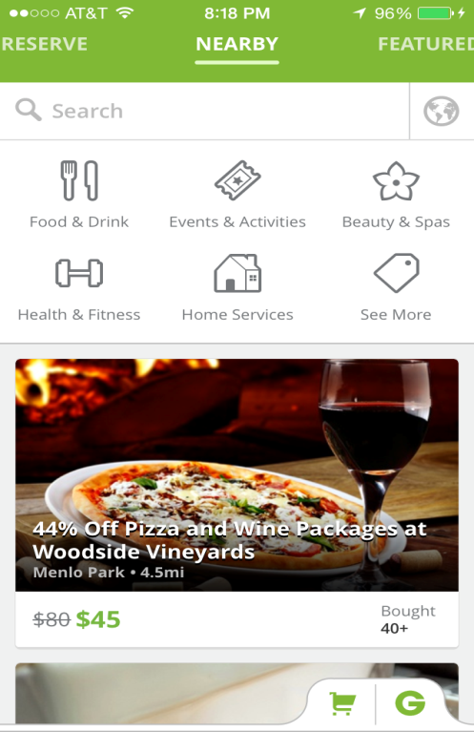
We A/B Test ALL product features

Slide 27
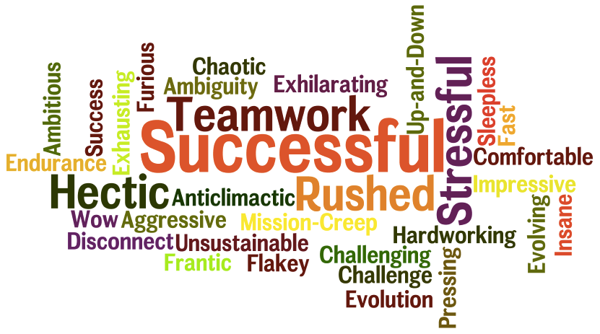
Retrospectives

Slide 28
Results have been very positive!

Slide 29
Groupon is no longer simply a “daily deals” merchant but a technology company.
- GigaOm

Slide 30
Note: It’s a long journey

Slide 31
Sri@groupon.com engineering.groupon.com

