Slide 1
The Evolution of Testing Methodology at AWS: From Status Quo To Formal Methods With TLA+
Tim Rath
Principal Engineer
AWS Database Services
Amazon.com

Slide 2
AWS Landscape

Slide 3
Services comprise large fleets of servers decomposed into smaller services

Slide 4
Many of which experience sustained exponential growth

Slide 5
S3 experienced exponential growth for 6 years to reach 1 trillion objects stored; less than a year later it reached 2 trillion objects ^{[1]}

Slide 6
DynamoDB processes millions of transactions per second in a single AWS region around the clock ^{[2]}

Slide 7
Systems and data are managed through subtle concurrent and distributed algorithms

Slide 8
“Must Haves” of Every Service
Security
Durability
Availability
Scalability

Slide 9
General Test Strategy
Developers
Unit Tests
Integration Tests
QA (release testing)
Functional Tests
Performance Tests
Stress Tests
Failure Tests

Slide 10
Test Adequacy Criteria
Literature expresses as a form of measurable code coverage ^{[3]}
Status Quo Criteria:
Statement coverage
Most common adequacy criteria employed today
Tools readily available to measure and report
Extremely weak criteria

Slide 11
Test Adequacy Criteria
Literature expresses as a form of measurable code coverage ^{[3]}
Perfect Criteria:
Cover every execution path across every possible state for the system
States may be infinite
Test space is exponential with path length

Slide 12
Test Adequacy Criteria
Real world practice further defines test adequacy criteria through an ad-hoc process:
Brain-storm test scenarios
Brain-storm stress test workloads
Brain-storm failure scenarios

Slide 13
Better testing of distributed algorithms
We look for strategies that:
Help to understand and protect algorithm invariants
Help expand test coverage
Allow thorough testing as early as possible in the development process

Slide 14
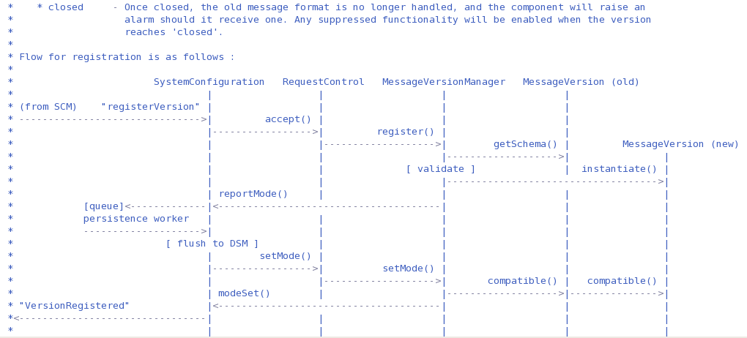
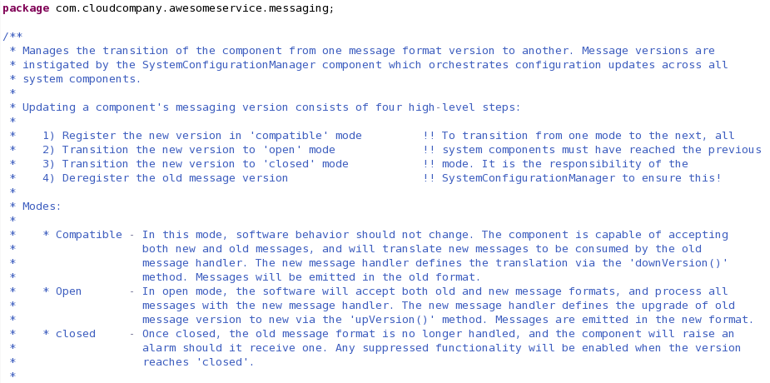
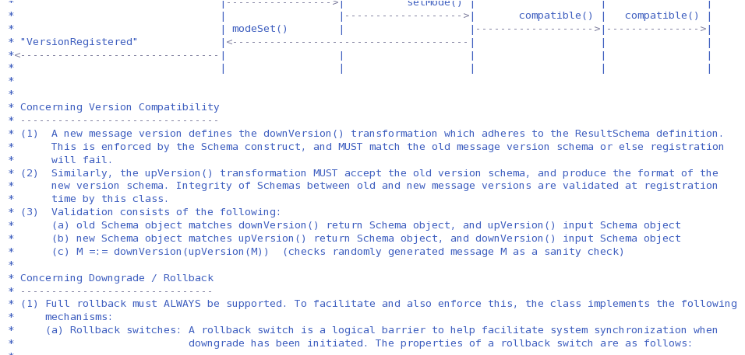
Development starts with specification
Strategy that helps to
understand algorithm invariants

Slide 15
Testing Starts With Development
Write tests and test support structure while working on the implementation
The spirit of “Test Driven Development” without subscribing to the specific formula
It is unclear how useful adhering to strict TDD concepts really is ^{[4]}
The emphasis it puts on test, and test thoroughness is where the value is ^{[5]}
Strategy that helps
expand test coverage

Slide 16
Assert system invariants
Asserts enforce the specification in code
Strong assert statements come from clear understanding of the specification
Strategy that helps to
protect algorithm invariants
Strategy that helps
expand test coverage

Slide 17
Generative Testing
Formalization around randomized testing with invariant or “property” checking

Slide 18
Generative Testing
Test Case
Generator
Test
Execution
Validation Of Properties Against Result
Expected Properties Of Result
Loop
No
Properties Violated?
Yes
Report Failure Case

Slide 19
Anecdotes From QuickCheck Paper ^{[6]}
Made them think harder about properties; document the specification
Need to think about the input domain to exercise less probable paths
Strategy that helps to understand
and protect algorithm invariants
Strategy that helps
expand test coverage

Slide 20
In Process Clusters
Process
2) Insert arbitrary code into the communication channel
3) Ability to pipeline the inserted bits of code
1) Run multiple nodes in the same process as unit test

Slide 21
In Process Clusters
Helps write better integration tests
Allows easy construction of intricate test scenarios
Integration testing of distributed components in a unit test environment
Helps write better stress tests
Direct control at the communication layer
Much faster, lower over-head test cycles
Strategy that helps
expand test coverage
Strategy that allows thorough
testing as early as possible in
the development process

Slide 22
Informal Proofs
Requires deep thinking which promotes even better understanding of the algorithms
Hard to get right – can still lead to a false sense of security
Strategy that helps to
understand algorithm invariants

Slide 23
Formal Methods
Precise specification of algorithms
Tools to validate correctness
We surveyed some of the systems and languages for writing formal specifications, and ended up finding what we were looking for in TLA+ ^{[7]}
TLA+ gives us all possible executions over all possible system states for algorithm designs

Slide 24
TLA+
read
write
read
write
read
write
read
write
read
write

Slide 25
TLA+
How the model works:
Init == <set of initial system states>
Next == <set of possible next actions>
That’s it!
Strategy that helps to
understand algorithm invariants
Strategy that helps expand test coverage
Strategy that allows thorough
testing as early as possible in
the development process

Slide 26
Real World Examples
DynamoDB
Replication protocols
Membership handling
Quorum Configuration Changes
Other AWS projects ^{[8]}
Low level distributed network protocol
Internal distributed lock manager
S3, EC2, EBS system management algorithms

Slide 27
Thank You!
we’re hiring
rath@amazon.com

Slide 28
[1] Barr, J. Amazon S3-The First Trillion Objects. Amazon Web Services Blog. June 2012;
https://aws.amazon.com/blogs/aws/amazon-s3-two-trillion-objects-11-million-requests-second/
[2] Hamilton, J. Challenges in Designing at Scale: Formal Methods in Building Robust
Distributed Systems. Perspectives Blog. July 2014;
http://perspectives.mvdirona.com/2014/07/03/ChallengesInDesigningAtScaleFormalMethodsInBuildingRobustDistributedSystems.aspx
[3] Zhu, H., et al. Software Unit Test Coverage and Adequacy. ACM Computing Surveys,
Vol. 29, No. 4, December 1997;
http://www.cs.toronto.edu/~chechik/courses07/csc410/p366-zhu.pdf
[4] Bulajic, A., Sambasivam, S., Stojic, R. Overview of the Test Driven Development
Research Projects and Experiments. Proceedings of Informing Science & IT Education
Conference (InSITE), 2012;
http://proceedings.informingscience.org/InSITE2012/InSITE12p165-187Bulajic0052.pdf
[5] Dalke, A. Problems with TDD. Dalke Scientific (dalkescientific.com), December 2009;
http://www.dalkescientific.com/writings/diary/archive/2009/12/29/problems_with_tdd.html

Slide 29
[6] Claessen, K., Hughes, J. QuickCheck: A Lightweight Tool for Random Testing of
Haskell Programs. ACM SIGPLAN Notices Volume 35 Issue 9, Sept. 2000;
http://www.eecs.northwestern.edu/~robby/courses/395-495-2009-fall/quick.pdf
[7] Newcombe, C., et al. Use of Formal Methods at Amazon Web Services. (pending ACM
publication), November 2013;
http://research.microsoft.com/en-us/um/people/lamport/tla/amazon.html
[8] Newcombe, C. Why Amazon Chose TLA+. Lecture Notes in Computer Science Volume
8477, June 2014; http://link.springer.com/chapter/10.1007%2F978-3-662-43652-3_3

