Slide 1
The Road to Continuous Delivery at Perforce
Jonathan Thorpe
Technical Marketing Manager
Perforce
Laurette Cisneros
Build & Release Engineering Manager
Perforce

Slide 2

About the Presenters
Jonathan Thorpe
Technical Marketing Manager, Perforce
Focus on Continuous Delivery, DevOps
culture & automation technologies
Technical marketing roles at CFEngine,
Serena & Electric Cloud
In his spare time: Dabbles in mobile software development, masters the latest video game
consoles & plays with the Raspberry Pi.

Slide 3

About the Presenters
Laurette Cisneros
Build & Release Engineering Manager, Perforce
Over 25 years experience in the software industry
Extensive experience in release engineering,
version control, and product development.
In her spare time: Amateur enologist (and I do sample my own creations) and thinks Portal is the only game in town

Slide 4
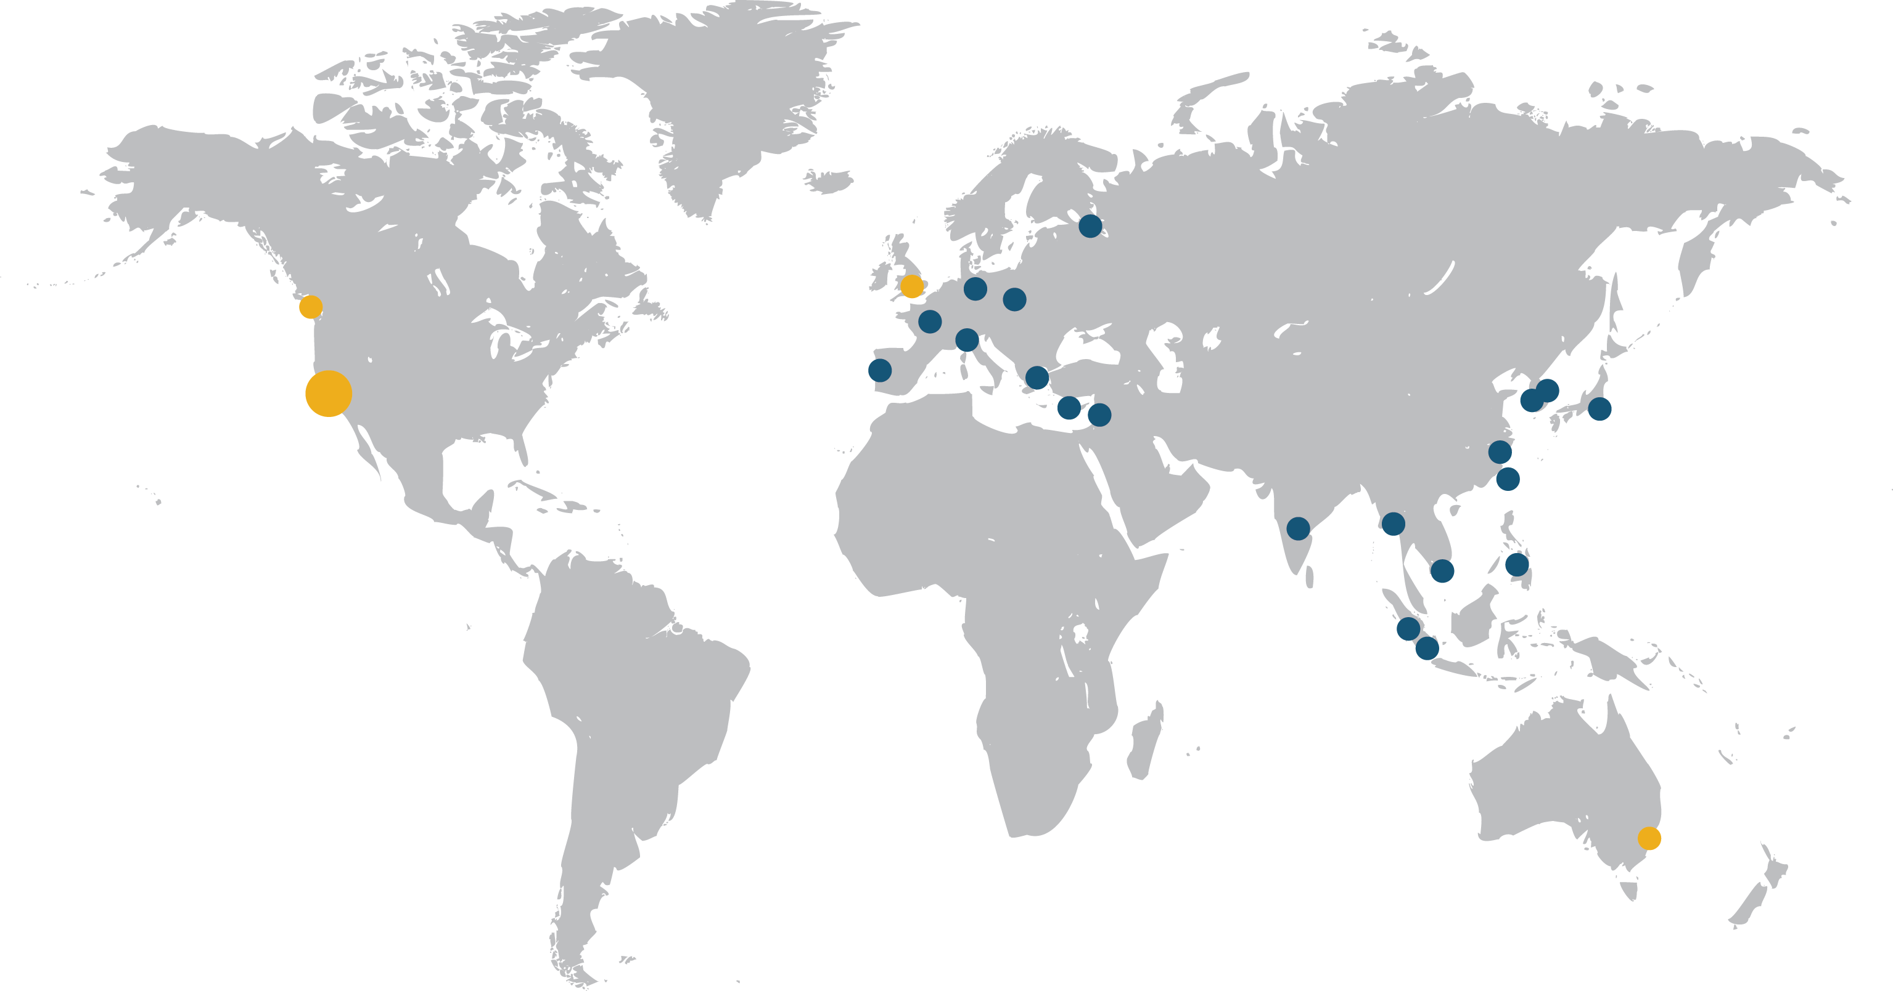
Perforce Overview
Global Availability and Support
Fastest, most scalable,
version management
and collaboration
Commonly used for
all types of content
  Code
  Binaries
  Movies
  Chip Designs
  Gaming
  Images
Versions Everything
Notes:
Perforce currently provides the world’s fastest and most scalable Software Configuration Management system.
Put simply, we let companies track versions, or iterations, of their software assets as they’re developed.
It’s not just source code we version. Far from it.
We also do the same thing for binary files and digital assets – pictures, web sites, audio – almost anything you can create.
Question to ask the audience – (especially executives) – are you familiar with version management – (if not, walk them through a customer example)
If it’s digital and being developed, refined or changed by individuals or teams, Perforce can capture and version every amendment made.
Right now, 350,000 users across 5,500 companies trust Perforce Software to safely version their code, assets and intellectual property.

Slide 5
Overview
Where we were 5 years ago
Why continuous delivery
Our approach
What’s worked
What’s been difficult
What we have learned

Slide 6
5 Years Ago – Before DevOps
Manual builds operated by engineering services team
Machines and “sliders”
Nightly builds:
  cron, bash/perl
  limited set of products/platforms
  Late night run, full day of changes
build-build scripts
  Beginnings of an abstraction layer
  Consistent interface for underlying “make” tool (jam)

Slide 7
Why We Felt the Need to Change
More products, platforms, programming languages
Fighting priorities, limited resources
Needed faster feedback on product changes
Manual handoffs between teams causing delays
Notes:
More products, platforms, programming languages, build tools being added
Needed faster feedback on product changes
Requests for self service capabilities
Manual handoffs between teams causing delays

Slide 8


Our Approach
Shared self-service release management infrastructure
Transitioned build/test/deploy knowledge in product teams
Trunk-based development and feature toggles
Extensive automated testing with QA focused on exploratory testing
Automatic (gated) releases

Slide 9





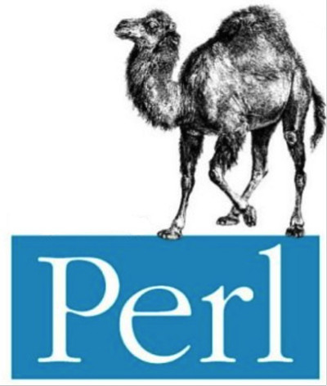


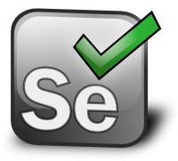

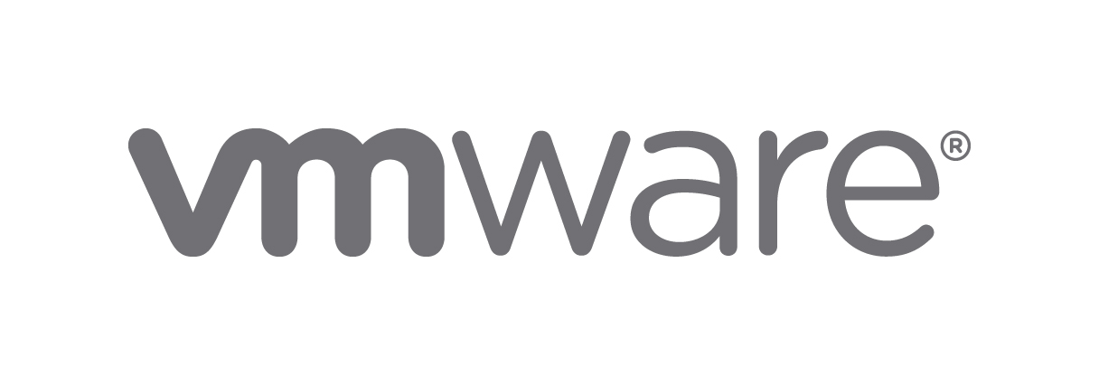
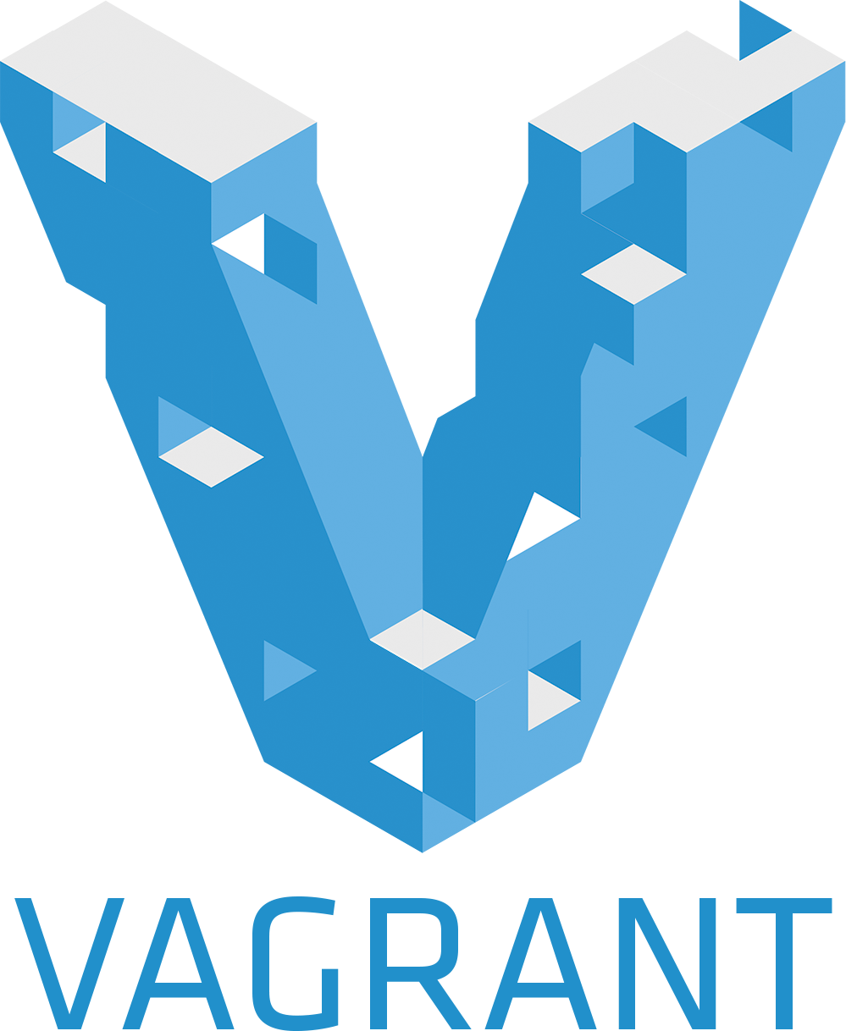
Continuous Delivery Tool Chain
Version
Control
Build
Automation
Infrastructure
Automation
Test
Automation
Scripting
…and more

Slide 10
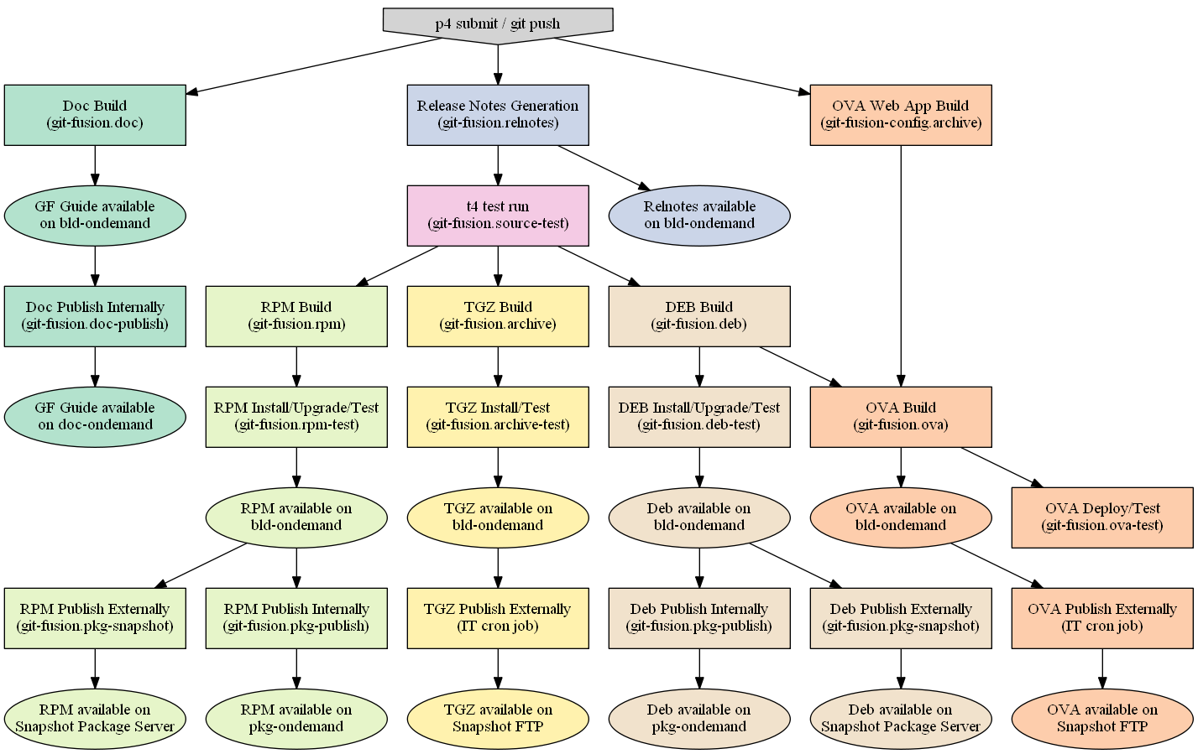
An Example Process

Slide 11
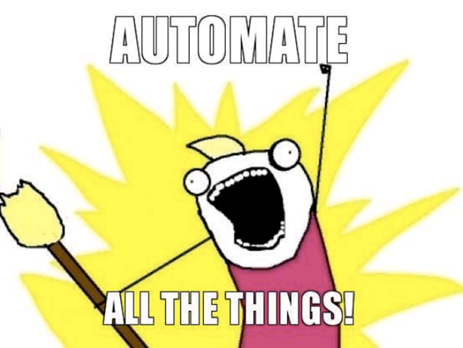
Continuous Delivery for All
Server
Web apps
Graphical clients
Web Services
Connectors
30+ Products
50+ Platforms
10+ Programming Languages

Slide 12

Continuous Delivery Pipelines
Web Apps
DEV
QA
PERF
STG
PROD
Packaged Apps
DEV
QA
PERF
Product
Manager

Slide 13

Results So Far
Release process time down to 4 hours
Up to 75% automated test coverage
  Releasing without regressions
Massive increase in production releases
  450 releases in 2014
  8 releases in 2012
  19 releases in 2013
Engineering services dedicated to strategic projects

Slide 14
What Worked Well
Trunk based development
Feature toggles
Pragmatic approach, continuous improvement
Versioning everything in a single system
  Source
  Artwork
  Binaries
  VM Images

Slide 15
Why Single Source of Truth
Easy to manage the code base
Easy to secure all intellectual property
Easy to prove compliance
Facilitates collaboration between departments
Everything is stored in Perforce versioning engine

Slide 16

What’s Been Difficult
Systems designed to be managed by a small group of experts
  Transition to embedded team too abrupt
  Skills gap
Teams understanding why shared infrastructure was necessary
Instead of being responsible as an embedded team, just allocated tasks to an individual
Ad-hoc requests from developers
How do we measure success?

Slide 17

What We Have Learned (Culture)
DevOps and Continuous Delivery popularity opened doors internally
  Increased investment in infrastructure
DevOps and Continuous Delivery culture has lead to greater empathy
  Build, test and deployment automation requires similar skills to developers
Management education
  It’s not all about development
  Set goals, not how to achieve them

Slide 18

What We Have Learned (Technology)
There’s no such thing as a single “DevOps Solution”
There will be some overlap in functionality in tools used, that’s okay
Mixing commercial and open source software has challenges but is essential for us to succeed
Use the right tool for the job
  Don’t shoe horn into existing tools for the sake of it
Focus on what we can do today
  Small victories add up

Slide 19

Next Steps
Stay on course
Determine better ways to measure impact
Re-evaluate what’s been done and what can be improved
Continue to tackle technical debt
Automated infrastructure testing

Slide 20
Thank You!
Jonathan Thorpe
jthorpe@perforce.com
@jonathan_thorpe
Laurette Cisneros
laurette@perforce.com
  P4Ideax
  Forums
All Perforce products are free for 20 users, forever. Including tech support.
info.perforce.com/free

